Slide 1



Ole Olesen-Bagneux (O2)
VP, Chief Evangelist & Author, PhD
Keynote:
Organizing and Searching Data
- with AI, for AI
CDAO Germany, Munich, April 28-29

Slide 2

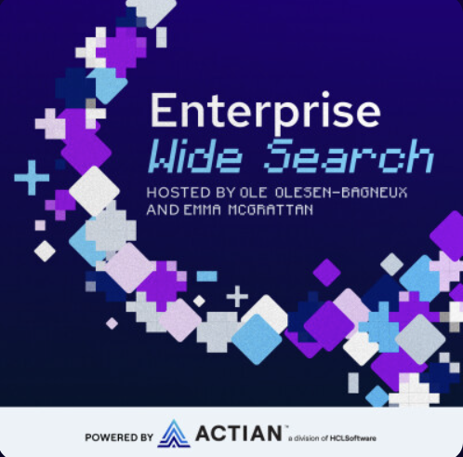

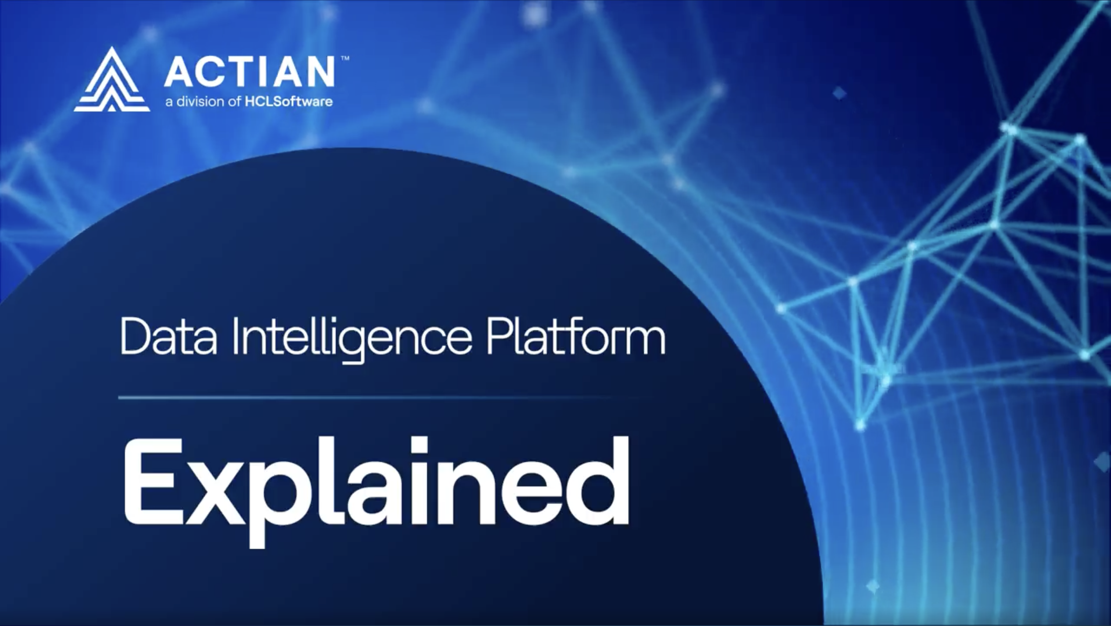
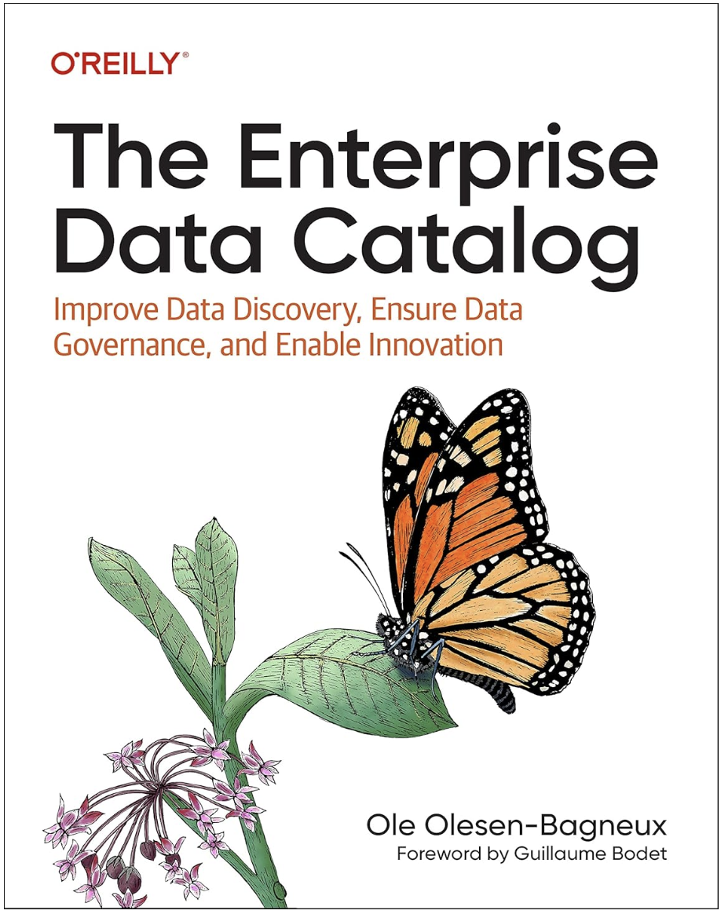
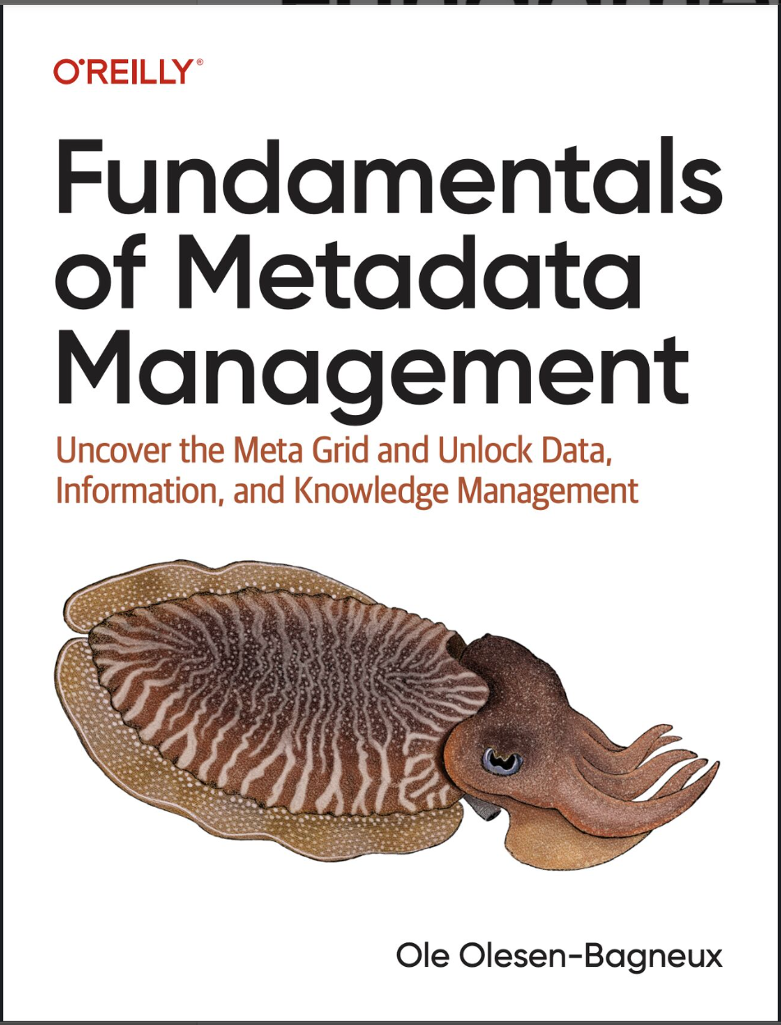
Ole Olesen-Bagneux (O2)
VP, Chief Evangelist in Actian, telling the story
of the Actian Data Intelligence Platform.
Tech author based out of Copenhagen, Denmark.
Fundamentals of Metadata Management (O'Reilly, 2025) The Enterprise Data Catalog (O'Reilly, 2023)
Rethinking Data & AI tech with a PhD in Library- and Information Science.

Slide 3


Setting
the stage
This talk addresses how organizing and searching enterprise data is changing because of AI. I will share insights from writing the 2nd edition of The Enterprise Data Catalog
The past and
present of data catalogs
Organizing data in data catalogs
Search outside data catalogs

Slide 4
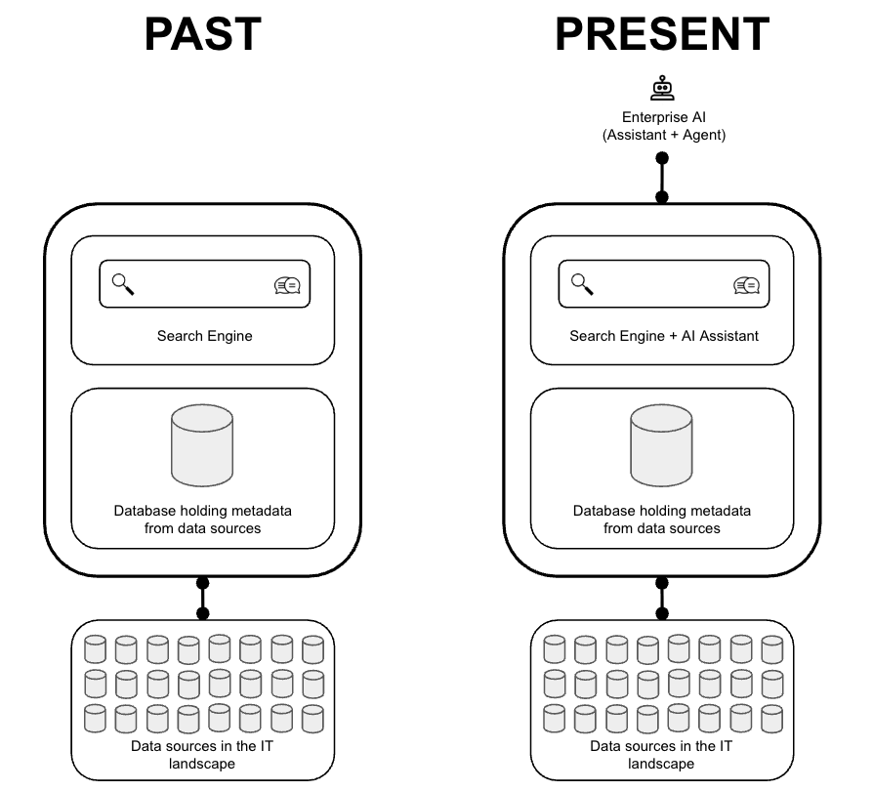

Data catalogs
before and after AI
In the immediate past, the target architecture was the search engine
Organizing data is now augmented by AI
In the present, the target architecture is a search engine + conversational search, in data catalogs and outside data catalog

Slide 5
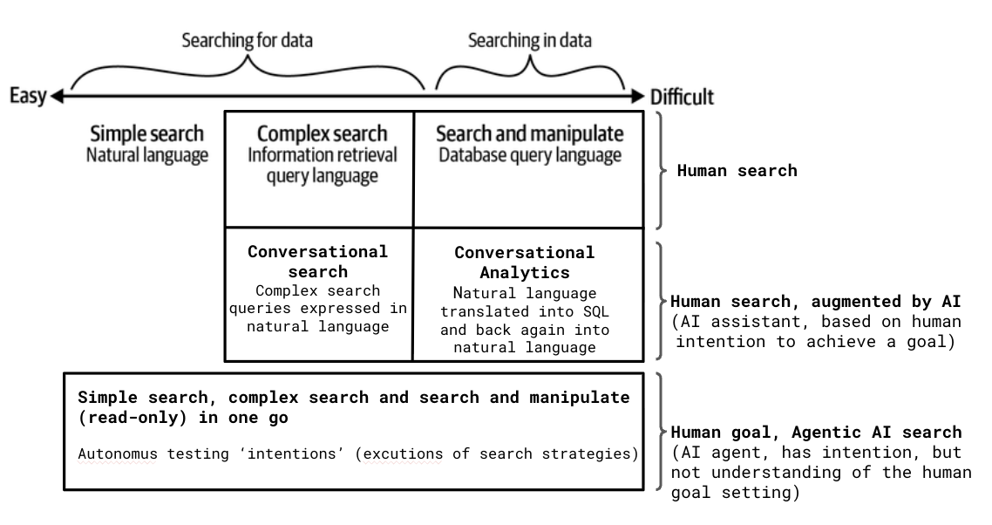
The spectrum
of search
Searching for data and searching in data
Searching for data happens at the metadata layer, in the data catalog
Searching in data, happens at the data layer in the database
Agentic search is performed without humans defining nothing but the goal, and goes across searching for and in data
CDAO – take notice: employee behavior will change!

Slide 6

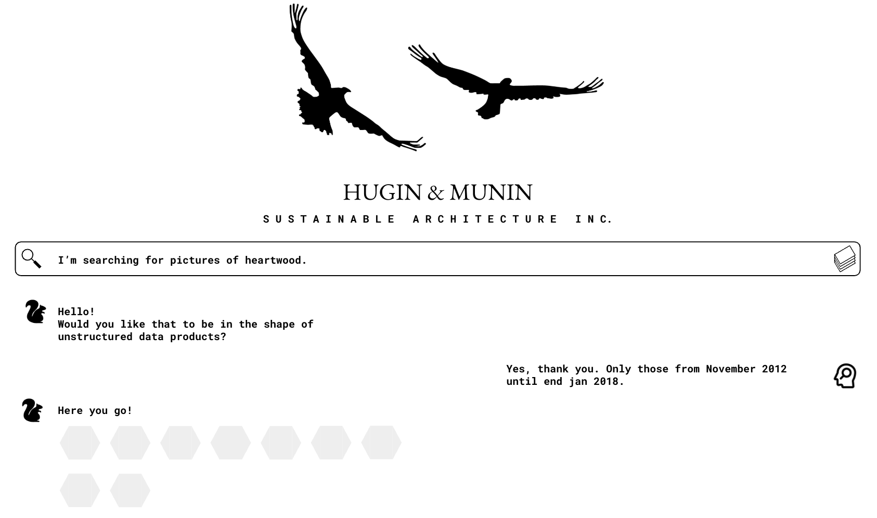
Searching for data
inside a data catalog
In the immediate past, the target architecture was the search engine
In the present, the target architecture is a search engine + conversational search, in data catalogs and outside data catalog

Slide 7
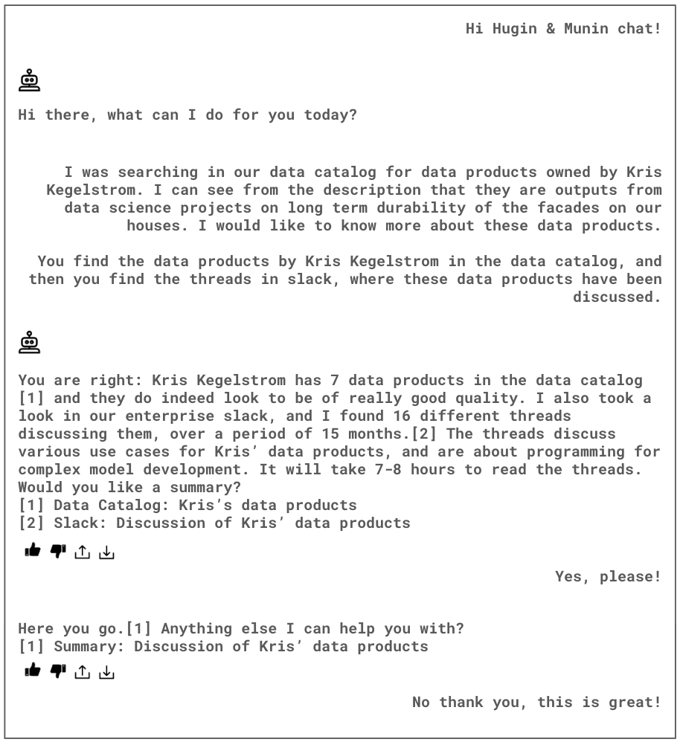
Searching for data
outside a data catalog
This situation is completely new
The data catalog is now a source amongst other sources

Slide 8
Wrap up
1
2
Searching for data with a data catalog is changing because of AI
the ideal in the immediate past was the search engine, now, it is a search engine + conversational search
3
4
this expands how data can be searched for in data catalogs, with complex topics becoming easy to formulate, and to search outside the data catalog
Agentic AI is pushing the boundary further, so humans will end up formulating nothing but the goal of the search

Slide 9
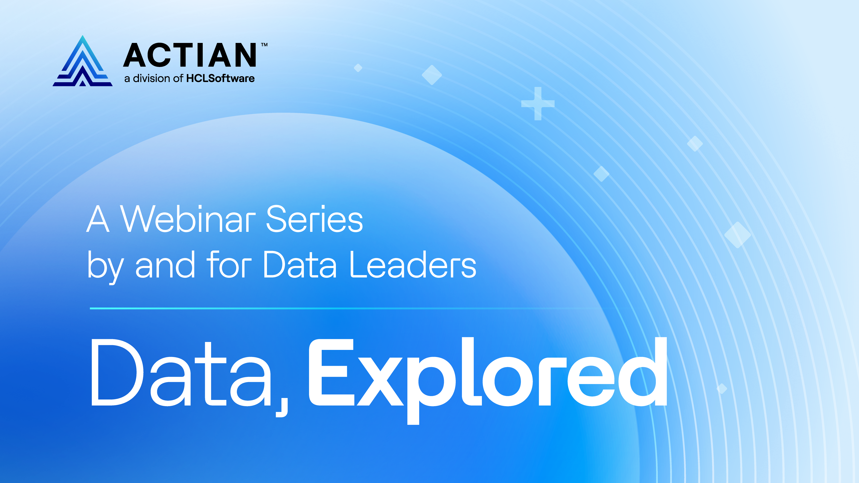
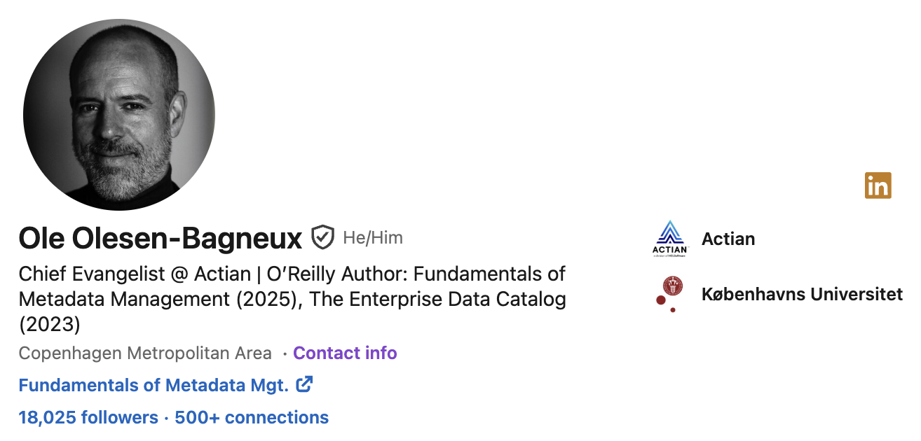

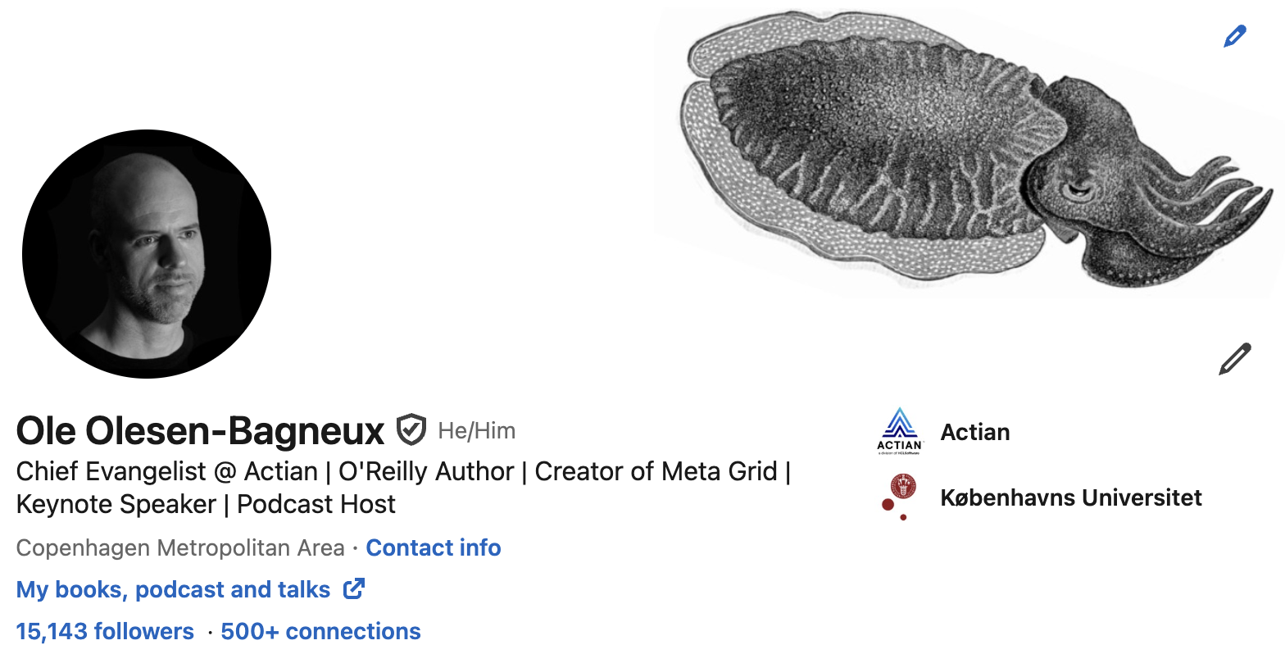
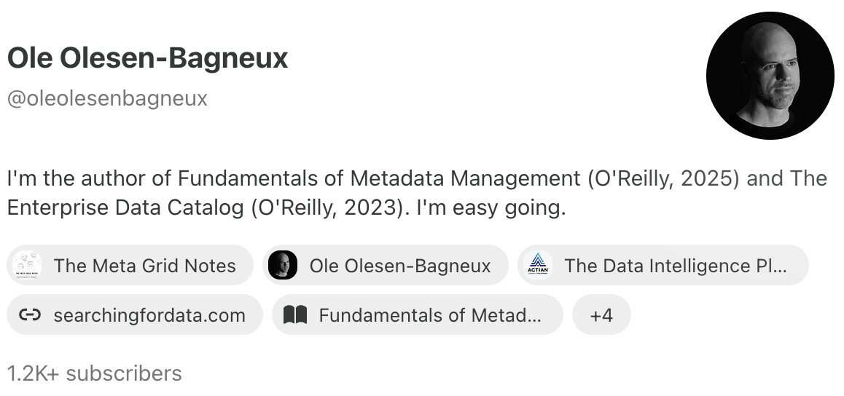
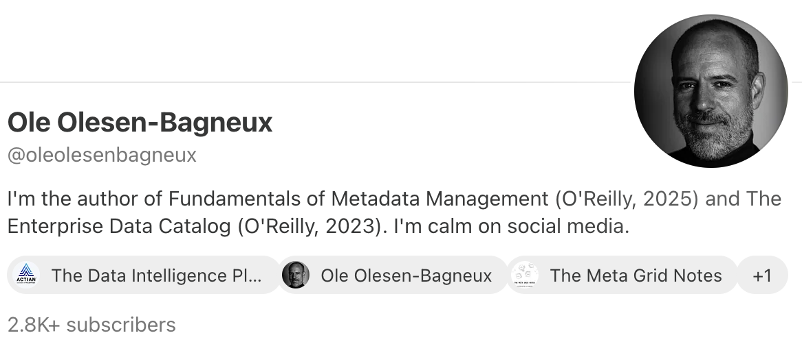

Connect, subscribe and engage
v
v

