Slide 1
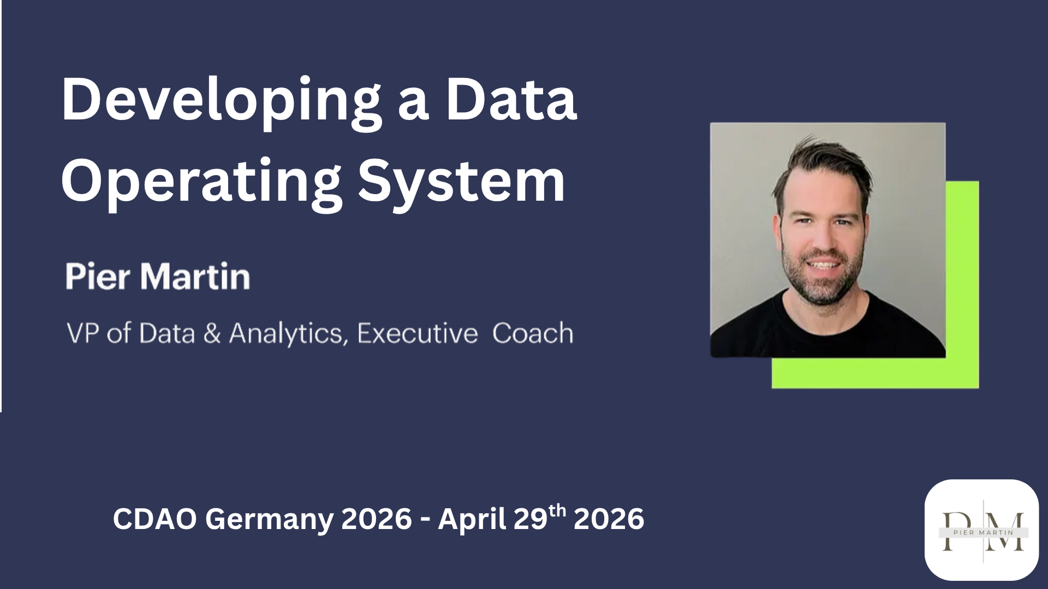
DEVELOPING A
Data Operating
System
PIER MARTIN
VP of Data & Analytics • Executive Coach
CDAO Germany 2026 – April 29th 2026

Slide 2



ABOUT ME
Background
I'm a Canadian who doesn't appear to like to live there. I've lived across 3 continents and spent 19+ years in Data & Analytics. Seven years ago, a transformative coaching experience pulled me into that space too.
19+ years
in Data & Analytics
50+ countries
EXPERIENCE
VP, Data & Analytics - Zeal Network SE (2025–present)
E-Commerce, FinTech, PropTech, Wealth Management, Gaming
IECL Certified Executive Coach
lived on 3 continents
Ice Hockey
Coach and former player
PASSIONS
Travelling (50+ countries) • Coaching Ice Hockey
2 / 21

Slide 3
THE COMPLAINTS WE ALL HEAR
Sound familiar?
The same frustrations echo across almost every data team.
"I don't have a seat at the table."
"Garbage in, garbage out."
"The business doesn't care about data."
"They never listen to our recommendations."
"We're just a service team, not a partner."
"They want insights, but won't fix the inputs."
"We spend all our time building dashboards no one reads."
"We're measured on delivery, not impact."
"We're asked to prove value but not given ownership."
"We can't move fast; governance slows everything down."
These aren't data problems - they're leadership operating problems.
3 / 21

Slide 4
WHY IT'S BREAKING
Data teams are set up to fail.
Unrealistic demand, blame when things go wrong, and work that rarely gets used.
91%
87%
~20%
Unrealistic asks
Blamed anyway
Actually used
frequently receive analytics requests with unreasonable expectations or timelines.
say they're blamed when something goes wrong with the company's data or analytics.
dashboard adoption rate - the majority of what data teams build never gets used.
DataKitchen & data.world
DataKitchen & data.world
Luzmo, 2025
5 / 21

Slide 5
THE COST IS REAL
And the numbers are getting worse.
Burnout and churn aren't anecdotal - they're measurable, and disproportionate in data teams.
82%
97%
78%
of knowledge workers
of data engineers
report feeling burnt out at work to some degree.
experience burnout in their day-to-day work - the highest rate across knowledge work.
say they “wish their job
came with a therapist”.
DHR Workforce Trends Report, 2025
DataKitchen & data.world
Eagle Hill Workforce Burnout Survey, Nov 2025
4 / 21

Slide 6

THE DIAGNOSIS
There's a silent epidemic killing data.
It's not a tooling problem. It's a mindset problem.
Data teams aren't failing because of a lack of tools or talent.
They're failing because of limiting operating habits - the invisible defaults that shape how we think, prioritize, and communicate.
Most teams have upgraded their stack. Few have upgraded their operating system.
6 / 21

Slide 7





ROOT CAUSES
What's holding data teams back?
Five symptoms of a limiting operating system.
1
2
3
4
5
External Locus of Control
Victim Mentality
All-or-Nothing Thinking
Technology-First Obsession
Customer Avoidance
Blaming business users, legacy systems, or "lack of data culture" instead of owning outcomes.
"Garbage in, garbage out" is the battle cry of teams giving up accountability.
Believing data is either perfect or useless - that you either have a data culture or can't begin.
Expecting the next stack to solve root problems without changing behaviors or operating models.
Pushing dashboards and platforms instead of asking "what problem are we solving?"
7 / 21

Slide 8
THE MISSING LAYER
It's not a tool. It's an operating system.
A Data Operating System is the invisible structure that makes technical work consistently valuable.
It aligns how your team thinks, works, and communicates.
MINDSET
How we think
Mindset
PROCESS
How we work
Process
COMMUNICATION
How we connect
Communication
8 / 21

Slide 9
THE NEXT EVOLUTION
From stack to system.
Over 70% of data leaders say their biggest challenge isn't tooling - it's collaboration and clarity. (MIT Sloan, 2024)
MODERN STACK (Tools)
MODERN SYSTEM (Operating System)
dbt, Snowflake, Fivetran
Shared product thinking & rituals
BI dashboards
Decisions tied to measurable outcomes
Data contracts
Clarity on roles, priorities, and trade-offs
Governance policies
Enablement guardrails users trust
Sprint delivery
Predictable communication rhythm
9 / 21

Slide 10
?
SO
How do we
solve this?
Three upgrades, one operating system.
10 / 21

Slide 11


MINDSET
ADOPT A CUSTOMER-FIRST MINDSET.
Treat internal stakeholders as customers - not interruptions.
OLD OS
NEW OS
"Marketing asked for this dashboard; we'll build it once the schema is ready."
"Let's understand what decision this dashboard supports and how we'll know it worked."
→ Reactive, transactional, and disconnected from value.
→ Proactive, partnership-driven, outcome-focused.
KEY PHRASES TO USE
LEADER MOVES
"What problem are we solving for the business?"
"How will we measure success once this ships?"
"Who will use this, and how will it change their workflow?"
"What's the simplest version that still solves the problem?"
Reframe users as customers - adopt their language, goals, and urgency.
Bring your team closer to the front lines: shadow a user, join their meetings.
Replace "feature complete" with "customer impact delivered."
11 / 21

Slide 12
MINDSET
RETHINK GOVERNANCE.
Shift from enforcing control to enabling confident use.
OLD OS
NEW OS
"We can't share that dataset until the policy is finalized."
"Let's make sure the right people have the right data - with the right guardrails."
→ Creates bottlenecks, slows delivery, positions data as an obstacle.
→ Empowers responsible use, builds trust, shortens time to value.
KEY PHRASES TO USE
LEADER MOVES
"How can we make compliance invisible to the user?"
"Let's design guardrails, not gates."
"What friction can we remove without increasing risk?"
"What's the simplest policy that still protects integrity?"
Reframe governance reviews as enablement conversations, not approvals.
Treat policies like products - design, test, and iterate with users.
Measure success by ease of access and user confidence, not policy volume.
12 / 21

Slide 13
PROCESS
INTRODUCE PRODUCT MANAGEMENT.
Apply product discipline to make data work measurable, iterative, and adopted.
OLD OS
NEW OS
"We've scoped the entire platform; now we just need six months to deliver."
"Let's release a minimal version to validate the problem, learn, and refine."
→ Big plans, no feedback loops, limited learning until it's too late.
→ Faster learning, stronger stakeholder trust, better business fit.
KEY PHRASES TO USE
LEADER MOVES
"What problem are we validating before we build?"
"What's the smallest version we can ship to learn something?"
"What feedback have we gathered from users this sprint?"
"What would we change based on what we've learned?"
Assign clear product ownership - one person accountable for value, not just delivery.
Introduce problem statements and MVP cycles into team rituals.
Measure progress by learning speed and adoption, not feature count.
Use retrospectives to review user feedback, not just sprint completion.
13 / 21

Slide 14
PROCESS
MEASURE WHAT MATTERS.
Prove the value of data work - not just its activity.
OLD OS
NEW OS
"We closed 47 tickets this month and published 12 new dashboards."
"Our churn model helped retain 2% more customers - roughly €600K in annualized revenue."
→ Focuses on effort, not effect. Illusion of progress without impact.
→ Links data work directly to business performance and ROI.
KEY PHRASES TO USE
LEADER MOVES
"What business metric does this work influence?"
"How can we estimate the value created or protected?"
"If we stopped doing this, what would break or be missed?"
"Where can we create the most measurable leverage next quarter?"
Introduce value engineering into your data roadmap - quantify cost and benefit.
Review projects in terms of business outcomes
Align incentives and visibility to impact metrics (adoption, revenue, retention).
Ask teams to tell the story of value before showing the volume of work.
14 / 21

Slide 15
PROCESS
PRIORITIZATION AS A LEADERSHIP CAPABILITY.
Focus creates impact. Clarity creates calm.
OLD OS
NEW OS
"We'll deliver all stakeholder requests - it's just a matter of time."
"Let's invest 80% of our capacity in what drives the biggest business impact."
→ Creates chaos, burnout, and diluted value.
→ Builds discipline, clarity, and predictable delivery.
KEY PHRASES TO USE
LEADER MOVES
"What would we stop doing if we added this?"
"What's the expected impact - and how do we know?"
"Is this urgent, or just loud?"
"Where are we saying 'yes' out of fear, not strategy?"
Introduce a simple Prioritization Framework (e.g., RICE or impact/effort).
Tie all prioritization back to business outcomes, not stakeholder volume.
Make trade-offs visible - say "no" publicly and explain why.
Review your roadmap monthly to drop or defer low-impact work.
15 / 21

Slide 16
COMMUNICATION
TAILOR TO YOUR AUDIENCE.
Clarity is a competitive advantage - match your message to the room.
OLD OS
NEW OS
"Here's the full dashboard and model performance summary for everyone."
"For leadership: the business risk we mitigated. For the team: what's driving it and what we'll improve next."
→ Overloads execs with detail and leaves teams guessing about what matters.
→ Builds confidence up the chain and clarity within the team.
KEY PHRASES TO USE
LEADER MOVES
"What's the one takeaway this audience should leave with?"
"How does this tie to their goals or KPIs?"
"What's the decision or action I want them to take?"
"What can I remove without losing meaning?"
Use a 3-tier communication model: executive, peer, and team.
Teach analysts to summarize: Headline → Evidence → Action.
Frame updates as business conversations, not technical recaps.
Review major deliverables through a "stakeholder lens" before sending.
16 / 21

Slide 17
COMMUNICATION
BE PROACTIVE AND CONSISTENT.
Trust grows when people always know what's happening and why.
OLD OS
NEW OS
"We'll share an update once we have something significant."
"Every Friday we share what's in motion, what's blocked, and what we're learning."
→ Creates anxiety, surprises, and rework when stakeholders lack context.
→ Builds transparency, predictability, and confidence across functions.
KEY PHRASES TO USE
LEADER MOVES
"Here's what we delivered, what's in flight, and what's next."
"Here's what we learned this week and how it affects the plan."
"Flagging this early so we can decide together."
"Here's the impact of last month's work and what's coming next."
Establish a rhythm: weekly updates, monthly summaries, quarterly reflections.
Use repeatable templates (written or verbal) to reduce friction.
Encourage your team to over-communicate context, not volume.
Track communication as a leadership habit - consistency builds credibility.
17 / 21

Slide 18
MINDSET
LEAD WITH GROWTH BEHAVIORS.
Curiosity about customers drives better data, better products, and better teams.
OLD OS
NEW OS
"We just need to finish this model, clean up the schema, and document the process."
"How does this model improve a customer experience, a product decision, or a revenue stream?"
→ Optimizes for technical output, not customer outcomes.
→ Centers the work on value creation and what actually changes for the business.
KEY PHRASES TO USE
LEADER MOVES
"Who benefits from this work, and how will they feel the impact?"
"What customer moment does this data touch?"
"What feedback are we getting from real users of our insights?"
"Where did we assume, instead of ask?"
Make customer impact the default first question in project reviews.
Share stories that link data outcomes to real customer experiences.
Reward curiosity - celebrate questions that improve understanding.
Bring data teams into customer-facing sessions (sales, demos, support).
18 / 21

Slide 19
CALL TO ACTION
Upgrade your team's operating system.
The highest-leverage work for a data executive isn't in the stack - it's in the system.
OS LAYER
FOCUS ON
WHY IT MATTERS
Your leaders are the
operating system.
Mindset
Coach managers to start every project with a customer problem, not a data request.
Alignment & business credibility.
How they think, work, and communicate defines whether your organization scales clarity or chaos.
Process
Define a shared operating rhythm across teams - reviews, updates, retros.
Consistency & predictability.
Upgrading your OS means enabling your team to operate with rhythm, context, and purpose.
Communication
Set expectations for proactive, tailored updates to execs, peers, and teams.
Trust, less noise, clarity at scale.
You don't scale impact by adding people. You scale it by upgrading how your people operate.
19 / 21

Slide 20
The future belongs to
system thinkers,
not stack builders.
Pier Martin - CDAO Germany 2026

Slide 21
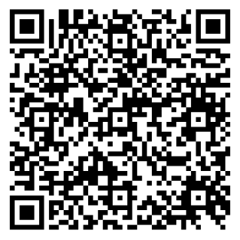
KEEP GOING - INVEST IN YOUR PEOPLE
Want to go deeper?
From Data Manager to AI-Ready Leader
[ QR CODE ]
A 4-day Maven cohort course for data leaders.
Get execs to act on your insights (not tune out)
Influence Product, Ops, and Marketing without reporting lines
Build credibility around AI - without just demoing tools
Shift from "ticket shop" to trusted partner
20% OFF
upcoming cohorts
★★★★★ 4.8 (24 reviews)
CODE: CDAO20
21 / 21

