Slide 1
AUTODOC
Unlocking Efficiency at Scale: Supply Chain Analytics and TCT

Slide 2


AUTODOC
Pavlichenko Dmytro
Linkedin
Manager Data Analytics

Slide 3
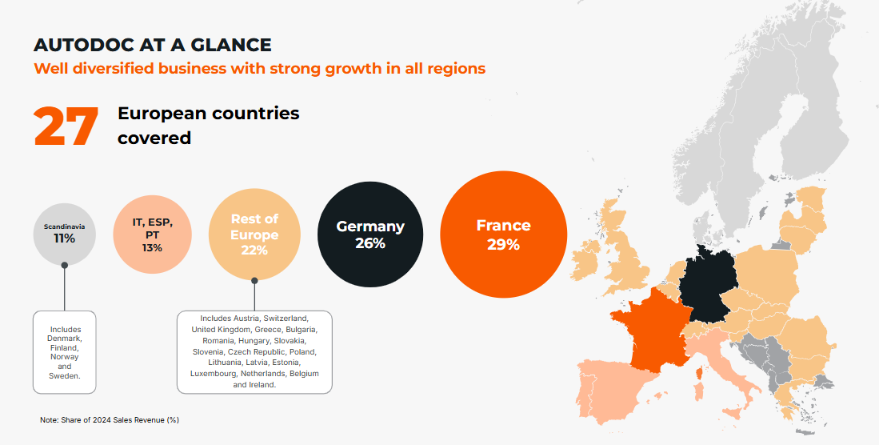

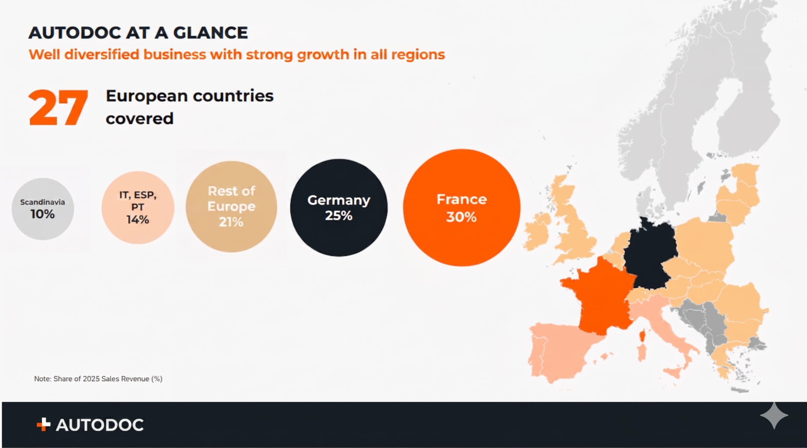



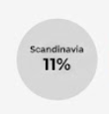
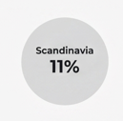






TEXT
TEXT
TEXT
TEXT
TEXT

Slide 4
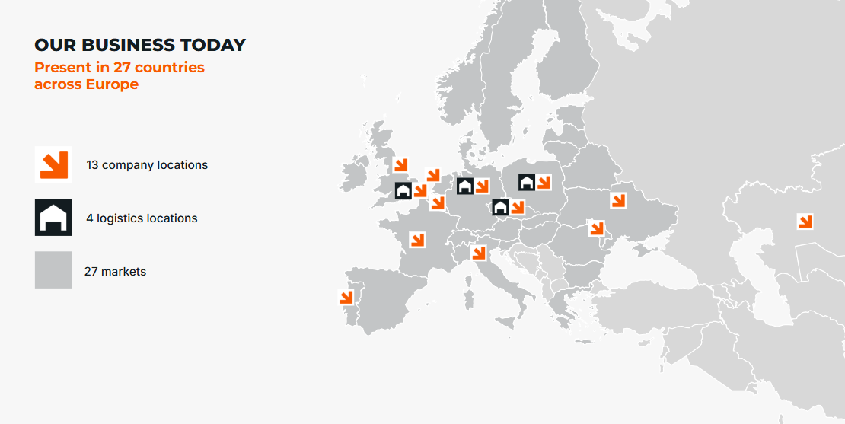
TEXT
TEXT
TEXT
TEXT
TEXT
TEXT
TEXT
TEXT
TEXT
TEXT
TEXT

Slide 5
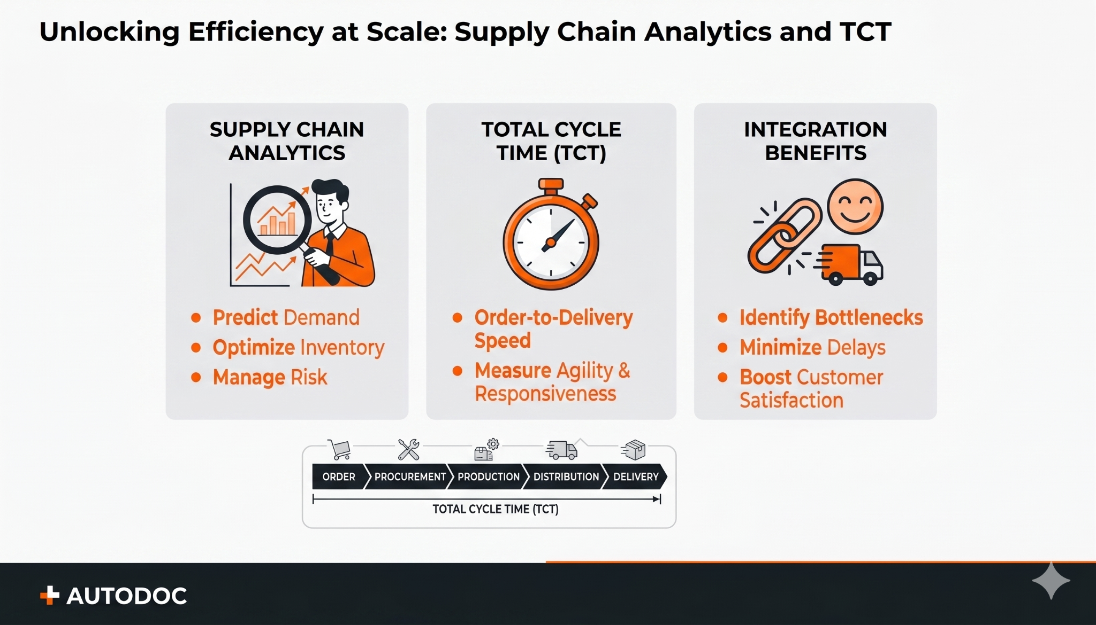
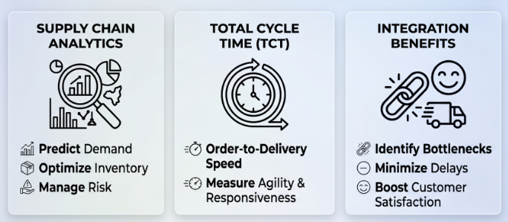
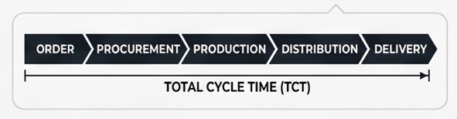

Unlocking Efficiency at Scale: Supply Chain Analytics and TCT

Slide 6



Main Pains
Long delivery time (TCT) to the customer
Growth % returns
Low % NPS

Slide 7
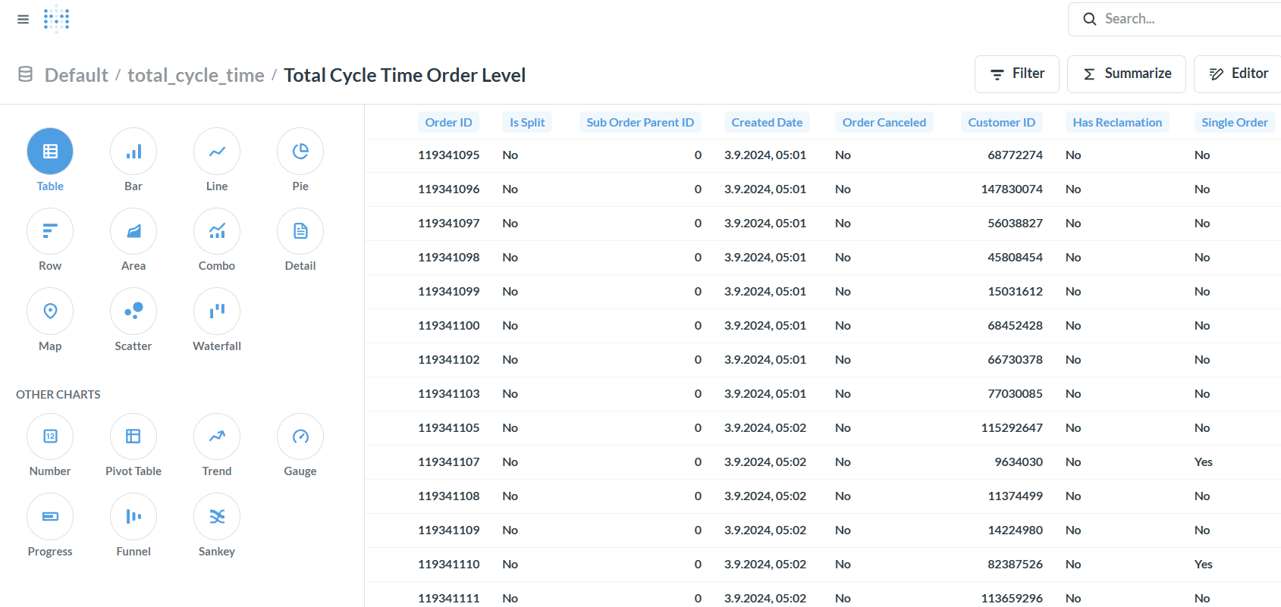

How?
Create a bridge between key business stakeholders and the analytics team
Weekly alignments , specific channel, focus groups
TEXT
Start to collect and save each new TCT buckets
Create new business processes, develop data-marts
Implementation of self-service for users
Simple data sets in 1 place and smart navigation 24/7
Adapt a new storytelling style
Develop more UX/UI BI boards

Slide 8
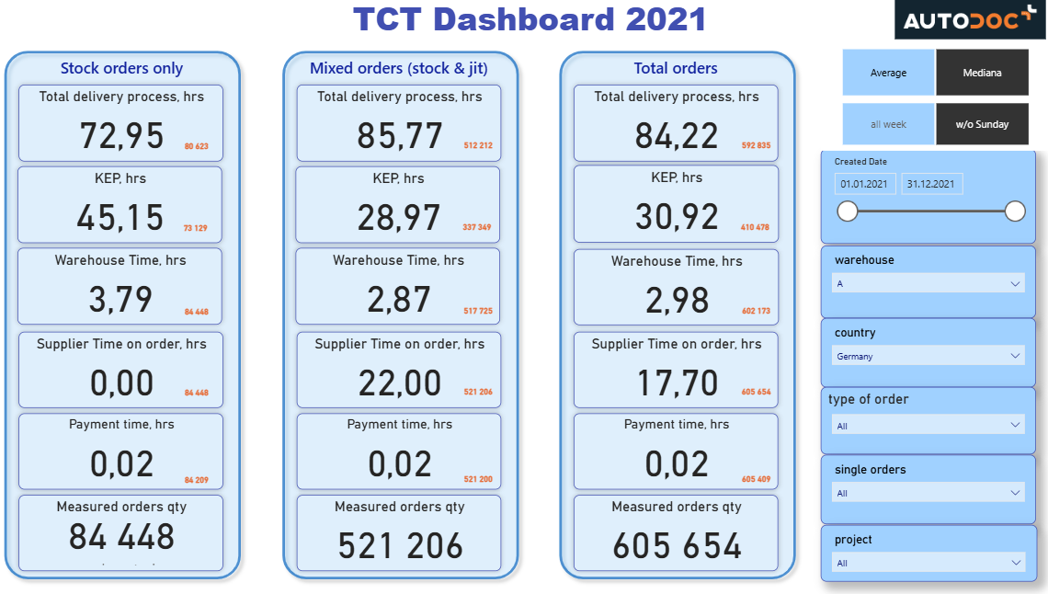
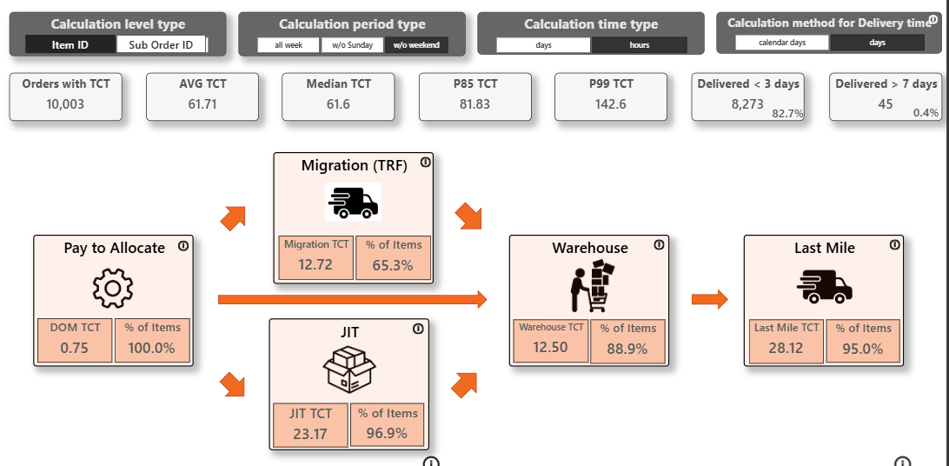




Storytelling
5 years ago Today
TEXT
TEXT
Text
TEXT
Text
6 key actively monitoring indicators
25 key actively monitoring indicators
5 different sources
15 different sources
8 different filters
22 different filters

Slide 9



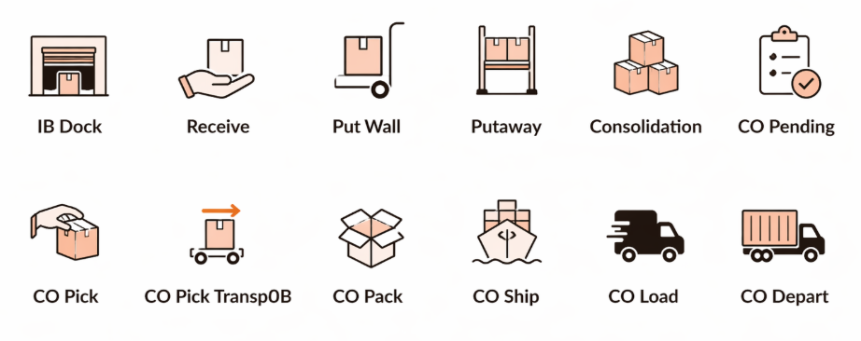
Unlocking Efficiency at Scale
+20% the TCT improvement (‘21 vs ‘25)
bucket expansion from 6 to 25
created a Data Product for all users

Slide 10


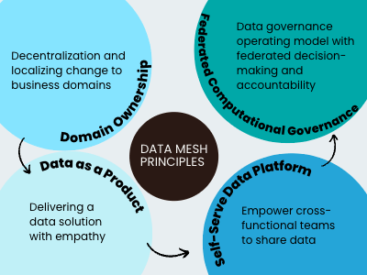






Data & Analytics - Stack

Slide 11
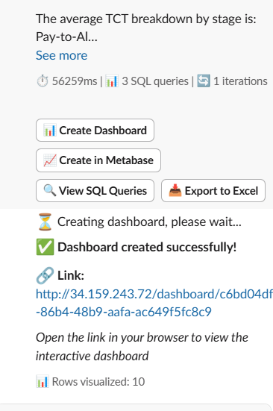


TCT analytics agent prototype

Slide 12
THANK YOU

