Slide 1
OPERATIONALIZING AI IN A REGULATED GERMAN INDUSTRY
28 May, 2025
Elizabeth Press

Slide 2
AGENDA
Introduction
Understanding regulation, standards and consistent delivery
Risk management & governance in an innovative environment
Best Practices
Why is compliance, security and risk management competitive advantages?

Slide 3
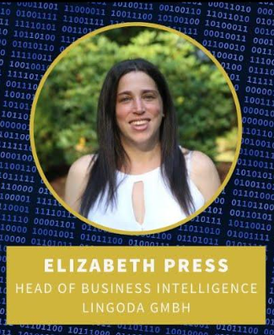

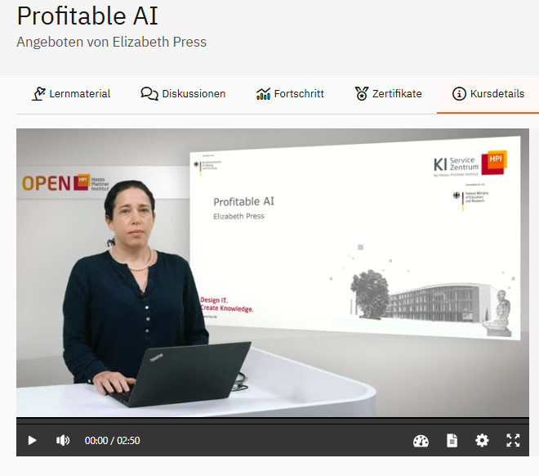
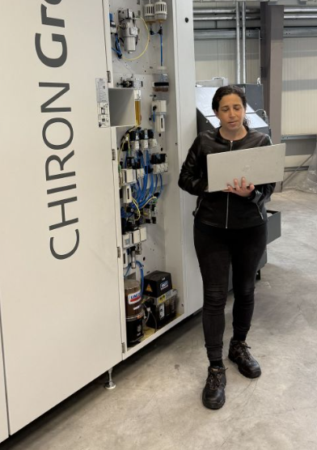
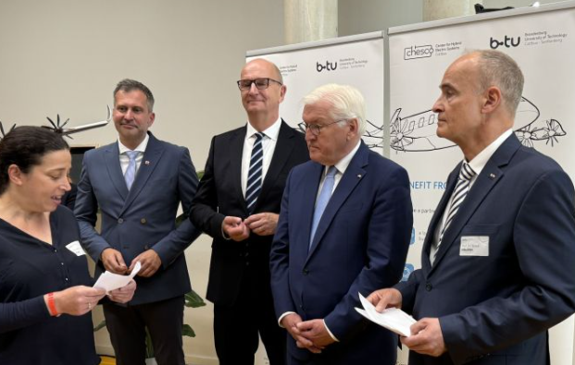





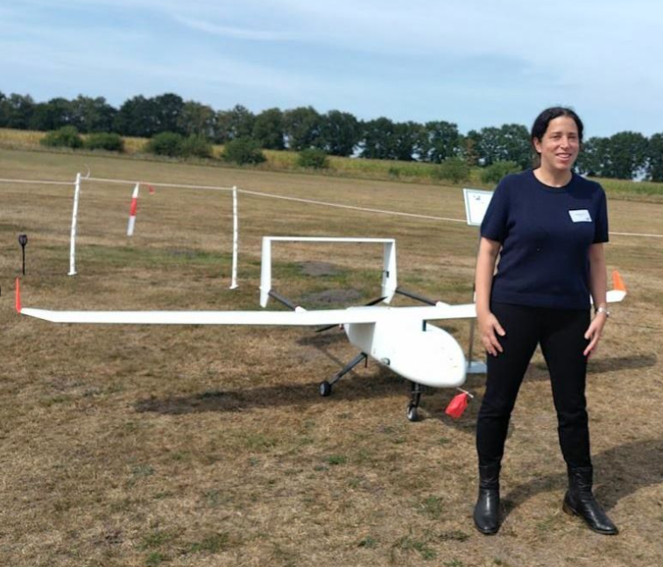


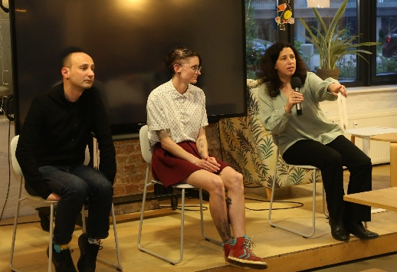
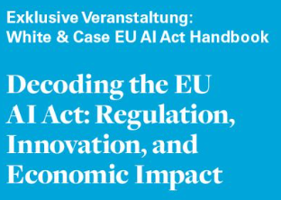

MY LAST FEW YEARS:
FROM LANGUAGE APPS TO AEROSPACE & DEFENSE
Startup Consultancy
Aerospace & Defense-Relevant Tech

Slide 4









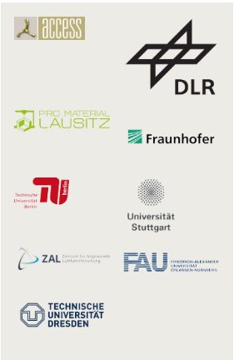







CENTER FOR HYBRID ELECTRIC SYSTEMS COTTBUS
CHESCO – WE MAKE GREEN MOBILITY HAPPEN
Industry Partners
research center
Specialization in research and development of
hybrid-electric and electric drive systems.
Design
Months
Multi-Sector
Weeks
Digitalized Processes
Analysis
f-merc
Research Fields
Research Partners
Bewertung
Produktion
Hybrid Electric System Integration
Electric Systems and
Components
test center
Gas Turbines and Fuel Cells
with H2 and SAF
Test
Digital Technologies
Thermal-Management
Efficient Manufacturing Technology
Notes:
Infrastruktur für schnelle Prototypenerstellung an einem Ort gebündelt 🡪 Ziel: Beschleunigung von Innovationszyklen

Slide 5

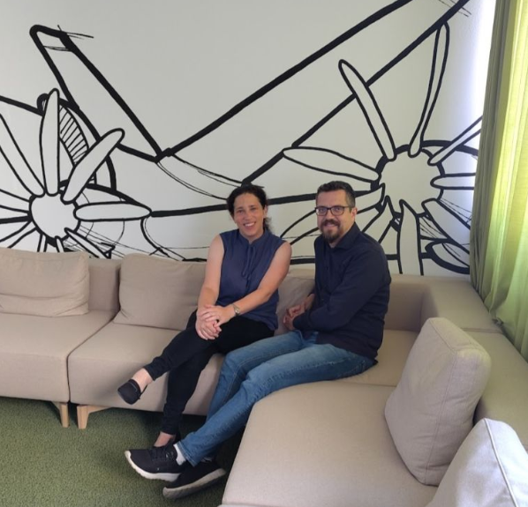
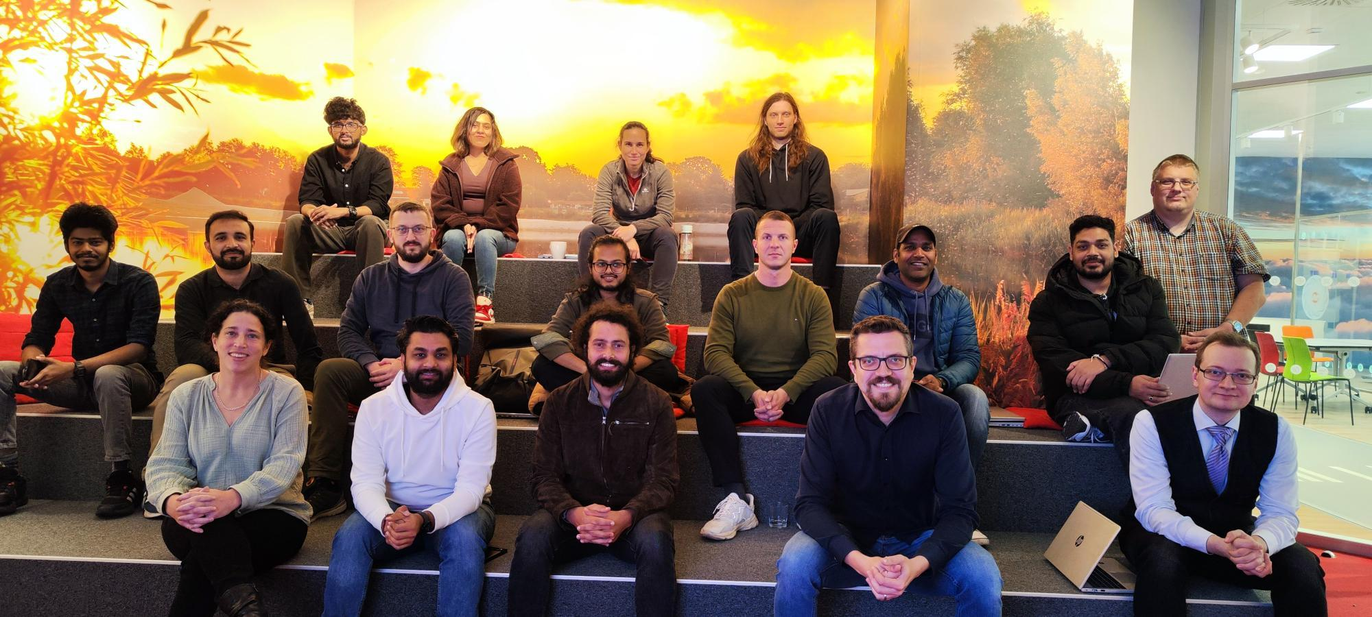
DIGITAL @ CHESCO
WHO IS TEAM DIGITAL AND WHAT DO WE DO?
    We are developing an integrated digital platform that combines data strategy, systems engineering, interoperability, cybersecurity, and digital sovereignty
    What drives us?
      Value through systems engineering and data strategy
      Connectivity with Digital Twin and Digital Thread
      Resilient and secure environment – as well as digital sovereignty
      Accelerated development through collaboration and research
Secure digital collaboration and sustainable industry start with platforms that make complex systems understandable and visible.
Notes:
Digitalen Zwilling
„real“ machen - Anwendung auf industrielle Herausforderungen
Schnittstellen-Zwillinge - zum besseren Verständnis des Systemverhaltens
Verbindung von Design und Produktion 🡪 Ermöglichung von System-Engineering
Tiefgreifende Digitalisierung von Fertigungs- und Produktionsprozessen - in Verbindung mit Design
Integration von Daten und Informationen - Verbindung von Produktion, Logistik und Design
Interdependenzen beschreiben
Technische Fähigkeiten bereitstellen
Sicherstellung eines angemessenen Schnittstellendesigns
Anwendungsfälle für das Systemverständnis
Datenanalyse - basierend auf Algorithmen (in Partnerschaften) und für relevante Anwendungsfälle
Innovative Partnerschaften - zur Fertigungssimulation, zur Datenstruktur, zur Konnektivität und zu relevanten IoT-Lösungen
Digitaler Faden - unter Verwendung strukturierter Daten und der Asset Administration Shell (AAS), um Daten zu strukturieren und sie bei Bedarf verfügbar zu machen

Slide 6
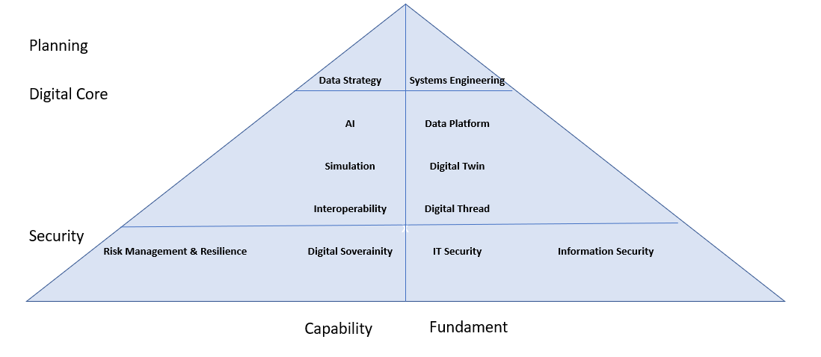
CHESCO‘S DIGITAL RESEARCH STRATEGY
Connecting Physical & Digital for Regional Transformation
Value Proposition
Connect physical and digital worlds to make processes visible, traceable, and auditable-ensuring sovereign, standards-compliant, and shareable data across the value chain.
Strategic Approach
We rapidly apply and scale proven technologies in real-world settings.
We offer secure, connected environment for partners to research, experiment and prove new ideas, technologies and products.
Impact on Lausitz
Increase total factor productivity
Boost regional competitiveness
Enable more high-impact projects
Improve emergency response and regional
resilience in crisis situations
Attract and anchor new industries via chesco
Build future value chains in the region
Differentiation
End-to-end, AAS-based digital twin capability that seamlessly connects industrial data across the lifecycle-forming the digital backbone for interoperable data spaces.

Slide 7
LEVELS OF OUR RESEARCH ACTIVITIES AND IMPACT
Level | Challenge | Transfer into the Lausitz
Level 1: We are Data Infrastructure: | Failure of Data Sovereignty | -Attract and anchor new industries via chesco -Build future value chains in the region -Improve emergency response and regional resilience in crisis situations
 | Knowledge Gap Human-Machine
Level 2: We accelerate the R&D cycle: | Siloed Engineering Lifecycles | -Increase total factor productivity -Boost regional competitiveness -Enable more high-impact projects
 | Regulatory and Certification Burden in Drones and Aerospace
Level 3: Enabling Tool for the Digitalization of SMEs in the Lausitz | Everything in the Digital Area SMEs with insufficient digitalization want to be reimagined / innovatively shaped | -Increase total factor productivity -Boost regional competitiveness
Our Digital Advantage
Digital w/ Other functions
Digital transfer

Slide 8
EU REGULATION IMPACTS EVERY LAYER OF OUR STACK
AI
Governance
EU AI Act
→ Governs AI system risk, deployment, and transparency
Data Governance
GDPR
Data Governance Act
→ Controls what data can be used, and how it can be shared
Digital Services Act→ platform accountability & competition rules
NIS2 → organizational cyber resilience & incident accountability
Cyber Resilience Act → secure-by-design software/product lifecycle
Platform + Cyber + Resilience
EU regulation is converging into a unified control system over AI systems, data ecosystems, and digital infrastructure security — requiring organizations to integrate compliance into architecture, not add it afterwards.

Slide 9



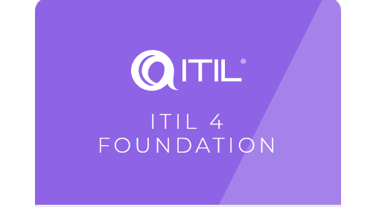
OUR JOURNEY TO CREATE A CULTURE OF COMPLIANCE, RISKMANAGEMENT CONSISTENT DELIVERY
Cyber Essentials
EN 9100
Qualitäts- management- system
ITIL
IT Service Management
ISO 27001
ISMS
Firewalls
Secure configurations
User access controls
Protection against malware
Patch-management
Data security
Access
Passwort policy
Resource handling
Resource management
Mobile work
Internet handling
Data life cycle management
Key Components:
Incident Management
Service Request Management
Knowledge Management
Problem management
Change enablement
Anomaly detection and operation monitoring
Configuration management
ISMS: A system of policies and controls to protect information, continuously improved.
Risk Management: dentify and reduce security risks.
Annex A: 114 controls in 14 areas (e.g., access, cryptography, security).
Continuous Improvement: Uses the Plan–Do–Check–Act cycle to stay up to date.

Slide 10
OUR INFORMATION SECURITY MANAGEMENT SYSTEM
Goal:
To create a system to manage information security & ensure operational resilience for Chesco operations and research partners.
Governance
Risk Management
Compliance
Management & Regulations & Security Posture
↑
Governance & Risk Registry
↑
ISMS (controls + evidence)
↑
Monitoring + Detection + Honeypots
↑
Digital Twin+ Data Platform + Factory + Cloud + Research
Requirements, Goals, Policies
ISMS Key Measures & Management
Technical controls & monitoring
Operations

Slide 11
WE HAVE AN INTEGRATED MANAGEMENT SYSTEM FOR IT GOVERNANCE TO ENSURE CONSISTENT QUALITY & SECURITY
Strategy
Portfolio Management
6- Month IT Governance Refresh Cycles
based on feedback & OKRs
Taxonomy
Quality Management System (QMS)
Information Security Management System (ISMS)
Compliance
Incident &
Problem Management
Core IT Operations
Operational Resilience
Integrated Management System
Core Operations
Change Management
Continuous Improvement
Training & Awareness

Slide 12
WE ALIGNED ON A TAXONOMY
FOR A HOLISTIC VIEW OF RISKS AND OPPORTUNITIES
Layer | Risks | Key Opportunities
OT (Operational Technology) | -Equipment failure -Cyber-physical attacks -Downtime & Safety -Legacy system vulnerabilities | -Predictive maintenance -Higher automation -Real-time process control,
IT (Information Technology) | -Data breaches -Ransomware -Downtime of business systems -Integration failures -Data quality issues | -Cost optimization, -Scalable analytics -Improved planning & forecasting
Edge & Integration | -Protocol incompatibility -Edge device compromise, -Data loss at edge -Latency issues -Insecure device onboarding | -Reduced cloud dependency -OT-IT convergence
AI / Intelligence | -Model drift, -Lack of explainability, -Automation errors | -Predictive optimization -Autonomous decisions -Data quality improvement -Faster troubleshooting
OT (Operational technology)
  Sensors
  Programmable logic controllers
  SCADA Systems
  Industrial Robots
  Embedded control systems
IT (Information Technology)
  ERP
  Databases & Datalakes
  Cloud platforms
  Networking systems
  BI Tools
Edge & Integration
  Industrial IoT Gateways
  Edge computing devices
  Protocol converters (OPC-UA, MQTT)
AI /Intelligence
  Models (Prediction, LLMs, etc)
  Decision systems (Dispatch systems, policy engines)

Slide 13
WE CONDUCT THREAT MODELLING AND RISK ASSEMENTS
BASED ON OUR HOLISTIC TAXONOMY
Threat modelling
Risk Assessment
ID | Component | Threat Scenario | Compliance risk | Vulnerability | Impact | Likelihood | Severity | Risk Level | Mitigation | Risk Owner
R1 | Sensors | Attacker spoofs vibration readings |  | No authentication on sensor bus | False maintenance triggers | Medium | High | High | Signed telemetry, anomaly detection
R2 | ERP database | SQL injection |  | Legacy input validation | Data breach | Medium | High | High | WAF, parameterized queries
R3 | Cloud storage | Misconfigured bucket |  | Public access enabled | Data exfiltration | Medium | High | High | Policy-as-code, CSPM tools
R4 | BI tools | Dashboard manipulation |  | Weak access controls | Bad decisions | Medium | Medium | Medium | Data integrity checks
R5 | IoT gateway | MQTT hijacking |  | No topic ACLs | Sensor data manipulation | Medium | High | High | Mutual TLS, topic-level ACLs
R6 | Edge compute | Container escape |  | Misconfigured runtime | Edge takeover | Low | High | High | Hardened container runtime
R7 | Protocol converter | OPC-UA injection |  | Missing validation layer | OT protocol abuse | Medium | High | High | Message signing, gateway firewall
R8 | AI models | Data poisoning |  | Unvalidated training data | Wrong predictions | Medium | High | High | Data lineage tracking, validation

Slide 14
REQUIREMENTS CAN BE GATHERED BASED ON
THREAT MODELLING AND RISK ASSESSMENT
Operational Requirement
Category | Functional System Requirements (WHAT) | Non-Functional Implementation Requirements (HOW BUILT) | Non-Functional Performance Requirements (HOW WELL)
Edge & IoT Layer | Preprocess sensor data; aggregate streams; translate protocols (OPC-UA/MQTT) | Secure gateways; containerized edge apps; protocol validation; local autonomy | Low-latency processing (<100ms); offline resilience; high throughput buffering
AI / Intelligence Layer | Predict maintenance; detect anomalies; optimize production scheduling | Model versioning; training data governance; drift monitoring; explainability | High prediction accuracy; stable performance under data drift; scalable inference
Networking & Integration Layer | Enable secure data flow between OT, IT, cloud, and AI systems | Zero-trust architecture; encryption in transit; segmentation; API security controls | Low packet loss; high availability; predictable latency across domains
Cloud & BI Layer | Provide dashboards; aggregate analytics; support reporting and insights | Secure cloud configuration; identity management; data access controls; logging | Scalable compute; responsive dashboards; high query performance
A Holistic Requirements Model
Requires
Non-Functional Performance Requirement
Functional Requirement
Non-Functional ImplementationRequirement
Constrains
Non-Functional System Requirement

Slide 15
BASED ON PRIORITIZATION, WE CREATE OKRS, WHICH WE
EMBED INTO OUR SERVICE DELIVERY SYSTEM
What is an OKR?
Objective: Ensure 99.9% App Availability
├── KR1: App uptime ≥ 99.9%
├── KR2: Backup success ≥ 99%
└── KR3: Avg incident resolution ≤ 4 hrs
We use our OKRs to run our operations and ensure efficiency, compliance and security
ITIL Process | Objective (O) | Key Result (KR) / KPI | Metrics
Availability Management | Ensure high availability of IT services | Application uptime ≥ 99.9% | - App uptime %- Docker container status- Server uptime %
Capacity Management | Ensure IT resources meet demand | CPU & storage within acceptable limits | - VM CPU utilization- VM memory utilization- Storage capacity left
Backup & Recovery | Ensure data protection and recoverability | Backup success ≥ 99% | - % successful backups- Storage capacity available for backups
Incident Management | Minimize service disruptions | Mean time to resolve incidents ≤ 4 hrs | - # incidents by priority- MTTR (Mean Time to Resolve)
Problem Management | Reduce recurring incidents | Root cause resolution within SLA | - Logs for troubleshooting- % recurring incidents
Information Security Management | Ensure IT systems are secure & compliant | No critical security failures | - Firewall alerts & attacks- SSL certificate validity- License expiry tracking
Change Management | Ensure controlled deployment of changes | Changes implemented successfully ≥ 95% | - Patch compliance- Hardware setup availability

Slide 16

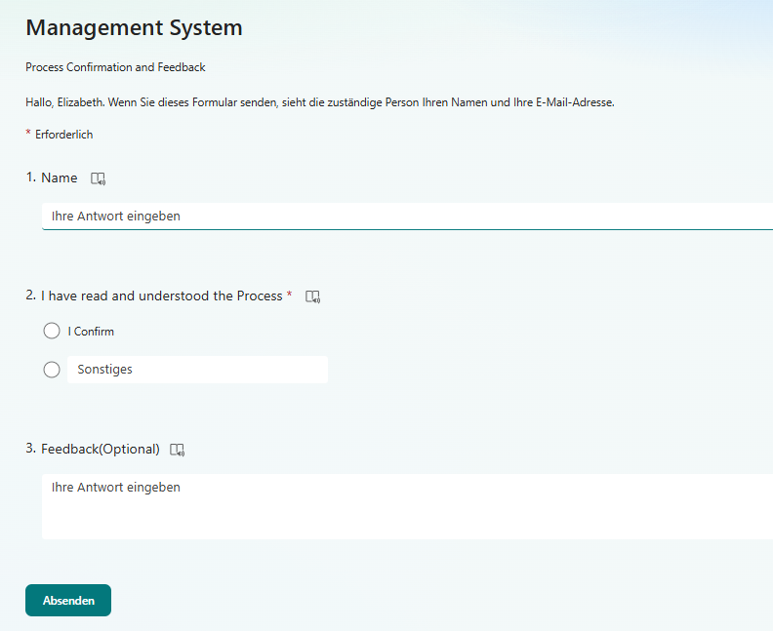
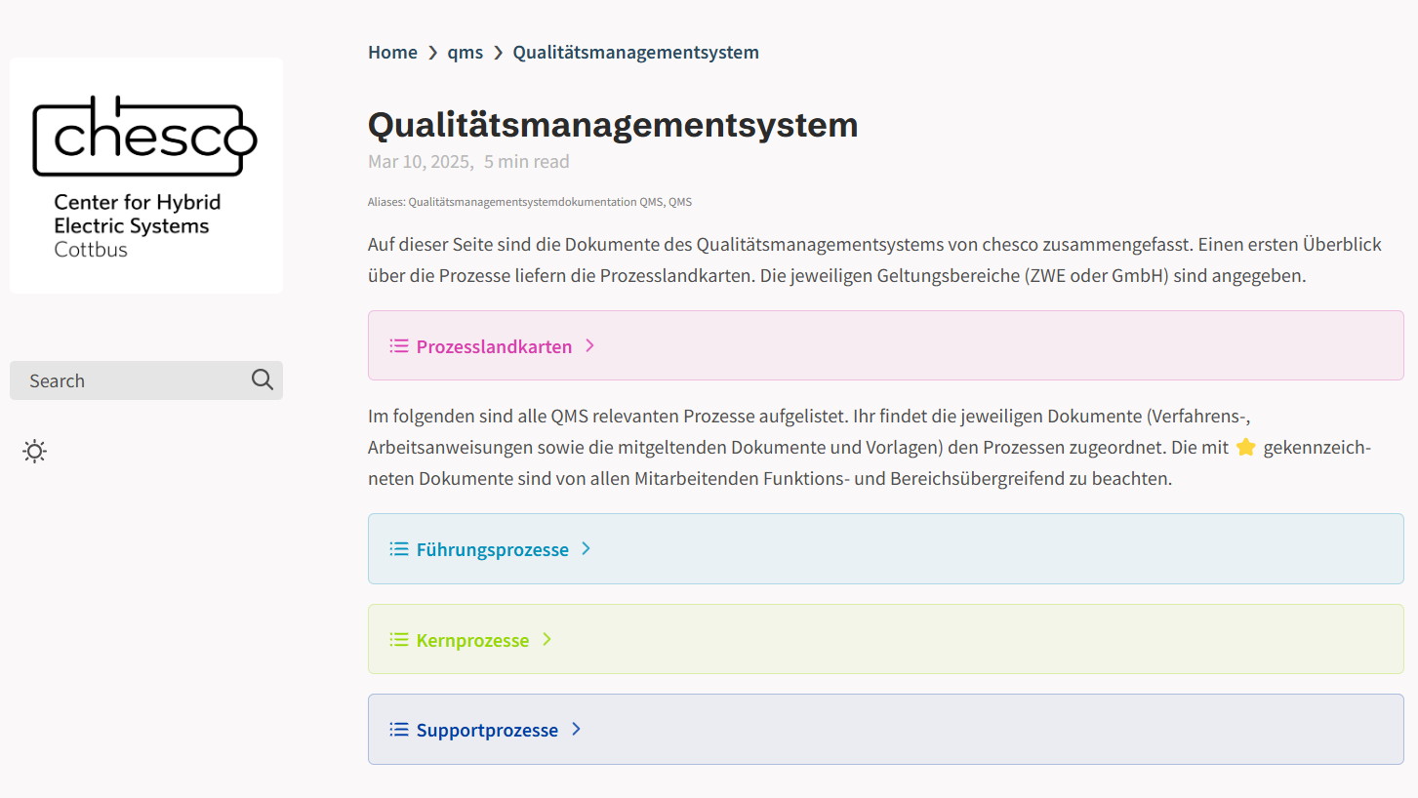
COMMUNICATION AND TRAINING ARE IMPORTANT TO ENABLE A CULTURE OF COMPLIANCE
Compliance Tracker: Important regulation and a „check list“ of high level points of awareness for the organization
(GDPR, Access Control)
Training: As part of IT Governance Process, we have trainings and confirmations that each of the team members have read and understood our
Process Documentation: Key processes are available for all employees to access and review
As part of the IT-Governance refresh cycle we embedd trainings & awareness, as welll as feedback into the cycle

Slide 17
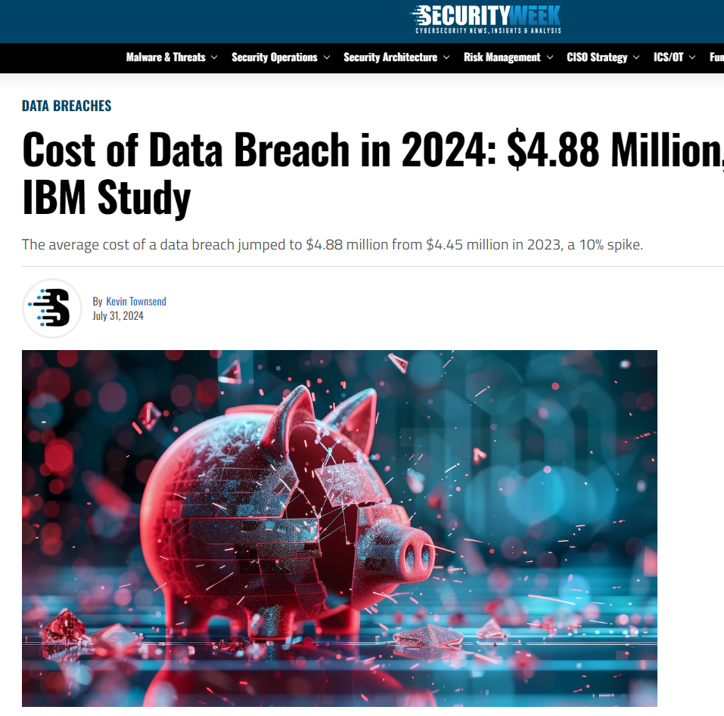
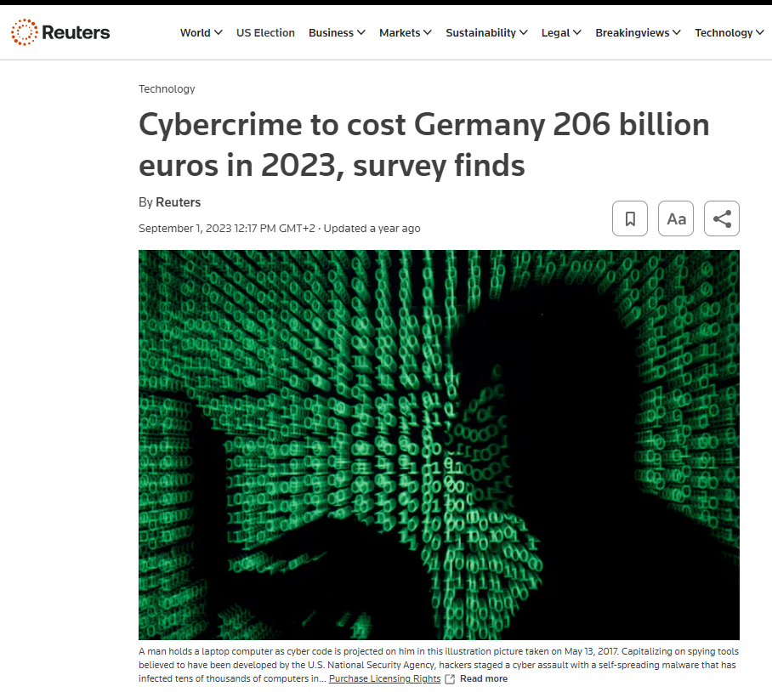
WHY IS COMPLIANCE & SECURITY & RISK MANAGEMENT A COMPETITIVE ADVANTAGE?
Ability to produce higher quality, auditible data sets and AI produts faster than competitors
Improved branding and customer trust
Lower costs, due do to less incidents and fines
Higher operational resiliency, less downtime, disruptions, etc.
Quelle: Cost of Data Breach in 2024: $4.88 Million, Says Latest IBM Study – SecurityWeek ; Cost of a Data Breach Report 2024 (ibm.com)
Quelle: Cybercrime to cost Germany 206 billion euros in 2023, survey finds | Reuters

Slide 18
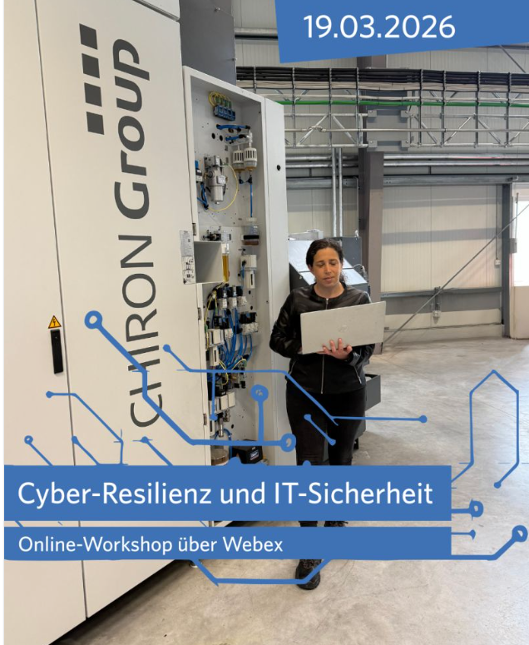
CYBER-RESILIENCE AND IT SECURITY WORKSHOP AS
TRANSFER TO THE LAUSITZ
This workshop is part of the taf (Transfer Agiler Fertigungsmethoden) Project:
Short-term transfer of new research results in production management, factory planning, and manufacturing technology into a digitalized production environment, and support of SMEs in initial transfer projects.

Slide 19
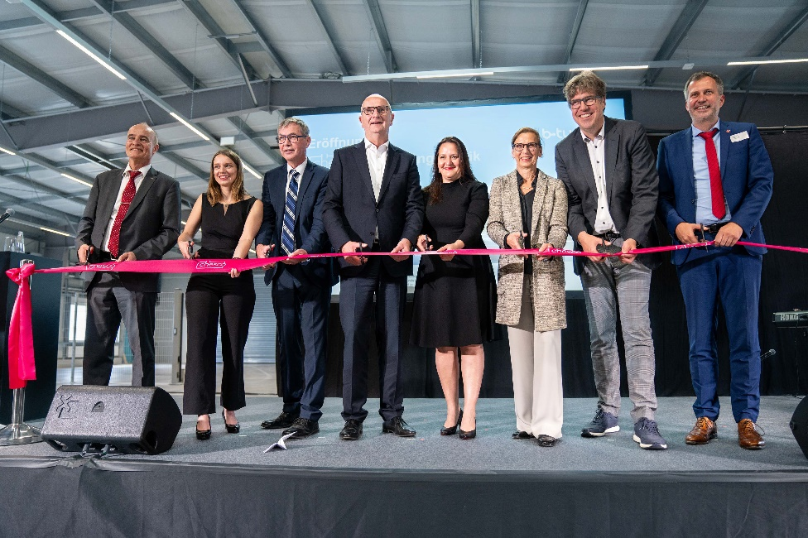
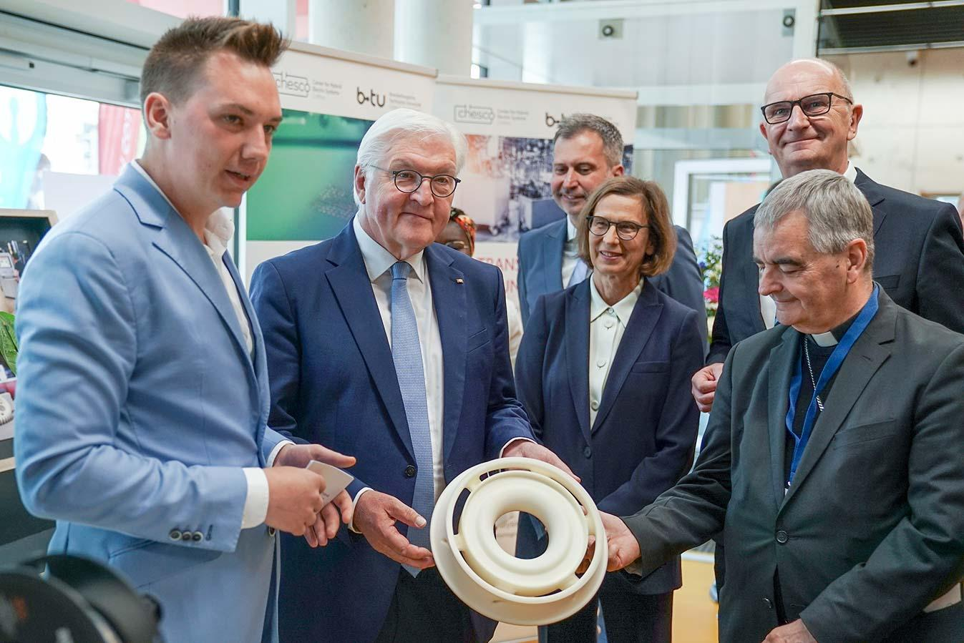

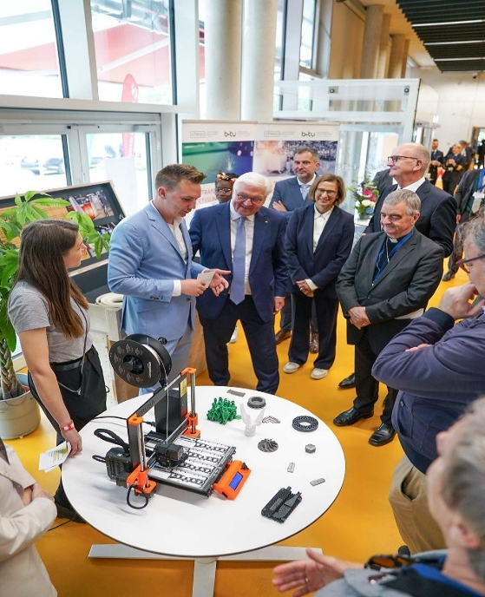
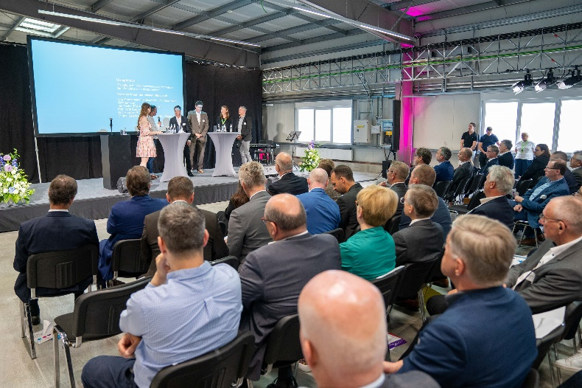

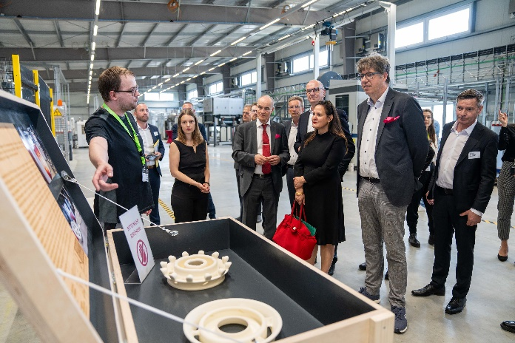
HIGHLIGHTS
Visit of German President
on 13.06.24
Opening of the chesco research factory on 24.05.24
Notes:
‹#›

Slide 20

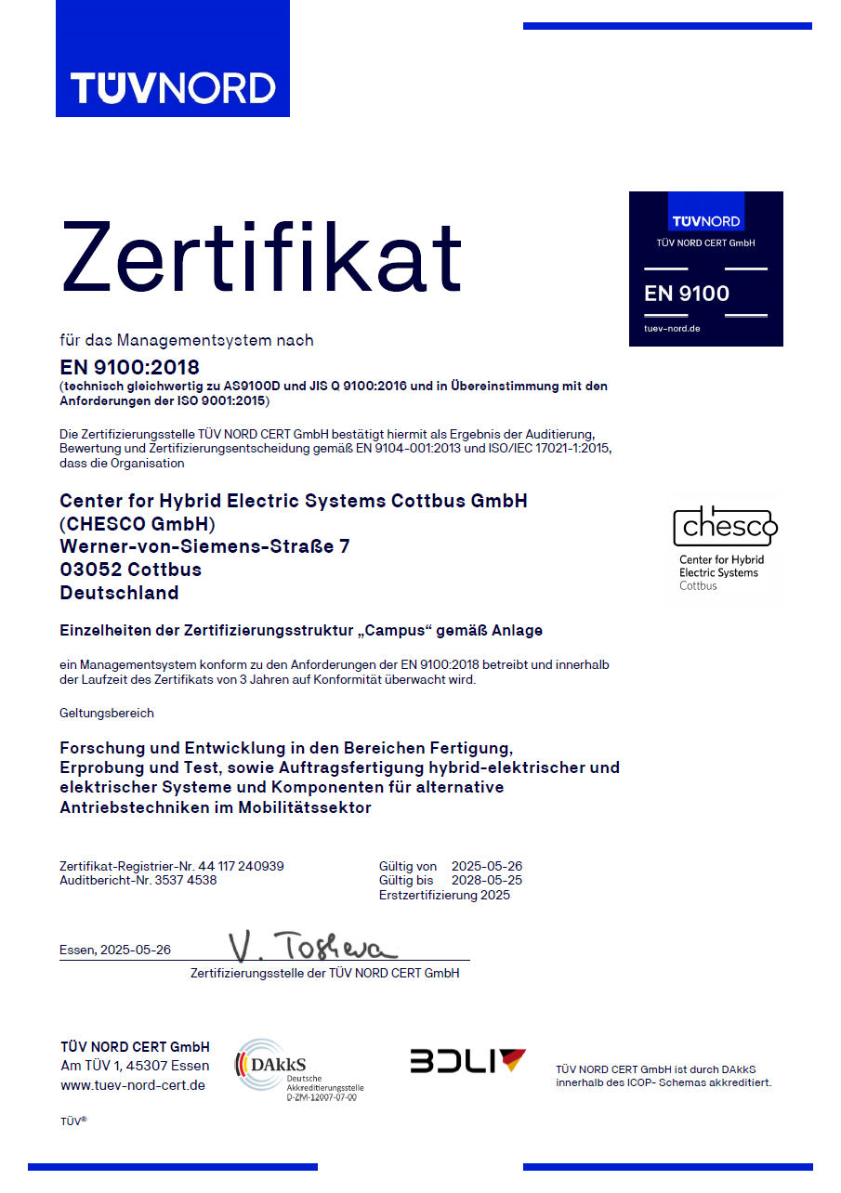
DIN EN 9100 ZERTIFIZIERUNG QMS
The quality management system of CHESCO GmbH has been successfully certified in accordance with DIN EN 9100 (Quality Management Systems – Requirements for Aviation, Space, and Defense Organizations) and thus also meets all the requirements of the baseline standard DIN EN ISO 9001.
Scope:
Research and development in the areas of manufacturing, validation, and testing, as well as contract manufacturing of hybrid-electric and electric systems and components for alternative drive technologies in the mobility sector.

Slide 21























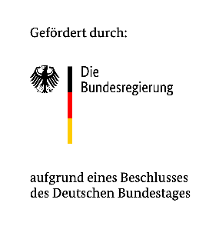







































WE MAKE GREEN MOBILITY HAPPEN.
Kontakt
Elizabeth.Press@b-tu.de
Digital & Incubation
www.btu.de/chesco
Dieses Projekt ist gefördert durch den Bund aus Mitteln des Investitionsgesetzes Kohleregionen und kofinanziert aus Mitteln des Landes Brandenburg.

Slide 22

Bleiben Sie in Kontakt
Chesco & BTU Research:
Elizabeth.Press@b-tu.de
Mein LinkedIn Profil

Slide 23
Backup

Slide 24
Overview of regulation & Impact
REGULATORY LAYER | WHAT IT DOES | STRATEGIC IMPACT FOR ORGANIZATIONS
EU AI Act | Risk-based AI regulation controlling development & deployment | AI becomes a regulated product → compliance-by-design across lifecycle
GDPR | Personal data protection framework | Strict limits on data use → privacy-by-design becomes mandatory
Data Governance Act (DGA) | Enables regulated EU-wide data sharing | Data becomes a governed strategic asset → controlled ecosystems
DSA / DMA | Platform accountability + competition regulation | Limits on platform power, transparency obligations, reduced data lock-in
NIS2 Directive | Cybersecurity & operational resilience law | Executive accountability + mandatory cyber risk management
Cyber Resilience Act (CRA) | Secure-by-design for digital products/software | Security shifts into engineering → full product lifecycle responsibility

Slide 25
UNDERSTANDING LAWS, STANDARDS AND SERVICE DELIVERY
IS BECOMING INCREASINGLY COMPLICATED
KRITIS
Data Privacy
Data Security
Cybersecurity
Information Security
Security
Quality management System
Business Continuity
IT Service Management
DSGVO
NIS 2
Gesetz zur Erhöhung der Sicherheit der IT
DSGVO
BSI-Gesetzes
BSI Kritisverordnung
NIS 2
IT Sicherheit Gesetz
BSI Standards
Telekommunika-tionsgesetz
IEC 62443
Industrial IT Security / Automated Controls system
Energiewirt-schaftsgesetz
ITIL
ISO 27001
ISO 9001 / EN 91000
ISO 22301
ISO 2000
EU-Vorschrift
Deutsches Gesetz
Normen / Standards

