Slide 1
The Real Challenge in Analytics:
It’s Not the Technology, It’s the People

Slide 2


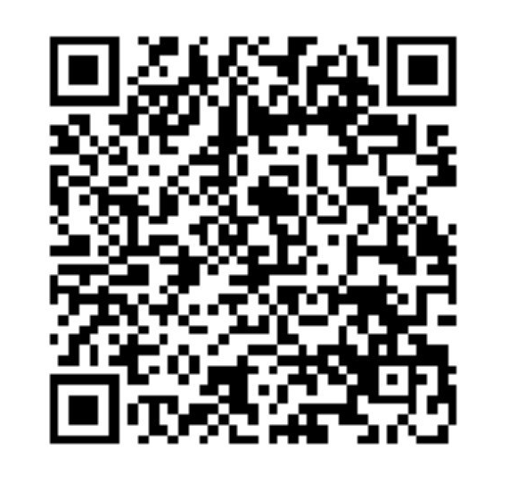
Marcin Nizinski
Leading IT Audit & Data Analytics function @ Siemens Energy
24 years of information management
Innovation and Technology Enthusiast
Agile Mindset Evangelist
Data Analytics Practitioner
marcin.nizinski@siemens-energy.com
https://www.linkedin.com/in/marcinn2/

Slide 3



We energize society
~1/6
of global electricity generation
is based on our technology.
100,000
employees work as a team
to energize society.¹
We are present in
>90 countries.
We invest around
€1.2bn annually in
research and development.
1) Number of employees as of December 31, 2024
© Siemens Energy, 2025

Slide 4
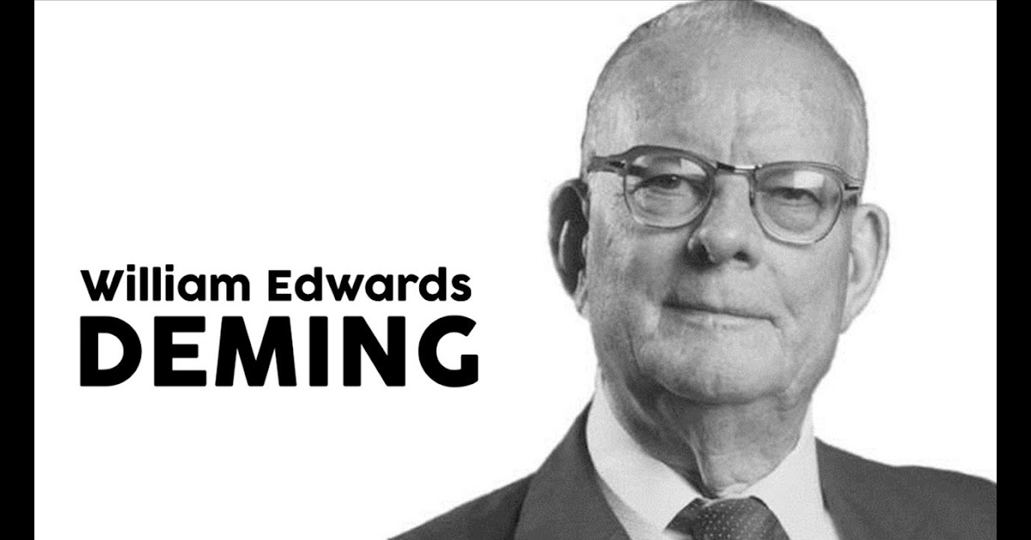
“Without data you’re just
another person with
an opinion”
W. Edwards Deming

Slide 5


Slide 6

DA & Audit
integration

Slide 7

One team,
One goal.

Slide 8
Success Factors
For Data Analytics Team

Slide 9
Relevant
Reliable
Responsive

Slide 10

Relevant

Slide 11

Reliable

Slide 12

Responsive

Slide 13
Competency Development
In Data Analytics Team

Slide 14

“Versatility is the
Key Competency
of the Future”

Slide 15
Competency Areas for Data Analytics Professionals
Data Wrangling*
Data Analysis
Subject Expertise
Design
Storytelling
Data acquisition
Data pre-processing
Integrate & manipulate
Manage data quality
(*Includes: extracting, parsing, joining, standardizing, augmenting, cleansing, consolidating and filtering)
Data discovery
Interpret data
Build data model
Apply appropriate analysis techniques
Train and diagnose models
Information requirements and business analysis
Understand the business logic and validate the data model
Putting analytics in a business context
Visualize results
Proper charts/objects for specific messages
UI/UX design
Create a story
Communication of results
Reporting

Slide 16
Competency Areas for Data Analytics Professionals
Data Wrangling*
Data Analysis
Subject Expertise
Design
Storytelling
Data acquisition
Data pre-processing
Integrate & manipulate
Manage data quality
(*Includes: extracting, parsing, joining, standardizing, augmenting, cleansing, consolidating and filtering)
Data discovery
Interpret data
Build data model
Apply appropriate analysis techniques
Train and diagnose models
Information requirements and business analysis
Understand the business logic and validate the data model
Putting analytics in a business context
Visualize results
Proper charts/objects for specific messages
UI/UX design
Create a story
Communication of results
Reporting

Slide 17
Competency development – balanced approach
Business acumen*
Process design
Risk management
Governance
Project management
IT Service Management (ITSM)
Collaboration
Communication
Presentation
Conflict management
Requirements gathering
Teaching/coaching
Storytelling
* in both dimensions: best practices or
standards and SE ways of working
Technical skills
Extraction, Transformation and Loading (ETL)
Computer languages
Information security
BI tools and databases
Statistical modelling
Machine learning / AI

Slide 18
70-20-10 Approach to learning
70%
20%
10%
LERN AND DEVELOP
LERN AND DEVELOP
LERN AND DEVELOP
THROUGH
EXPERIENCE
THROUGH
OTHERS
THROUGH STRUCTURED
COURSES & PROGRAMS

Slide 19
Working with Principles

Slide 20


Slide 21

…FAIL OFTEN

Slide 22

Tool Agnostic

Slide 23

Make it work.
Make it right.
Make it fast.

Slide 24



Answer the question and…
Zoom in
Zoom out

Slide 25

Wabi Sabi
(embrace imperfection)
Acknowledge three simple realities:
nothing lasts,
nothing is finished,
nothing is perfect.

