Slide 1


60%
state AI is a key influence on data programs
only12%
report their data is of sufficient quality & accessibility for AI
Source: Data & Insights trends 2024, Precisely-Lobow Report
Notes:
By a show of hands, how many of you have an AI strategy in place at your company or are currently working on developing one?
By a show of hands, how many of you feel your company’s data infrastructure, processes and services are fully prepared to support AI strategies and initiatives? I.e do you have a solid data strategy in place?
43% from 2023

Slide 2

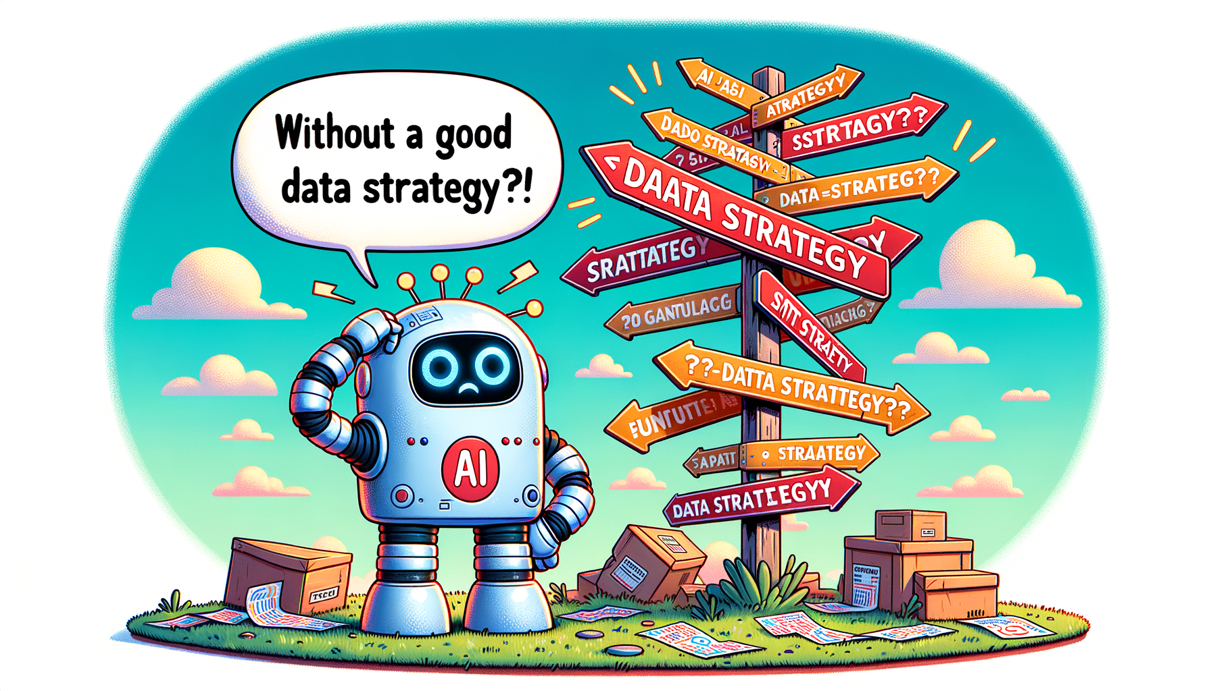
Notes:
Without a robust data strategy ensuring high degree of data quality, standards & processes, AI strategy cannot go far. So why am I talking about this? No my topic for today is not Gen AI strategy. Rather it is about Operationalizing Data Strategy so that the desired target state defined for data strategies is achieved to enable companies achieve their goals on maximing value from data and also are able to actualise their AI strategies as well.

Slide 3

Turning Data Strategy into Operational Reality
A journey of strategic data enablement @
Saru Malhotra, April ‘25

Slide 4





About me
Saru Malhotra
Team Lead - Data and Analytics Strategy
Platform family with Kleinanzeigen:
Unique and exclusive interface for the vehicle trade
Location:
Berlin
1.439.539 offers

Slide 5
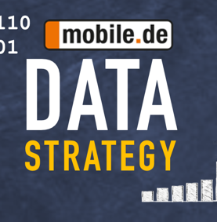
About
MOBILE.DE TODAY: THE MOST POPULAR AUTO WEBSITE IN GERMANY
600+ employees in Berlin
1.4M listings
Our Dealers
sell 54% of their cars via mobile.de
108M monthly visits
Platform family with Kleinanzeigen:
Unique and exclusive interface for the vehicle trade
Location:
Berlin
1.439.539 offers
est. 2020
Notes:
Data and Strategy team size 70 people. Size of company, >45 % tech , so primary a tech company

Slide 6







STEPS TO OUR ‘DATA 2 VALUE’ STRATEGY
with the WHY
target state
building blocks
teams assigned
LT buy-in
communication
Notes:
Like every good strategy we started with the WHY. To address the challenges around scalability, speed of execution and standards around achieving optimal data quality. At the same time ensuring we are ready to meet the growing demands of our business and industry growth with the right data ecosystem in place and most importantly build a strong data culture. Next we defined the target state over a 3-5 year horizon with yearly milestones.

Slide 7




…ONE YEAR LATER
Failed to achieve some of our stated goals
Failed to get commitment from ‘other’ teams
Failed to showcase business impact
Notes:
Like every good presentation, I will start with the WHY. I believe the WHY we need a good and robust data strategy is clear to everyone here and most of you have been part of those journeys in your respective organisations. I will focus on the WHY is it difficult to operationalise the data strategy and where we failed initially, what were our learnings that I want to share with you today. We started with the logical steps, by first nailing down our pains and challenges and setting goal we wanted to achieve with a strategy over a period of 3-5 years.

Slide 8

Notes:
Like every good presentation, I will start with the WHY. I believe the WHY we need a good and robust data strategy is clear to everyone here and most of you have been part of those journeys in your respective organisations. I will focus on the WHY is it difficult to operationalise the data strategy and where we failed initially, what were our learnings that I want to share with you today. We started with the logical steps, by first nailing down our pains and challenges and setting goal we wanted to achieve with a strategy over a period of 3-5 years.

Slide 9




KEY DISCOVERIES & INSIGHTS
Not about tools & process, BUT about PEOPLE
Foundational work
vs
Short-term business impact
Dedicated focus on change management & execution
Notes:
One of the first learnings for us was that the successful implementation of our Data2Value strategy needed a lot of focus on Change Management, Data Literacy and Education in the company. This was clearly not possible for the existing teams with the bandwidth they had. We created specialised roles, both for Data Mesh Transformation Manager to oversee the entire transformational journey of the company towards Data Mesh and Data Literacy Manager to focus on how do we make our company even better ‘data’ literate so that ‘data democratisation’ can actually becomes a reality for us. Not only that the ‘data’ teams are making data easily available and accessible to rest of the company, the rest of the company is able to effectively utilise and consume the data to be able to make insights actionable. Also, that they understand the various roles and responsibilities each of the teams have towards taking ownership of the data they produce and what falls under the scope of data ownership

Slide 10



DATA STRATEGY INTO OPERATIONAL REALITY
Strategic Orchestration
Enablement Framework
Measurability
Short-term wins
Foundational

Slide 11
STRATEGIC ORCHESTRATION
Strategy team size tripled. Increased capacity to drive strategic projects
Focus on change management:
Data Mesh | Data Literacy | Process | Data Product Management
Reduced data implementation time from months to weeks
Data Mesh Pilot:
Most ‘data-ready’ team | Complete Data Autonomy
~60% of team’s OKRs shared with business
Aligned Business Priorities:
Shared OKRs | Data initiatives as company objectives
Foundational
Short-term wins
Notes:
. data mesh pilot reduction in time to implement data solutions from months to weeks was the impact.
Aligning business priorities enabled the teams to achieve their business objectives with the right skills and competencies and ensured while doing that we were setting the right foundations

Slide 12
ENABLEMENT FRAMEWORK
Consolidate Data & BI Platform:
Common source of truth | Set standards | Processes
Synergies gained, community of experts, shared Dashboards
Data Product Management:
Transformation Support | Clarity on Data Roles
Data as a Product Mindset
Reduced efforts from Analytics in requirements translation
28% uplift in report automation capabilities
Data Enablement Focus:
Curated data sets | Ready-to-use dashboards |
Data Literacy Pilot fostering self-service Analytics
Foundational
Short-term wins
Notes:
One of the first learnings for us was that the successful implementation of our Data2Value strategy needed a lot of focus on Change Management, Data Literacy and Education in the company. This was clearly not possible for the existing teams with the bandwidth they had. We created specialised roles, both for Data Mesh Transformation Manager to oversee the entire transformational journey of the company towards Data Mesh and Data Literacy Manager to focus on how do we make our company even better ‘data’ literate so that ‘data democratisation’ can actually becomes a reality for us. Not only that the ‘data’ teams are making data easily available and accessible to rest of the company, the rest of the company is able to effectively utilise and consume the data to be able to make insights actionable. Also, that they understand the various roles and responsibilities each of the teams have towards taking ownership of the data they produce and what falls under the scope of data ownership.

Slide 13







DATA ENABLEMENT SETUP
Business Cluster
Business Cluster
Data Engineering Teams
Data Strategy Team
Data Product
Data Product
Data Literacy
Process
Looker/BI
Data Transformation
Notes:
One of the first learnings for us was that the successful implementation of our Data2Value strategy needed a lot of focus on Change Management, Data Literacy and Education in the company. This was clearly not possible for the existing teams with the bandwidth they had. We created specialised roles, both for Data Mesh Transformation Manager to oversee the entire transformational journey of the company towards Data Mesh and Data Literacy Manager to focus on how do we make our company even better ‘data’ literate so that ‘data democratisation’ can actually becomes a reality for us. Not only that the ‘data’ teams are making data easily available and accessible to rest of the company, the rest of the company is able to effectively utilise and consume the data to be able to make insights actionable. Also, that they understand the various roles and responsibilities each of the teams have towards taking ownership of the data they produce and what falls under the scope of data ownership.

Slide 14
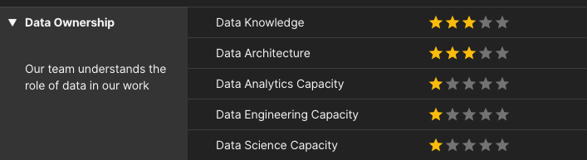
MEASURABILITY
13 % points increase for avg. company score over 10 months
Data (Transformation) Score:
Data Transformation Progress | Data Maturity |
20 dimensions as success metrics | 5 star rating
Data Literacy KPIs:
Engagement metrics (NPS) | Development Metrics |
Pre & Post assessment surveys
NPS 92%,
27 workshops,
47 hours of training, 40% participation rate (min. 1 training)
Data Enablement Metrics:
Data Platform usage & development |
BI Tool usage & development
~ 400 MAU of Looker (60% of the company)
Foundational
Short-term wins
Notes:
One of the first learnings for us was that the successful implementation of our Data2Value strategy needed a lot of focus on Change Management, Data Literacy and Education in the company. This was clearly not possible for the existing teams with the bandwidth they had. We created specialised roles, both for Data Mesh Transformation Manager to oversee the entire transformational journey of the company towards Data Mesh and Data Literacy Manager to focus on how do we make our company even better ‘data’ literate so that ‘data democratisation’ can actually becomes a reality for us. Not only that the ‘data’ teams are making data easily available and accessible to rest of the company, the rest of the company is able to effectively utilise and consume the data to be able to make insights actionable. Also, that they understand the various roles and responsibilities each of the teams have towards taking ownership of the data they produce and what falls under the scope of data ownership.

Slide 15

WHAT’S NEXT?
Notes:
One of the first learnings for us was that the successful implementation of our Data2Value strategy needed a lot of focus on Change Management, Data Literacy and Education in the company. This was clearly not possible for the existing teams with the bandwidth they had. We created specialised roles, both for Data Mesh Transformation Manager to oversee the entire transformational journey of the company towards Data Mesh and Data Literacy Manager to focus on how do we make our company even better ‘data’ literate so that ‘data democratisation’ can actually becomes a reality for us. Not only that the ‘data’ teams are making data easily available and accessible to rest of the company, the rest of the company is able to effectively utilise and consume the data to be able to make insights actionable. Also, that they understand the various roles and responsibilities each of the teams have towards taking ownership of the data they produce and what falls under the scope of data ownership.

Slide 16



LOOKING FORWARD TO…
Establish ROI Framework:
ROI for data initiatives | Set precedence
Scale Data Literacy:
Company wide data learning ecosystem |
Add AI Literacy
Align Data & AI Strategy:
Identify synergies | Clarify interdependence
Notes:
One of the first learnings for us was that the successful implementation of our Data2Value strategy needed a lot of focus on Change Management, Data Literacy and Education in the company. This was clearly not possible for the existing teams with the bandwidth they had. We created specialised roles, both for Data Mesh Transformation Manager to oversee the entire transformational journey of the company towards Data Mesh and Data Literacy Manager to focus on how do we make our company even better ‘data’ literate so that ‘data democratisation’ can actually becomes a reality for us. Not only that the ‘data’ teams are making data easily available and accessible to rest of the company, the rest of the company is able to effectively utilise and consume the data to be able to make insights actionable. Also, that they understand the various roles and responsibilities each of the teams have towards taking ownership of the data they produce and what falls under the scope of data ownership.

Slide 17

Effective Change Management
Clarify “What’s in it for me?” | Manage Expectations
Integrate & Adapt
Customized approach | Shared Responsibility
Demonstrate Value
Measure Business Impact | Report progress
Leadership Sponsor
Visible top-down prioritisation
Notes:
One of the first learnings for us was that the successful implementation of our Data2Value strategy needed a lot of focus on Change Management, Data Literacy and Education in the company. This was clearly not possible for the existing teams with the bandwidth they had. We created specialised roles, both for Data Mesh Transformation Manager to oversee the entire transformational journey of the company towards Data Mesh and Data Literacy Manager to focus on how do we make our company even better ‘data’ literate so that ‘data democratisation’ can actually becomes a reality for us. Not only that the ‘data’ teams are making data easily available and accessible to rest of the company, the rest of the company is able to effectively utilise and consume the data to be able to make insights actionable. Also, that they understand the various roles and responsibilities each of the teams have towards taking ownership of the data they produce and what falls under the scope of data ownership.

Slide 18
Thank you!
&
Any Questions?
Notes:
One of the first learnings for us was that the successful implementation of our Data2Value strategy needed a lot of focus on Change Management, Data Literacy and Education in the company. This was clearly not possible for the existing teams with the bandwidth they had. We created specialised roles, both for Data Mesh Transformation Manager to oversee the entire transformational journey of the company towards Data Mesh and Data Literacy Manager to focus on how do we make our company even better ‘data’ literate so that ‘data democratisation’ can actually becomes a reality for us. Not only that the ‘data’ teams are making data easily available and accessible to rest of the company, the rest of the company is able to effectively utilise and consume the data to be able to make insights actionable. Also, that they understand the various roles and responsibilities each of the teams have towards taking ownership of the data they produce and what falls under the scope of data ownership.

