Slide 1

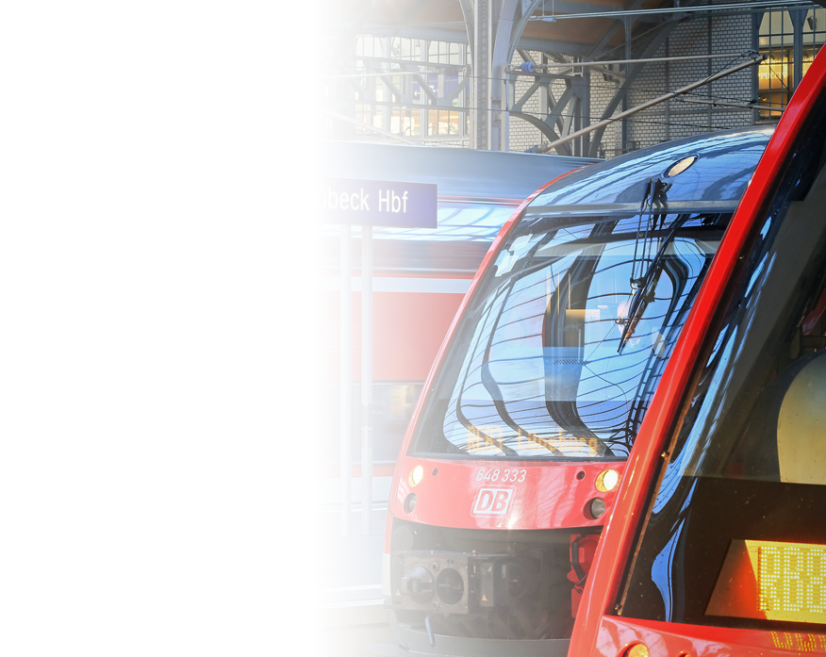
AI, Gen-AI, Agentic-AI:
From Innovation to Industry Revolution
Dr. Andreas Hamprecht | 29/04/2025 | Munich

Slide 2
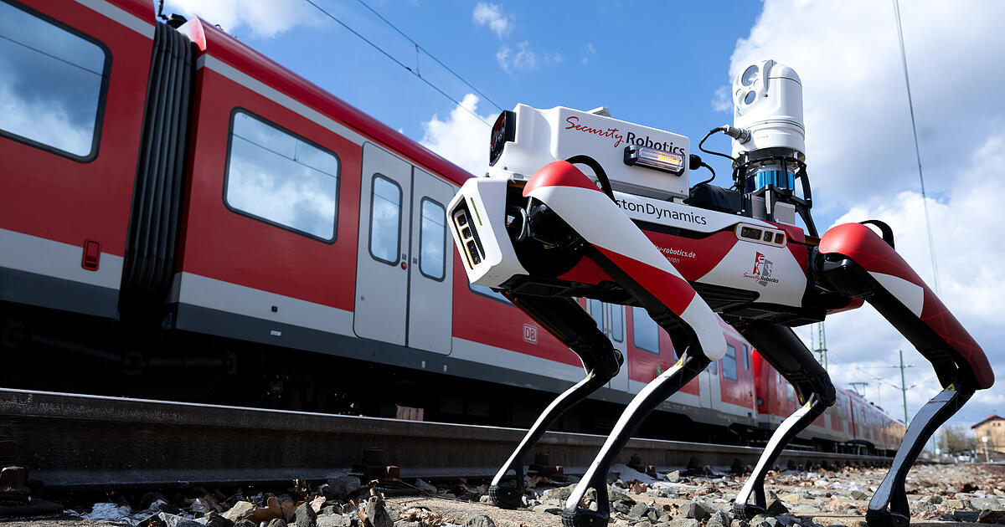

Slide 3

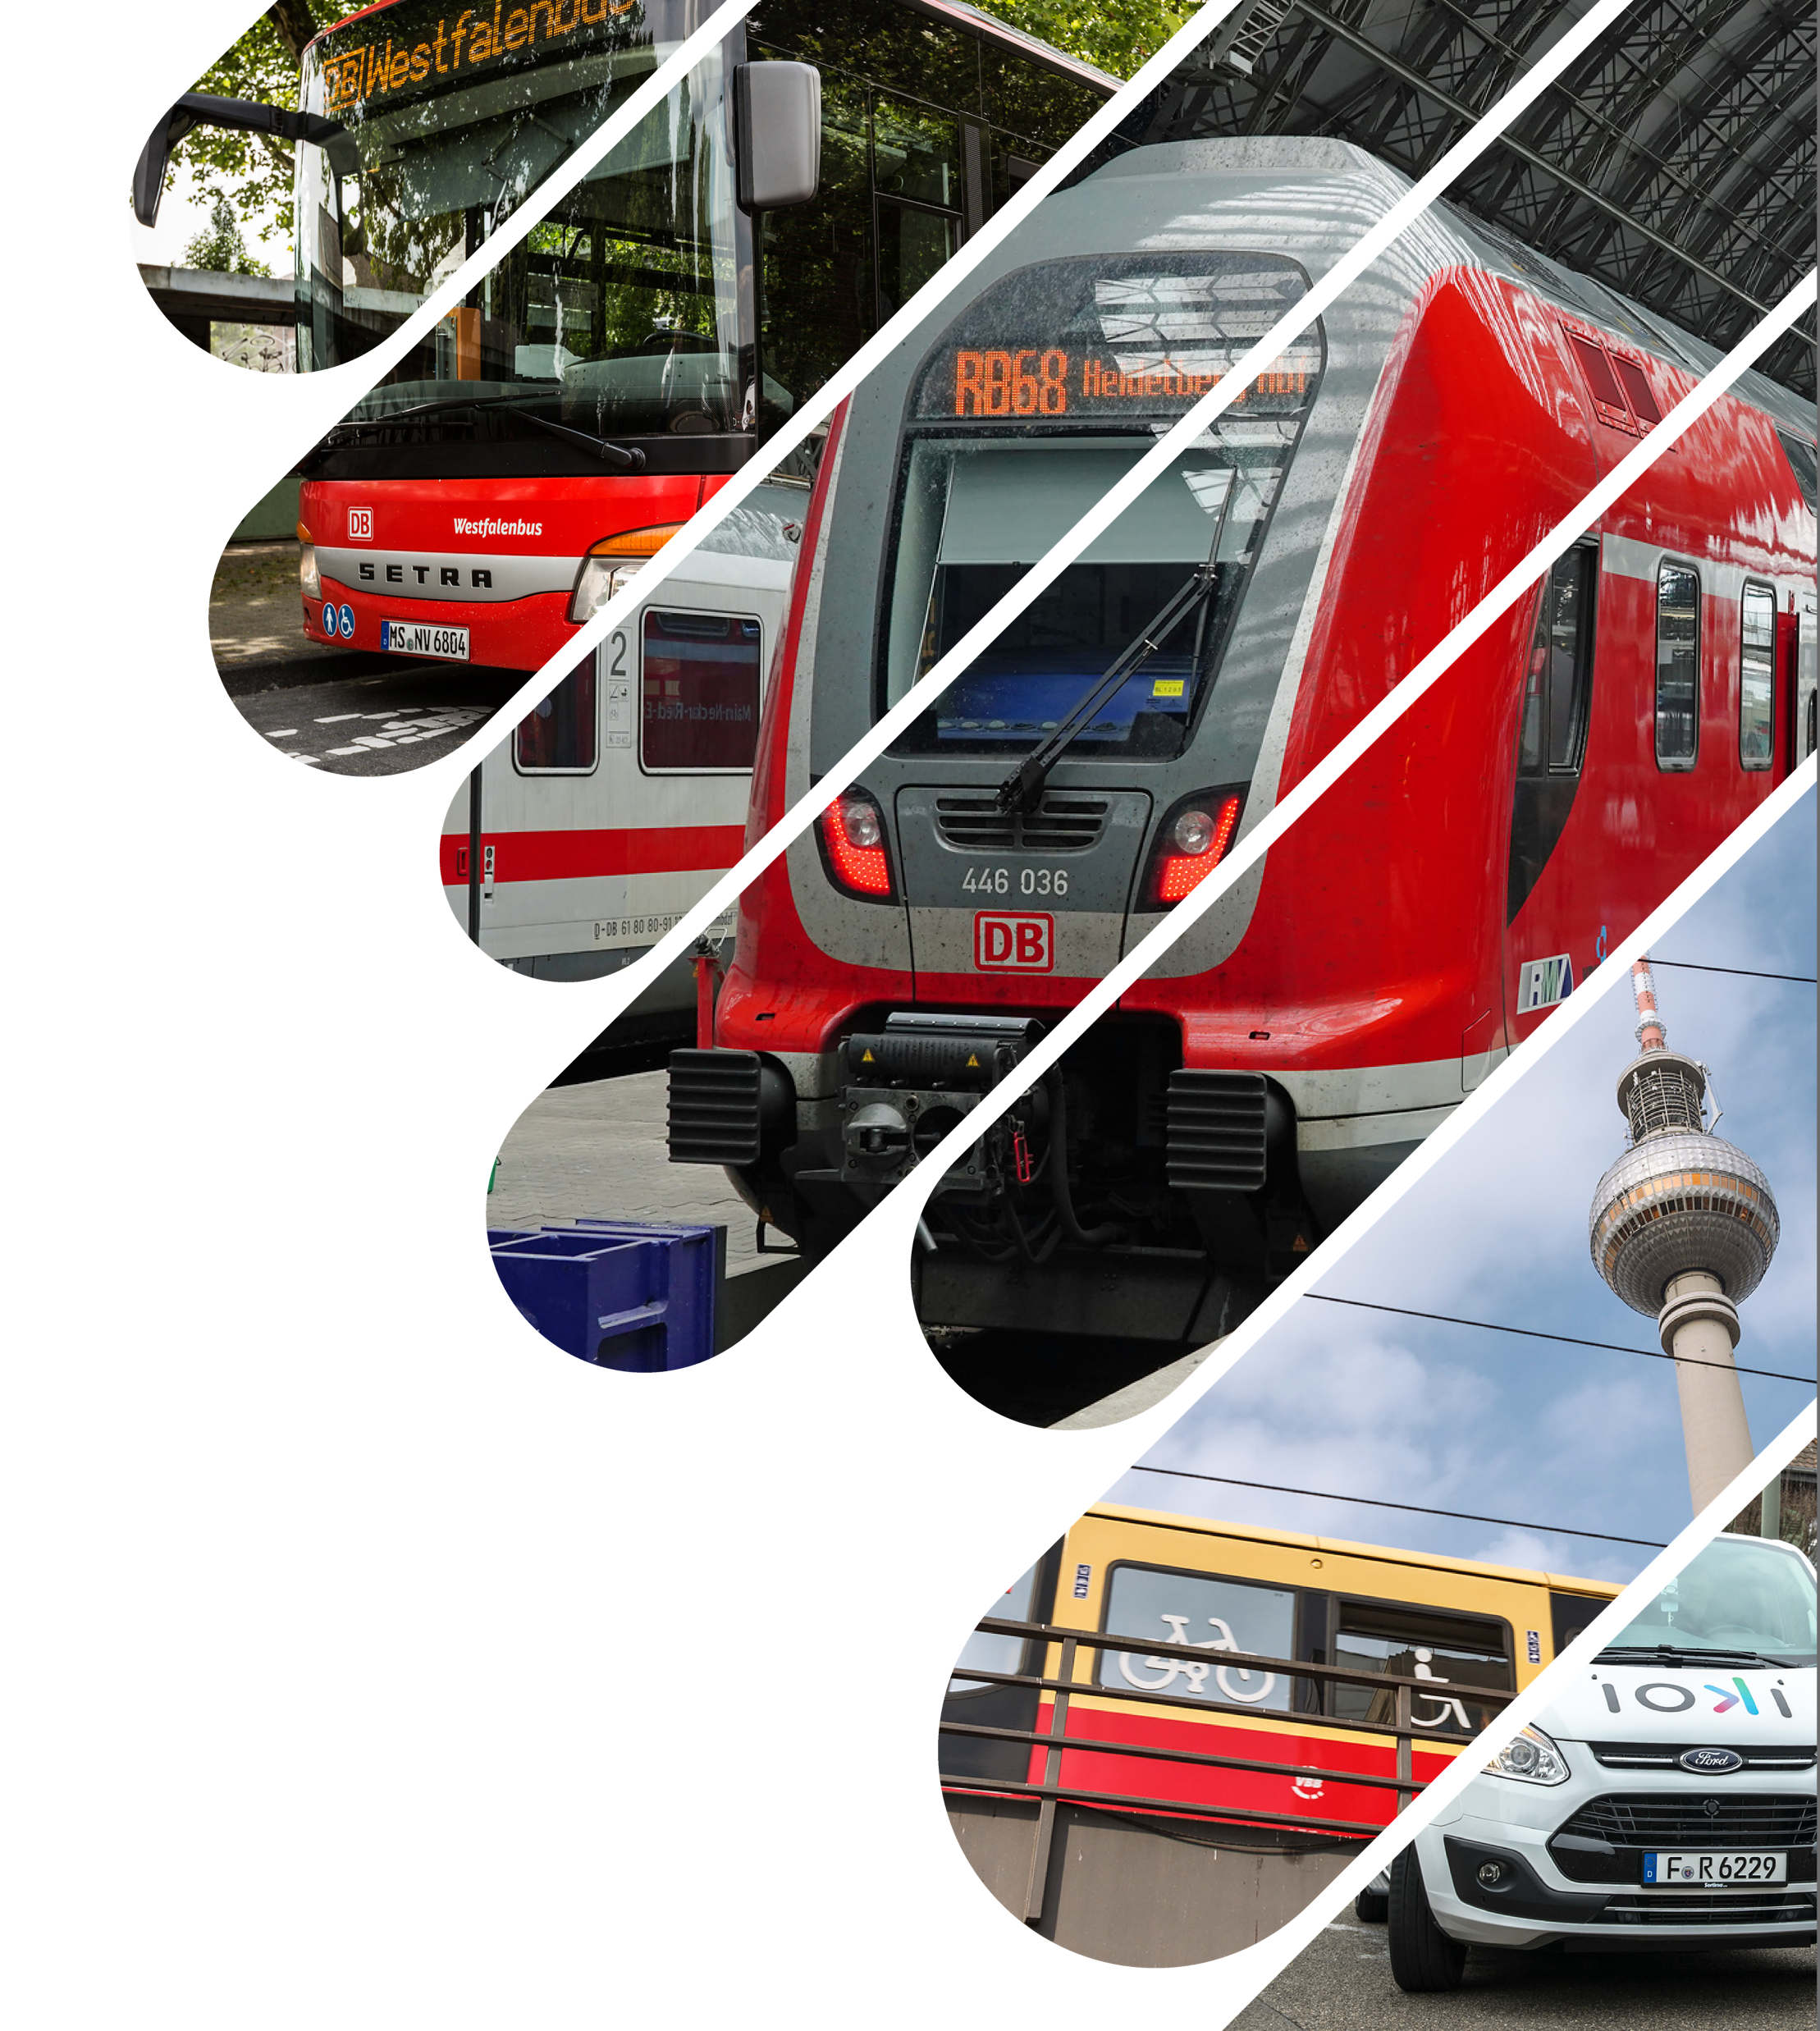
DB Regio at a Glance
Regional Transport Division of Deutsche Bahn
Approx. 6 million passengers on approx. 22,000 trains daily
Largest regional bus operator in Germany
OnDemand Transportation and Autonomous Shuttles
Around €9 billion in sales per year
Almost 40,000 employees
Part of critical infrastructure in Germany

Slide 4
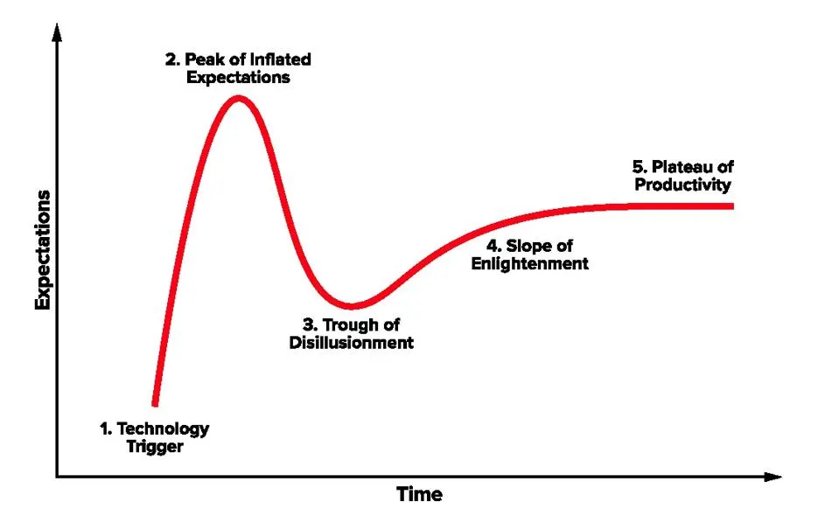
AI: Where Do We Stand in The Hype Cycle?
Computer Vision
Selfdriving
Vehicles
GEN
AI
Agentic
AI
Gartner

Slide 5
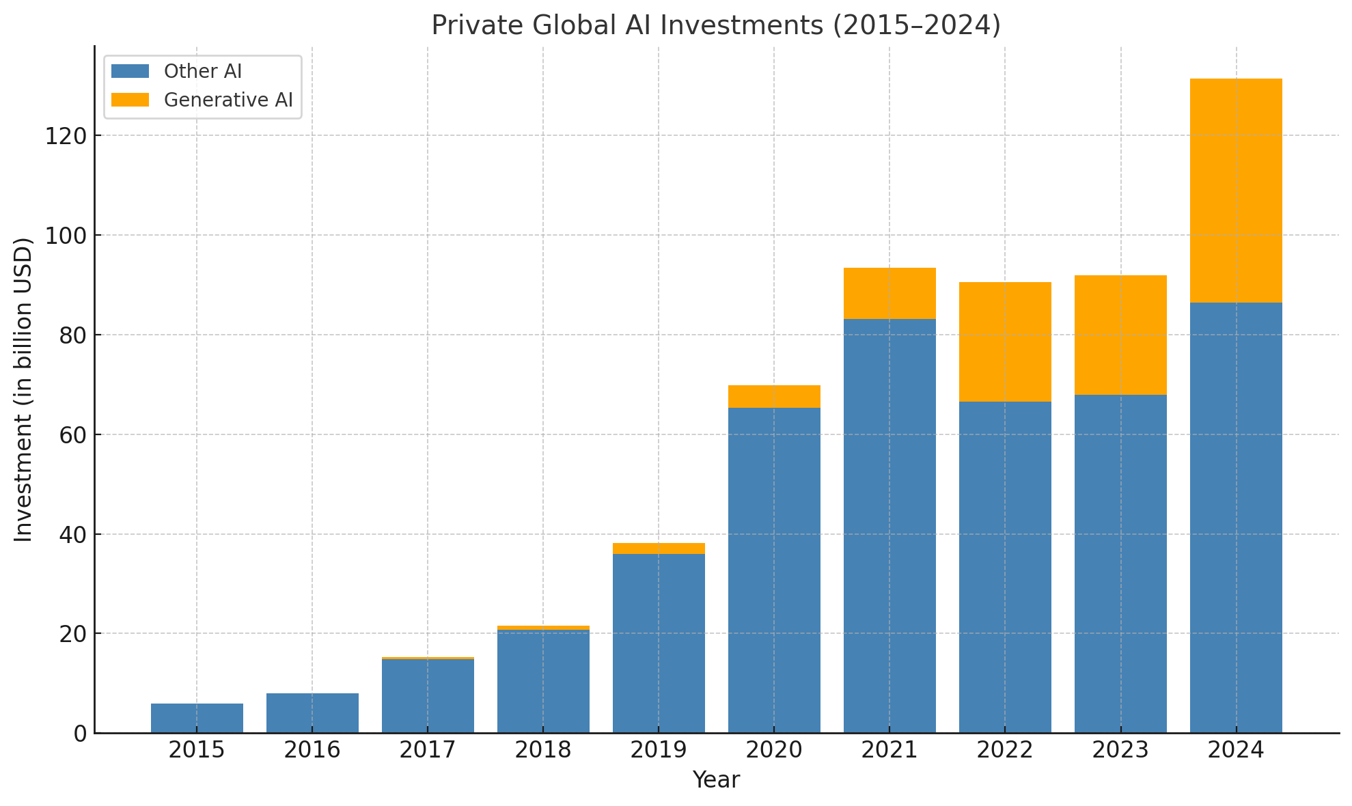
Driven by Generative AI, Private AI Investments Surged in 2024 After a Three-Year Plateau
Private AI investments worldwide
bn USD
Numerous sources evaluated and summarized by ChatGPT

Slide 6


Data
Business Potential

Slide 7
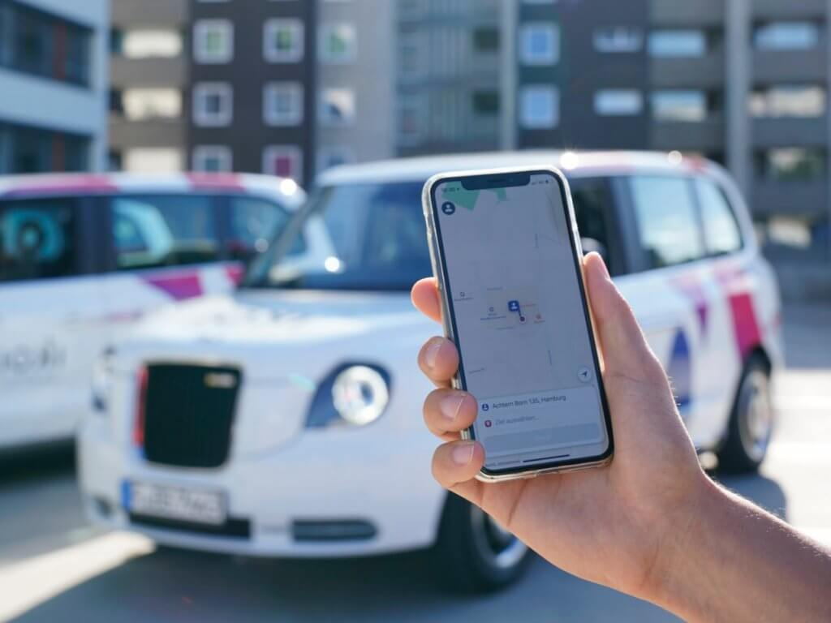
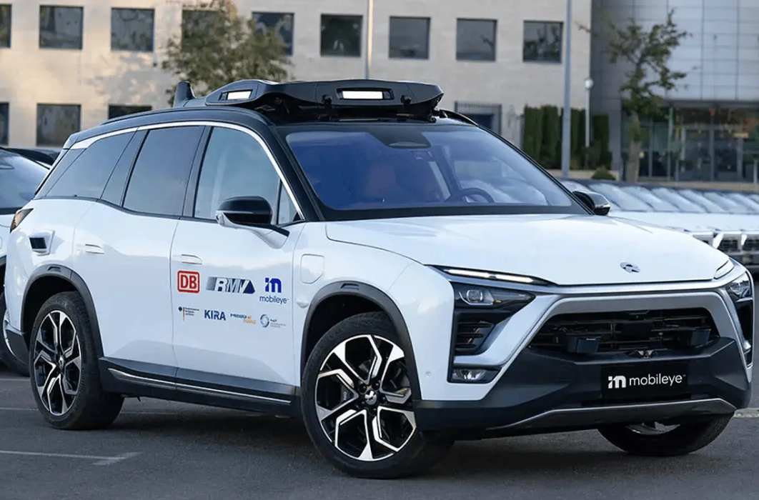
Competition
Innovation
Market Share Public Transport
Ride Pooling
DB
A
B
C
D
22,000 daily trains
4,200 trainsets
50 Workshops
Autonomous
Vehicles

Slide 8







Data Sources Network
Data Consumption
OneSource
Business Intelligence and Analytics Platform as a single Point of Truth for DB Regio's data
Data Ingestion
Data Services /
Analytics Services
Big data governance and regulations
Data Storage

Slide 9
IDDI
Central Platform for the event-based Exchange of Data between Systems serving as a Data Pipeline without any underlying Business Logic
Trainsets
Application
A
Application
Z
…
Gateway
Connector
Connector
Connector
IDDI (Instant Dynamic Data Integration)
Connector
One Source (BI Platform)
IDDE
(Instant Dynamic Data Engineering)
Other Event Platforms

Slide 10
Challenge #1
Surviving Financially
Committed Benefits
mEUR
160
10
2019
2020
2021
2022
2023
2024

Slide 11

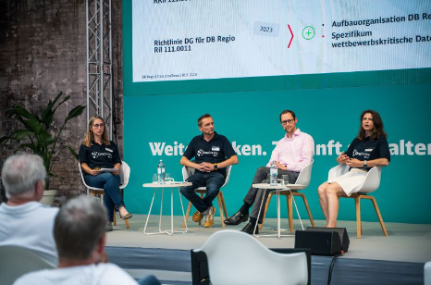
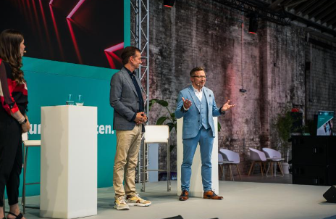
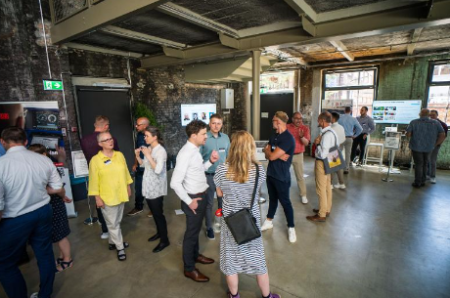
Challenge #2
Joining Forces
Regio Digital Community
400 Participants
IT and Business
Headquarters and Regions
In Person and Virtual Formats

Slide 12
Challenge #3
Act Systematically While Still Get Started
Corporate AI Factory
Iterative Product Development

Slide 13
Corporate AI Factory
LANE 1: Capacity Planning
LANE 2: Railway Operations
LANE 3: Inspection
LANE 3: Condition Based Maintenance
Strategy & Governance
Tech
Portfolio
Process Management
Operations (AI Hub)

Slide 14


DB Regio‘s
Most Beneficial AI Use Cases
3
  Software applications in traffic dispatching
  Visual inspection: Roof and side at the entry of the garage
2
  Visual inspection: Roof and side in productive circulation
2
1
  Various in-vehicle video services
2
  Visual inspection at the workshop

Slide 15
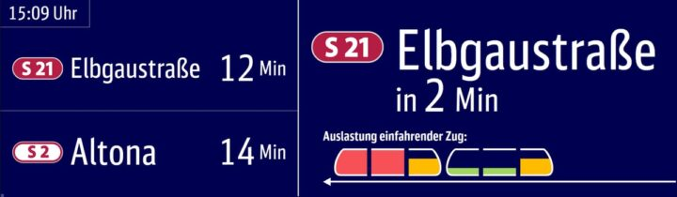
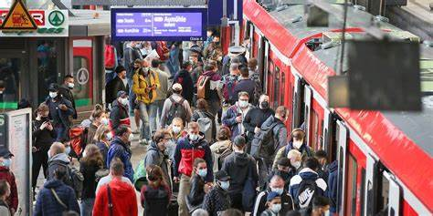
1
  In-Vehicle Video Services
Computer Vision
AI supported video analytics are used for passenger counting
This data opens up a wide range of applications for additional video services in the vehicle

Slide 16
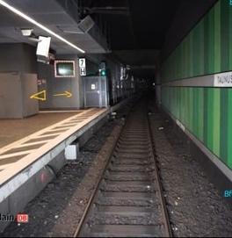
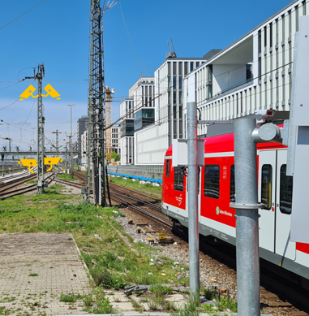
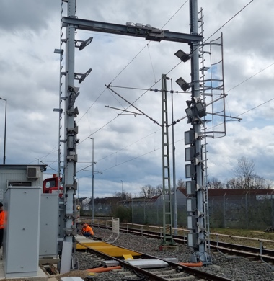
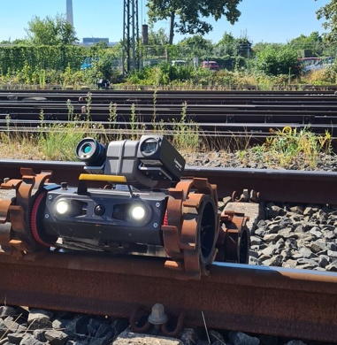
2
  Visual Inspection
Roof & side wall diagnosis in the Circulation
Graffiti detection
in circulation
Mobile visual inspection of the underfloor and side in front of the Workshop
Graffiti detection and condition monitoring at the parking facility

Slide 17
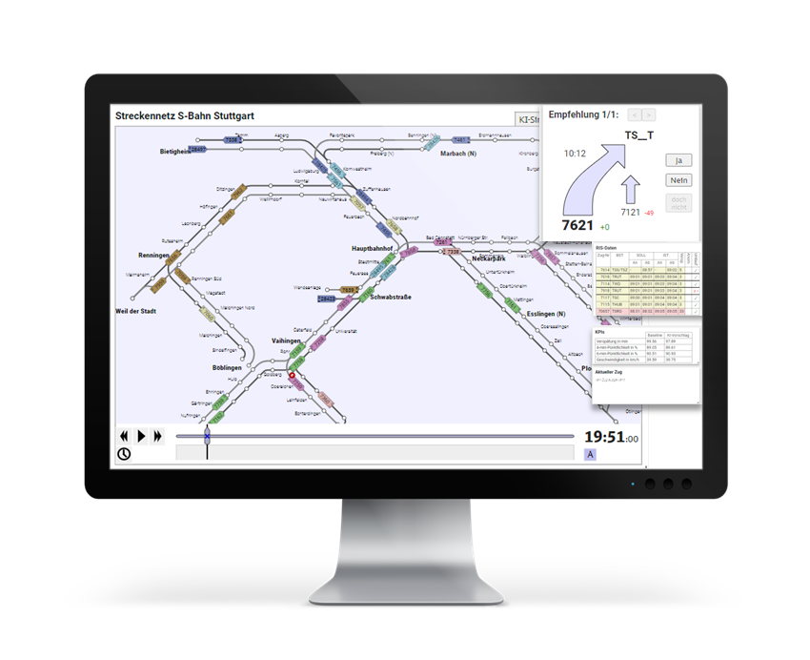
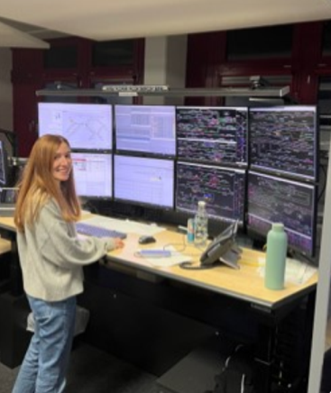
3
  Software Applications in Traffic Dispatching
  AI Assisted Dispatching
AI based suggestions for dispatchers for
Turnaround
partial cancellation
sequence change
Rerouting
Data-based evaluation of action proposals and further training of the data model

Slide 18
Gen AI
POC
POC
POC
Since November 30, 2022
Group Works Agreement DB
(Jul 2023)
Launch of DB AI Hub (Q4 2023)
EU AI Act (Aug 2024)
Founding Partner of Data Hub Germany (Oct 2024)
Launch of Bahn GPT
(Nov 2024)
POC
POC
POC
Top use cases lead to 90% savings in manual effort
Overall target: 20-30% savings of administrative overhead
POC
POC
AI Factory
Scaled Product

Slide 19
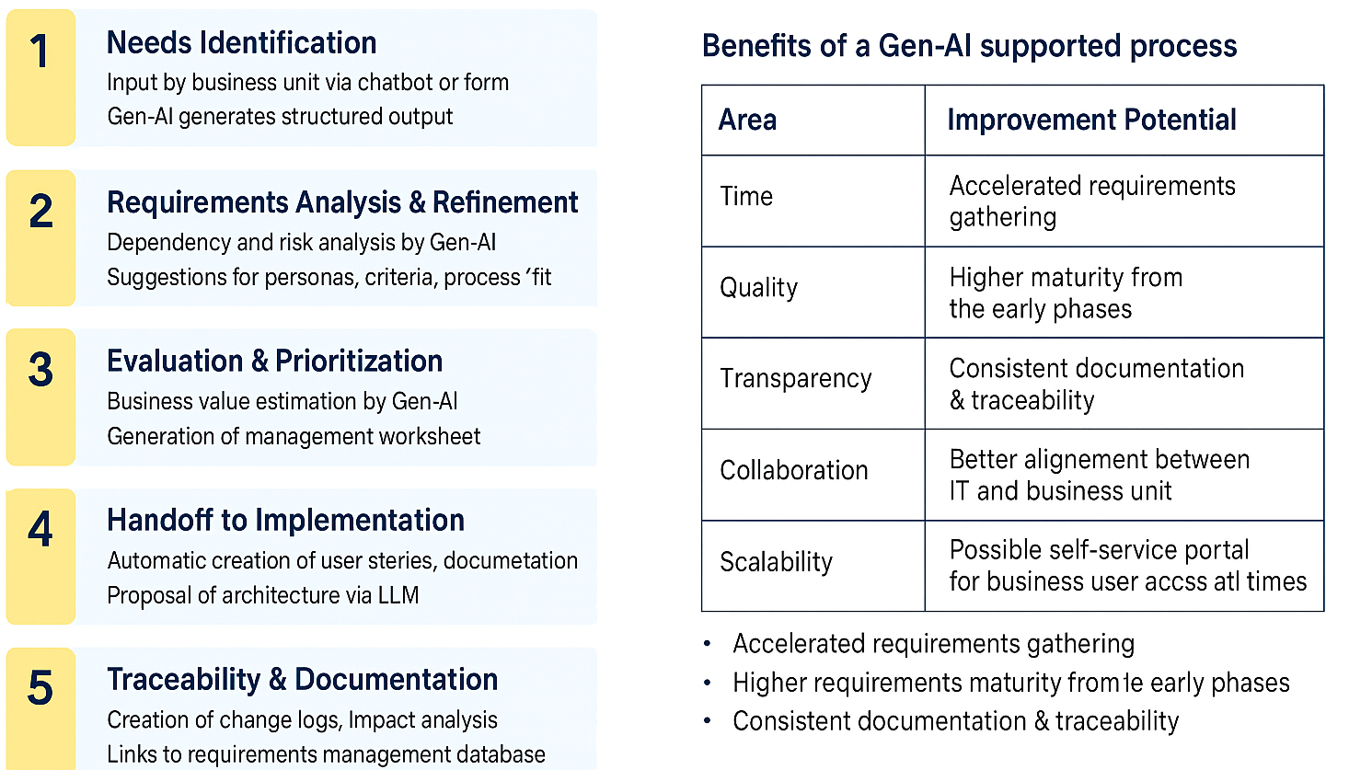
DB Regio Example:
Gen-AI Supported IT Requirements Management Process

Slide 20
Resümée / Learnings
Value-oriented IT development to finance basic development
Concerted development of data access and data quality at business unit level
Bundling AI expertise at Group level (DB AG)
Scouting of top use cases close to the core business
Active community building (governance alone is not enough)
Clarification of governance, data protection, cyber security
Involvement of the interest groups
Balance between systematics and pragmatism

Slide 21

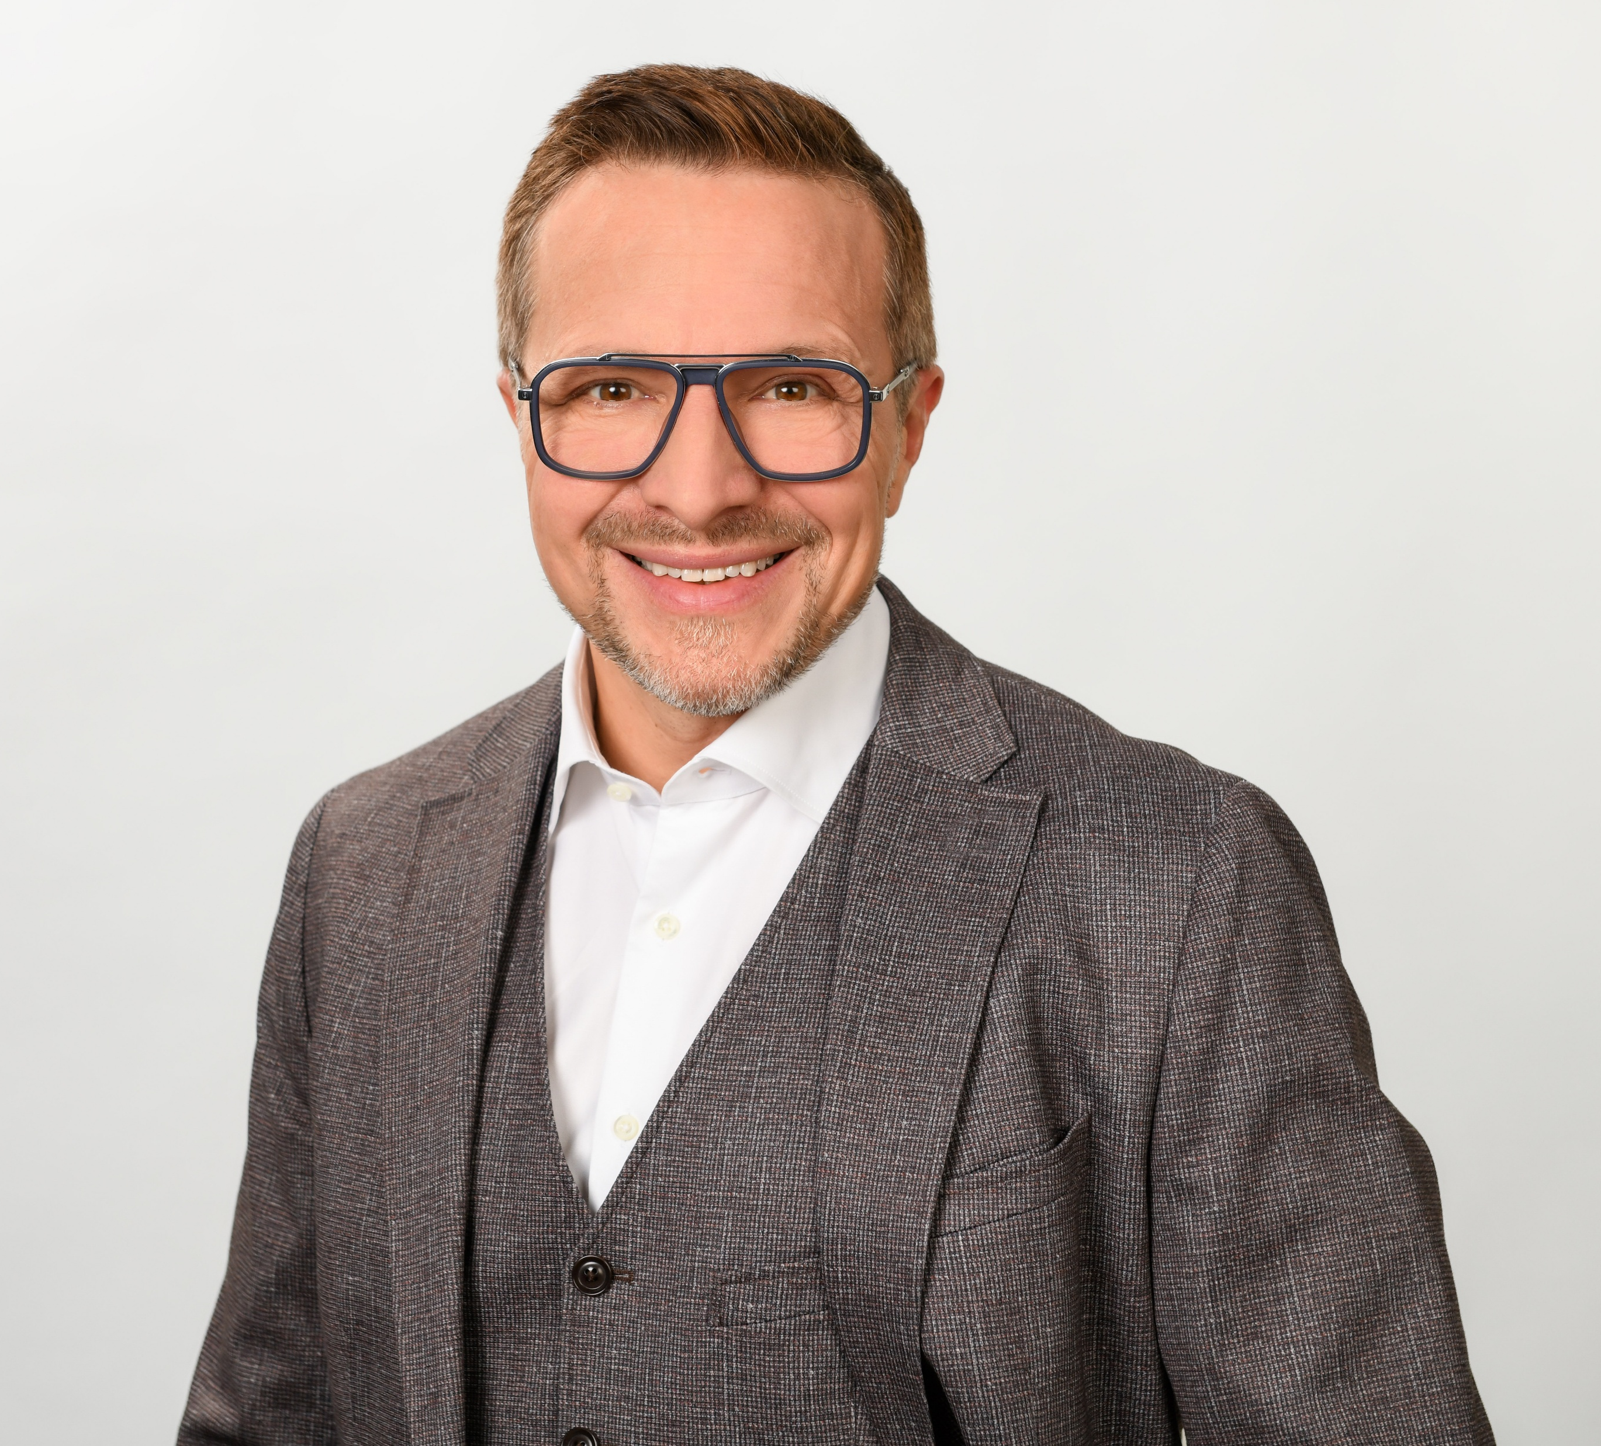


Thank You!
andreas.hamprecht@deutschebahn.com

