Slide 1

Balancing Innovation & Governance
Infrastructure for Data Teams in Finance
By Rudi Bauer and Hendrik Steinbach
- CDAO Germany

Slide 2



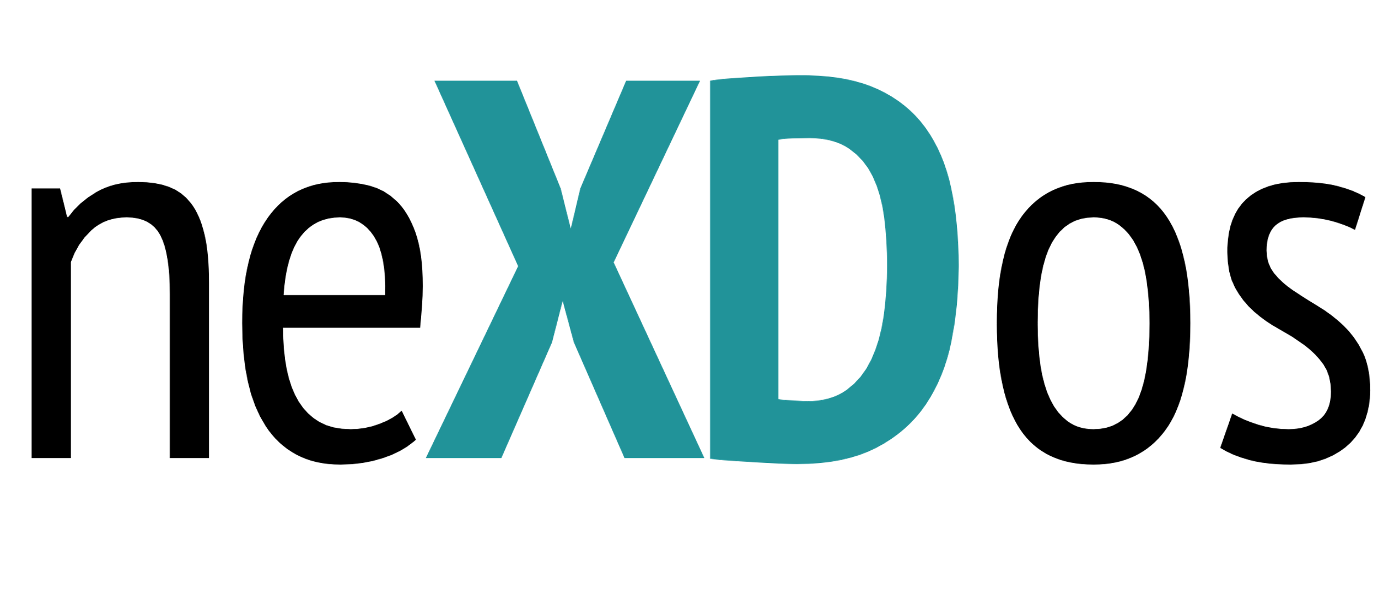

Who We Are
Hendrik Steinbach
Senior Associate & Lead Data Scientist at neXDos
Background in Finance & Statistics
&
Rudi Bauer
CEO & Founder of Infrafin
Specialist in Business Information Systems with over 15 years of experience
  Quantitative investment company
  Based in Munich
  Led by experienced asset managers
  Investment approach - Replicate the performance drivers of Private Equity strategies public markets
  USD 60 million Assets Under Management (as of 14th April)
    Flagship: neXDos US Buyout Style – daily liquid, tradable UCITS fund
IT services company
Based in Bonn
Led by experienced IT professionals
USP: IT infrastructure for financial applications
Notes:
- Highlight why nexdos and infrafin are working together

Slide 3
Inside neXDos – How we turn research into results
Investment Office
Sales
What it takes to make this work:
  Flexible development environment with easy collaboration
  Smooth transition from research to portfolio management
  Adherence to strict regulatory and security guidelines
Research
Study latest scientific publications
Translate & adapt insights into investment strategies
Client Relations
Manage investor relationships
Communication
Handle marketing & performance reporting
Portfoliomanagement
Execute & oversee live fund operations
Prepare analyses based on live data and on-demand client requests
Business Development
Expand distribution channels

Slide 4


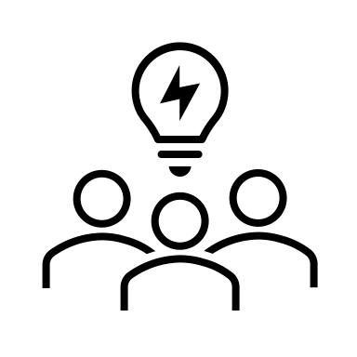
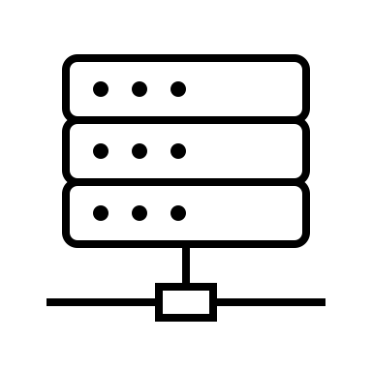

Overcoming the infrastructure gap for quant-driven investment company
Data Access
Real-time access to different databases.
Low Barrier to Entry
Easy-to-use tools with minimal engineering overhead for researchers.
Collaboration
Shared workflows and real-time collaboration via centralized tooling.
Robust Infrastructure
High availability, scalable systems, and fault-tolerant data access.
Easy Reporting
Intuitive dashboards and reporting for prototypes and live strategy performance.

Slide 5
IT- and Data Governance
Regulated market: KAIT/DORA, NIS2, GDPR, …
1
Data security: encryption at-rest & intransit (live & backup)
2
IT- and Data Governance
IT-Security: parts of Zero-Trust, Intrusion Detection/ Prevention System
3
Identity & Access Management (IAM)
4
Observability: log, meter, alert
5
6
Architecture Resilience, Fault Isolation, Environment Segregation
Reporting for regulators and customers
7

Slide 6
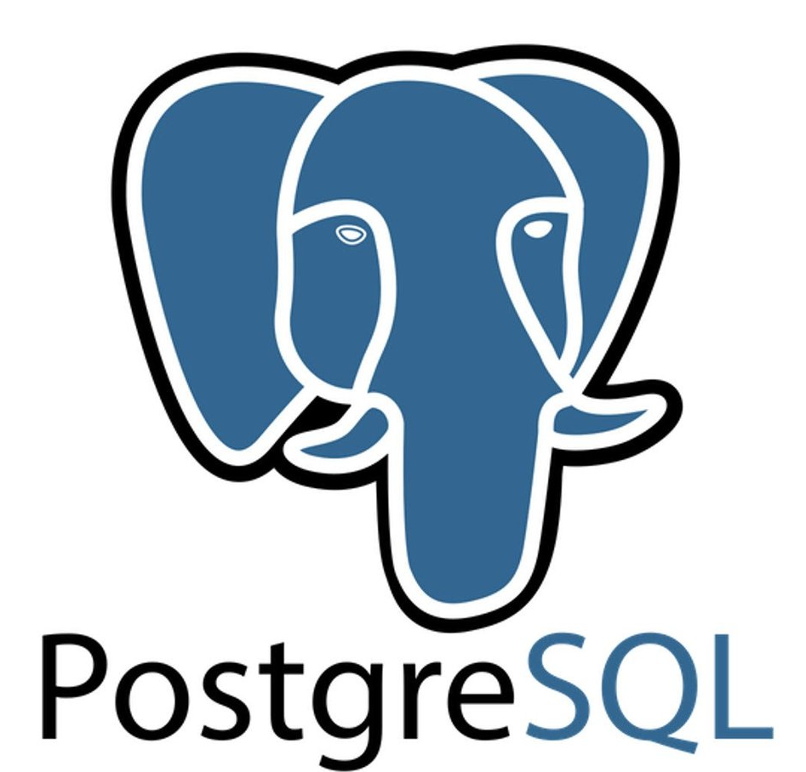
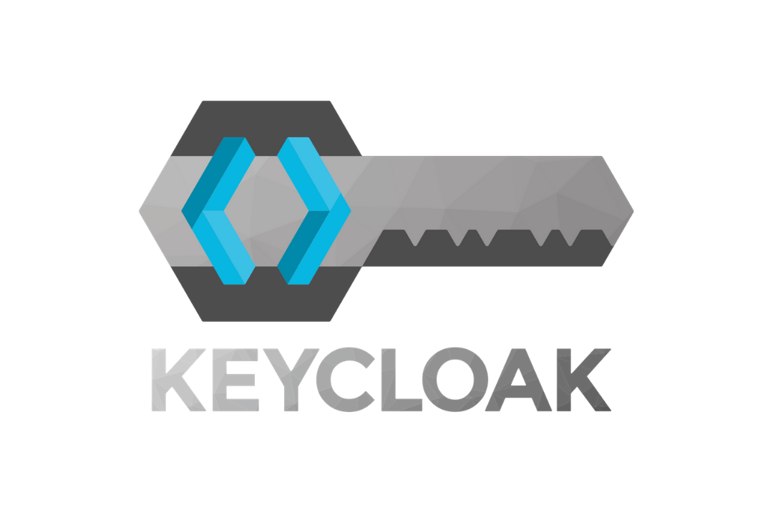
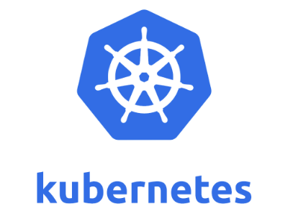

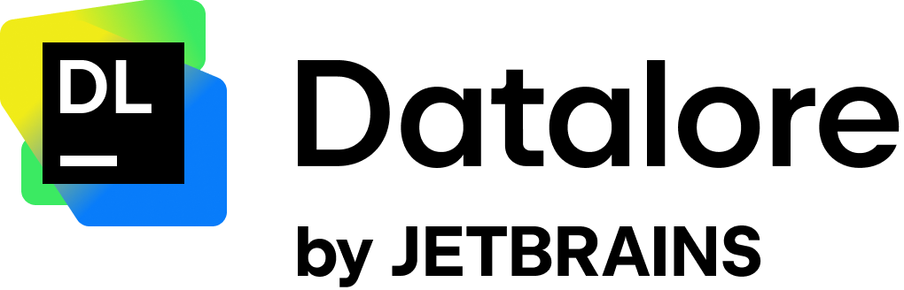

Architecture choices
Data Access | - | - | Central data store | Multiple database access with hidden secrets | - | Data workflows, backfilling, lineage
Low Barrier to Entry | - | Visual DevOps | Wide-spread | Python Notebooks, AI assistence | Single-Sign-On | -
Collaboration | - | Workflows, deployments | - | Live-editing on same notebook | - | -
Robust Infrastructure | High availability, scalability, fault-tolerance | - | Replication, clustering | Scalability | - | Scalability
Security | Full encryption at rest and in transit, isolation | RBAC | Full encryption at rest and in transit | Passwordless database connections | IAM | Secret management
Reporting | Logging, Metering, Alerting | Security compliance, code changes | Audits | Notebook to report functionality | Centralized access log, audits | -

Slide 7
Architecture choices
Data Access | - | - | Central data store | Multiple database access with hidden secrets | - | Data workflows, backfilling, lineage
Low Barrier to Entry | - | Visual DevOps | Wide-spread | Python Notebooks, AI assistence | Single-Sign-On | -
Collaboration | - | Workflows, deployments | - | Live-editing on same notebook | - | -
Robust Infrastructure | High availability, scalability, fault-tolerance | - | Replication, clustering | Scalability | - | Scalability
Security | Full encryption at rest and in transit, isolation | Role-based access control | Full encryption at rest and in transit | Passwordless database connections | IAM | Secret management
Reporting | Logging, Metering, Alerting | Security compliance, code changes | Audits | Notebook to report functionality | Centralized access log, audits | -

Slide 8
Architecture choices
Data Access | - | - | Central data store | Multiple database access with hidden secrets | - | Data workflows, backfilling, lineage
Low Barrier to Entry | - | Visual DevOps | Wide-spread | Python Notebooks, AI assistence | Single-Sign-On | -
Collaboration | - | Workflows, deployments | - | Live-editing on same notebook | - | -
Robust Infrastructure | High availability, scalability, fault-tolerance | - | Replication, clustering | Scalability | - | Scalability
Security | Full encryption at rest and in transit, isolation | RBAC | Full encryption at rest and in transit | Passwordless database connections | IAM | Secret management
Reporting | Logging, Metering, Alerting | Security compliance, code changes | Audits | Notebook to report functionality | Centralized access log, audits | -

Slide 9
Architecture choices
Data Access | - | - | Central data store | Multiple database access with hidden secrets | - | Data workflows, backfilling, lineage
Low Barrier to Entry | - | Visual DevOps | Wide-spread | Python Notebooks, AI assistence | Single-Sign-On | -
Collaboration | - | Workflows, deployments | - | Live-editing on same notebook | - | -
Robust Infrastructure | High availability, scalability, fault-tolerance | - | Replication, clustering | Scalability | - | Scalability
Security | Full encryption at rest and in transit, isolation | RBAC | Full encryption at rest and in transit | Passwordless database connections | IAM | Secret management
Reporting | Logging, Metering, Alerting | Security compliance, code changes | Audits | Notebook to report functionality | Centralized access log, audits | -

Slide 10
Architecture choices
Data Access | - | - | Central data store | Multiple database access with hidden secrets | - | Data workflows, backfilling, lineage
Low Barrier to Entry | - | Visual DevOps | Wide-spread | Python Notebooks, AI assistence | Single-Sign-On | -
Collaboration | - | Workflows, deployments | - | Live-editing on same notebook | - | -
Robust Infrastructure | High availability, scalability, fault-tolerance | - | Replication, clustering | Scalability | - | Scalability
Security | Full encryption at rest and in transit, isolation | RBAC | Full encryption at rest and in transit | Passwordless database connections | IAM | Secret management
Reporting | Logging, Metering, Alerting | Security compliance, code changes | Audits | Notebook to report functionality | Centralized access log, audits | -

Slide 11
Architecture choices
Data Access | - | - | Central data store | Multiple database access with hidden secrets | - | Data workflows, backfilling, lineage
Low Barrier to Entry | - | Visual DevOps | Wide-spread | Python Notebooks, AI assistence | Single-Sign-On | -
Collaboration | - | Workflows, deployments | - | Live-editing on same notebook | - | -
Robust Infrastructure | High availability, scalability, fault-tolerance | - | Replication, clustering | Scalability | - | Scalability
Security | Full encryption at rest and in transit, isolation | RBAC | Full encryption at rest and in transit | Passwordless database connections | IAM | Secret management
Reporting | Logging, Metering, Alerting | Security compliance, code changes | Audits | Notebook to report functionality | Centralized access log, audits | -

Slide 12
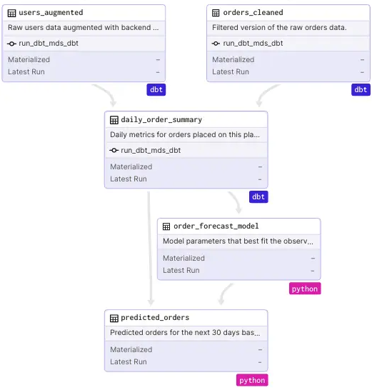
Data workflows using the data orchestrator dagster
Portfoliomanagement
Multiple databases access
Lineage
Python-first API
Modular pipelines
Kubernetes supportable
Dagster UI with intutive dashboards
Notes:
Data backfilling
Nightly updates and cleaning: what I want: "Check out new data with my coffee every morning"
How to add new data provider
- Modern orchestration with full visibility, lineage, and control

Slide 13
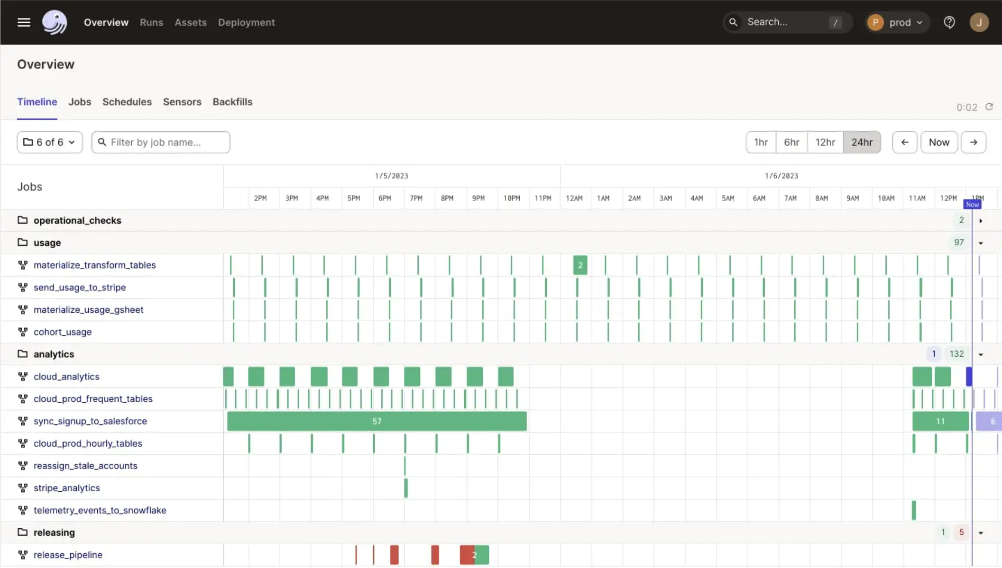
Data workflows using the data orchestrator dagster
Portfoliomanagement
Multiple databases access
Observability
Python-first API
Modular pipelines
Kubernetes supportable
Dagster UI with intutive dashboards
Notes:
Data backfilling
Nightly updates and cleaning: what I want: "Check out new data with my coffee every morning"
How to add new data provider
- Modern orchestration with full visibility, lineage, and control

Slide 14
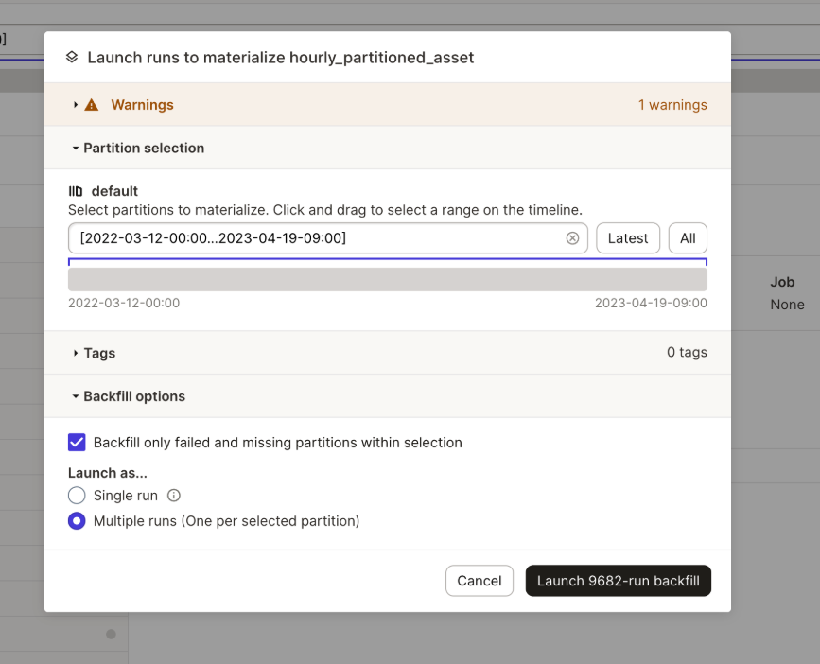
Data workflows using the data orchestrator dagster
Portfoliomanagement
Multiple databases access
Backfilling
Python-first API
Modular pipelines
Kubernetes supportable
Dagster UI with intutive dashboards
Notes:
Data backfilling
Nightly updates and cleaning: what I want: "Check out new data with my coffee every morning"
How to add new data provider
- Modern orchestration with full visibility, lineage, and control

Slide 15
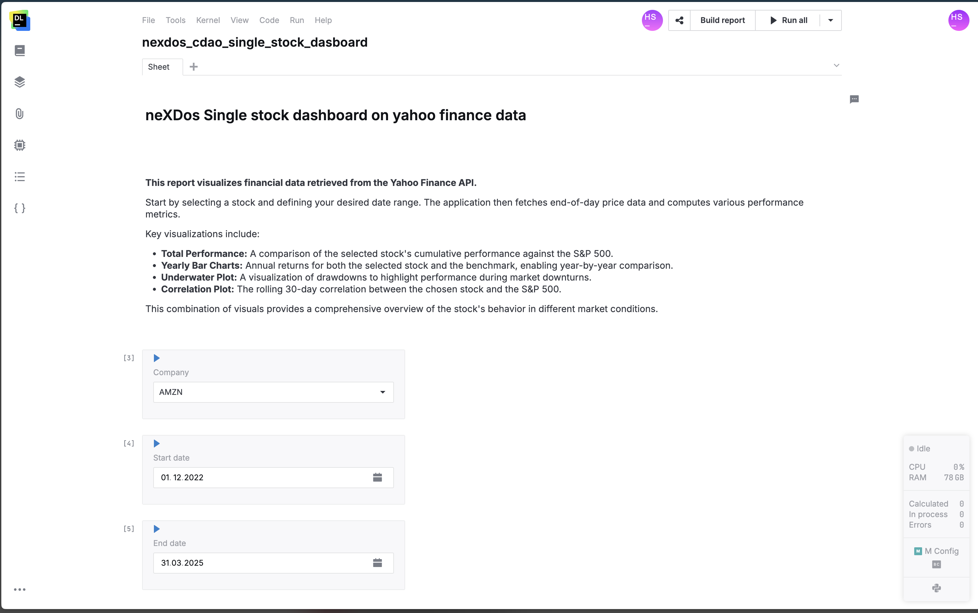
Development workflow with JetBrains Datalore
Research
Native integration to many databases
Notebook-like coding
Live collaboration
K8s supportable
Native report creation
Access report on laptop:
https://datalore.k8s.nexdos.de/report/interactive/Qje0U1DPZvlbusEHH1tfAP/0hAk7VTI2W1QarR7mYMqm3

Slide 16


Thank you for your attention!
Feel free to reach out!
Hendrik Steinbach
neXDos GmbH
Senior Associate
hst@nexdos-capital.com
Rudi Bauer
Infrafin GmbH
CEO & Founder
rba@infrafin.de

