Slide 1

CDAO Germany 2025
Data Analytics: Commercial Opportunities enhanced through Data Partnerships
Gareth Farr: Head Data Science & AI
Munich, 29 April 2025

Slide 2

The Value of Data
May 6th, 2017, The Economist
It contained an article titled
‘The world's most valuable resource is no longer oil, but data’
As soon as banking transactions went digital, Banks Became Data Companies
However, few if any, act like it
Source: The Economist

Slide 3

Powered by Data
How has data been treated?
But how should we treat Data?
As an
Asset
According to IFRS an Asset is defined as
A resource controlled by the entity as a result of past events and from which future economic benefits are expected to flow to the entity
Source: IFRS

Slide 4

Equal Access
However, each company has their own proprietary data
Therefore, the fundamental baseline is the same
If data is a common resource, then Analytics, Data Science and AI are the methods of mining and refining the data to extract the value
& this is the competitive advantage

Slide 5

Data as a Product
a product is an object, or system, or service made available for consumer use.
it is anything that can be offered to a market to satisfy the desire or need of a customer.
Source: Wikipedia

Slide 6










We need to be where our clients are
instant loan?
Integration of banking products into lifetime events of consumers.
car insurance?
foreign currencies?
new debit card?
mortgage?
savings plan?
insurance advice?
long-term financing?
UniCredit - Internal Use Only
Notes:
Banks (as we know them) might disappear, but banking won‘t.

Slide 7








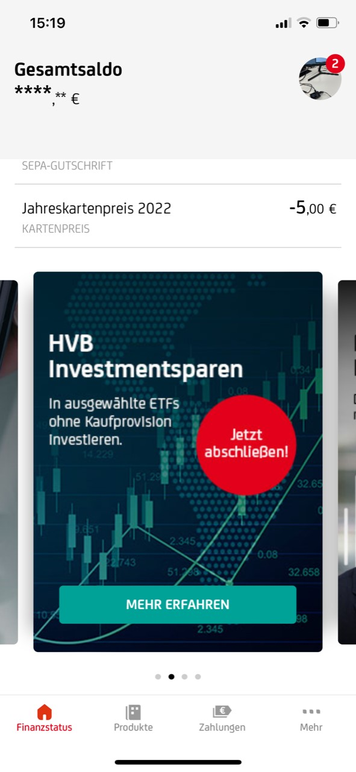


We need to offer the right products at the right time
Previous lifetime events
Today
Future lifetime events
Lifecycle
engagements
€
Inheritance
Real estate
Start a family
Retirement planning
Salary
increase
Inheritance planning
Marriage
Customer value
Mobility
spendings
Hello Max
Do you have some extra money to invest? Try our convenient investment savings plan.
1st job
College
financing
1st account
Customer lifetime
UniCredit - Internal Use Only
Notes:
Implement a life-time event prediction engine using transactional, behavioral and demographic data of our customers
By analyzing data patterns and historical trends, the engine can predict significant life events such as marriage, childbirth, home purchases, or retirement
This information allows us to proactively tailor our products and services to meet the changing needs of customers, develop targeted marketing campaigns, and offer personalized financial advice
For example, offering customized financial planning for customers approaching retirement or providing mortgage options to newlyweds looking to buy a home

Slide 8
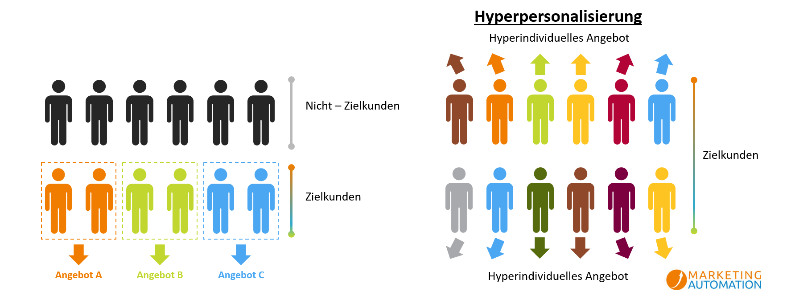
Responding to individual needs and wishes
Hyper-personalized offer
Non-target customers
Target clients
Target clients
Offer A
Offer B
Offer C
Hyper-personalized offer
Relevant offers and service are the most important differentiators
Customers expect to be addressed by name and that communication is tailored to their needs
The core of hyper-personalization is to use user data to create an individually personalized user experience, but also to offer individual, contextual experiences, offers and content in real time.
8

Slide 9





Understanding our Clients
Client Type-Matrix
Smart Shopper
Convenient Buyer
Convenient Buyer
Service Seeker
Service Seeker
Service Seeker
Service Orientated
Smart Shopper
Smart Shopper
Convenient Buyer
Convenient Buyer
Service Seeker
Service Seeker
Classification in the Matrix allows us to understand customers according to possible preferences and therefore a highly personalized approach
Price
Seeker
Smart Shopper
Smart Shopper
Convenient Buyer
Convenient Buyer
Service Seeker
Service orientation
Price
Seeker
Price
Seeker
Smart Shopper
Smart Shopper
Convenient Buyer
Convenient Buyer
Price
Seeker
Price
Seeker
Price
Seeker
Smart Shopper
Smart Shopper
Convenient Buyer
Price orientation
Digital
Channel Affinity
Personal Consultation
Source: D-Cco 2023 - Kundentypen

Slide 10

Curated Customer Experience
Using Data to drive personalisation
Personalisation to drive customer experience
Using customer experience to drive revenue

Slide 11

Thank you!
Q&A

Slide 12


Gareth Farr
Head: Data Science & AI
UniCredit Bank GmbH
Gareth.Farr@unicredit.de

