Slide 1


Empowering Product Teams with Data - Building a Self Service Analytics Culture
-Divya Bokaria
–30 April 2025
Notes:
Let’s see if i can make all of this more tangible

Slide 2

Intro Slide
> Landed in Data space by luck over 12 years ago!
> I come in from the perspective of “why” do we need this data
> Worked in different industries and different levels of data maturity : ecommerce, classifieds, e learning and TV streaming
> Still do not have the right formula for the question though :)
Divya Bokaria - Director of Data and Analytics, Zattoo
Notes:
build/ buy, centralised vs decentralises, self service or not

Slide 3
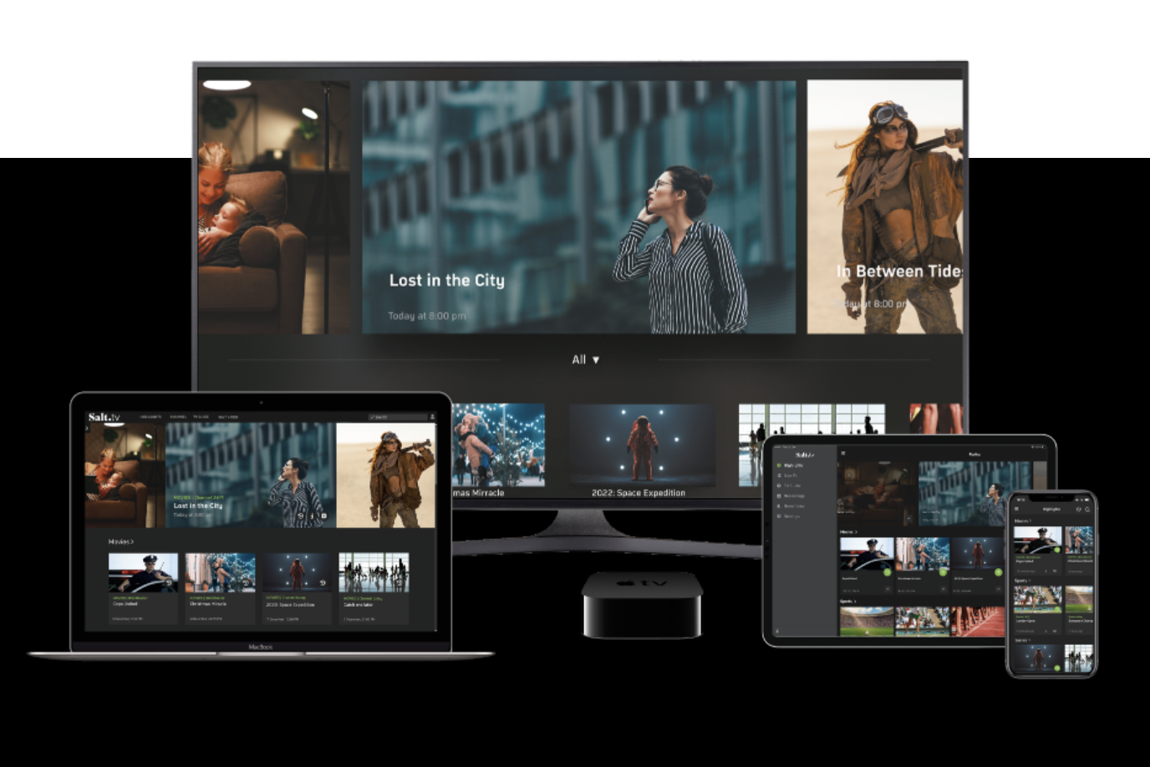
About Zattoo .. Its a TV streaming company
Notes:
We stream on all major devices and have a direct consumer subscription in DACH region and B2B customers offer TV, ISP like 1&1
How devices and remotes make product analytics unique at zattoo. Unify events for different apps

Slide 4
Show of Hands
How many of you work with Product Analytics tools or have helped set it up in your companies?
How many of you have never worked with product analytics tools?
Notes:
What is product analytics: it helps understand user behavior on digital products

Slide 5


Why we wanted to work on Product Analytics at Zattoo
From the server side we already knew what channels, shows people(anonymised of course) watch and on what devices
But we did not know how people navigate to what they are watching, making it hard to understand feature performance, upselling
Notes:
Not so helpful for teams designing remote experience, on understanding if people watch something due to recommenders or the channel list
Where can we put in packages for upselling

Slide 6
The different decision parts on the project
Architectural Parts
Data Collection, Enrichment,
Data Visualisation
Management Buy-in and resource commitment
Event and properties selection
It helped that my previous company had implemented this when I was there and I knew use-cases
Notes:
While central role is data, the responsibility is already quite distributed

Slide 7


It was important to align language which could be different for similar events between the squads
Event and property selection
One senior Product Analyst worked with all Product managers, other stakeholders to define the first list of events and properties
It was important to understand main events and to define 3 phases of implementation so that different squads could take right input
This also helped understand what event properties to take from client apps and what to enrich later
Notes:
Example: of properties is we took only ID of stream and now from that we needed to figure out program id etc for enrichment

Slide 8



Setting up a schema registry that only took events of type that were agreed on but flexibility of different versions was helpful
Data Collection
The ownership of the data collection was with over 10+ engineering squads
Build/ Buy: We did evaluate Snowplow for data collection and involved all squad’s engineering manager for decision making and finally build it ourselves
Real time Q/A: real time pipelines were setup with visualisation on superset that helped the squads Q/A their events at implementation stage

Slide 9

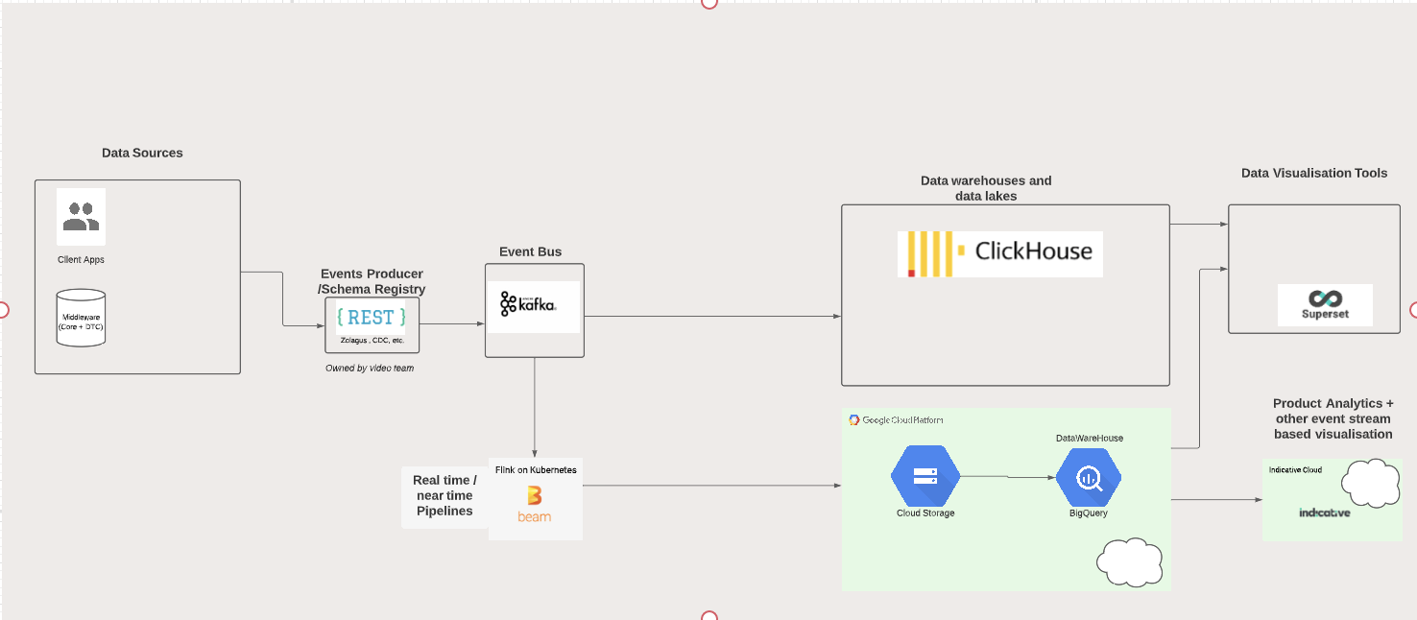
Kafka was the default choice for event streaming and was setup from scratch
Data Infrastructure This was totally with the data engineering team
Clickhouse is the real time datastore for Q/A and monitoring along with superset for visualisation
Bigquery which was already the data warehouse was used for the events tables which fed to viz tool Indicative

Slide 10
Encouraging Adoption of Product analytics
Standard dashboards build for all major questions
The tool Indicative was already selected with all PMs involved and is easy to use
First insights were surfaced with PMs

Slide 11

Standard dashboards build for all major questions
First insights were surfaced with PMs
Notes:
In 2022 we were already done

Slide 12
Learnings after 1 year
Clean data at event details level
Getting clean data for all properties has been a challenge
Adoption
Takes time and needs hand holding of use-cases at the start
Getting over data accuracy
Its important but the data is useful without the last number matching
Enrichment use-cases grows
Some enrichments that we did not make at the start became important soon and its important to have resources to do this
Events and properties need to be dynamic
Some events will be useless after collecting and need to be retired
Designers / UX
Designers are as interested for their research in this data as PMs (hopefully all squad members)
Notes:
Clean data for properties : for example we store interactions on remote button that lead to an event and it was defined quite differently in teams

Slide 13




Road Ahead at Zattoo
Dev Teams before Winter 2024
2024 and beyond
Setup more from technical skills viewpoint (Android, Apple, Set-top box)
Cross functional value stream teams (Find and Discover, Commercial experience, Watch experience)
Events and value may not cut across teams which would give squads more ownership of the functionality and the underlying data
Notes:
How value stream teams can help adoption more

Slide 14


Decentralised data ownership approach
Real time data store
Product microservices
Dev Teams
Collect
Validate
Enrich
Self service analytics products
Data lake
AI Models
Data People
The data team’s role is to set up the data lake and the decentralised data collection process as a product with the right tools
This is then used by all dev teams in the product again and to build AI models on top of it

Slide 15

Content pages
Thank you

