Slide 1
Profitable AI
By Elizabeth Press

Slide 2





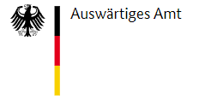
Elizabeth Press
Deputy CDO, Center for Hybrid Electric Systems Cottbus (Chesco)
Founder of D3M Labs, a consultancy, media platform & community
Expertise
Executive leadership & program management at the intersection of strategy, finance, data, and cybersecurity..
Professional Highlights
Data & cyber-resilience and IT-security strategy at Chesco
Data strategy, AI innovation, Data & Analytics projects for clients like Rolls-Royce, the German Foreign Office.
Director of Data at Berlin Scaleups.
Managed machine learning programs for the CMO Office at Dell.
Top-Tier Strategy Consulting & Financial Risk Management.
Co-authored books about FinTech & AI Innovation.
MSc. International Economics and Business from the Stockholm School of Economics, BA International Relations, Tufts University

Slide 3


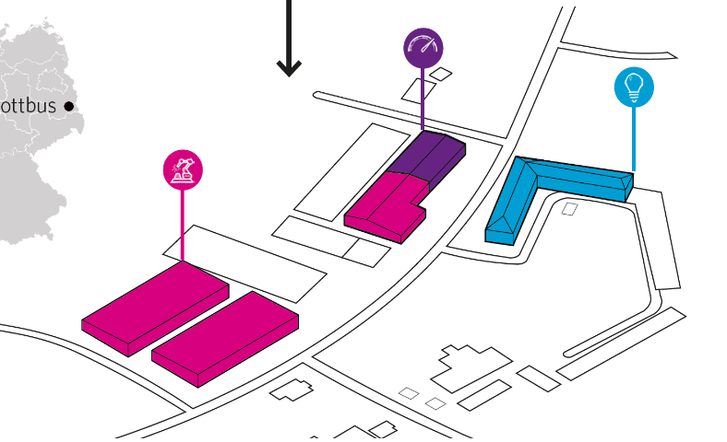

Center for Hybrid Electric Systems Cottbus (Chesco)
The research center includes the areas_ Design – Manufacture – Test – Digital. The current location is the chesco research factory.
we make green mobility happen
At BTU Cottbus-Senftenberg there is a unique research center for hybrid electic and electric systems for the mobility sector.

Slide 4
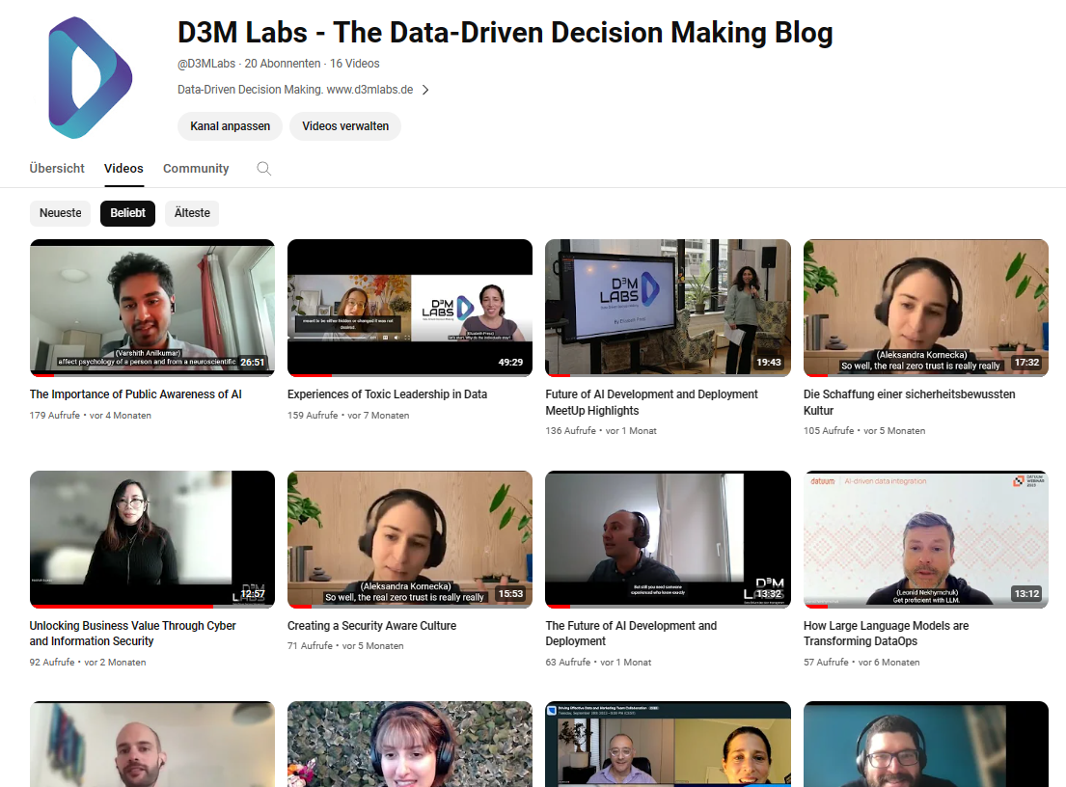
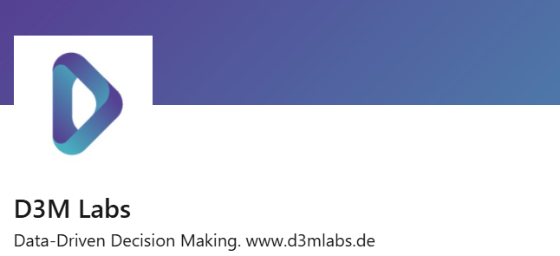

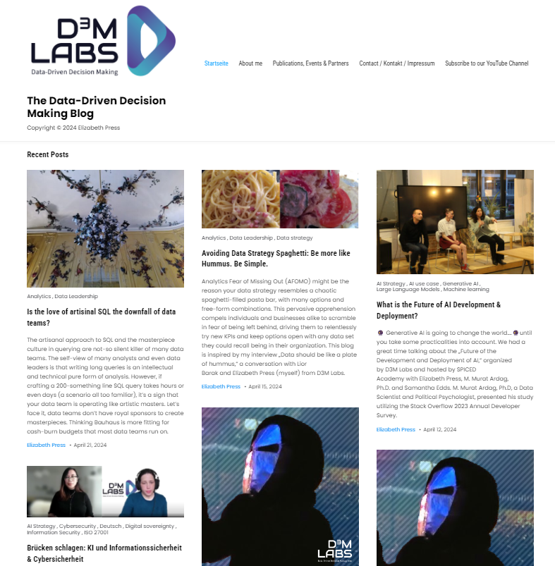

D3M Labs – The Data-Driven-Decision Making Media Platform
Advisory and media platform dedicated to profitable and secure digital business
Subscribe to the D3M Labs YouTube Channel: https://www.youtube.com/@d3mlabs
Follow Elizabeth Press and D3M Labs on LinkedIn
Visit www.d3mlabs.de
My QR Code:
Copyright © 2025 D3M Labs, Elizabeth Press
Notes:
P

Slide 5
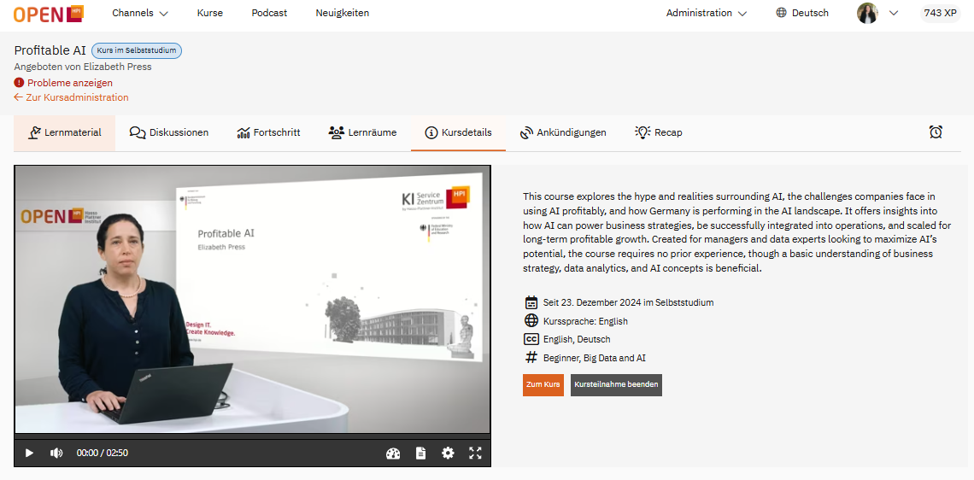

Profitable AI Online Course
5000+ Signups
Profitable AI | openHPI

Slide 6
Why is Profitable AI so Hard?
Lacking skills (beyond tech)
Lack of ROI on AI
Bad & little data
High costs
POC grave yard
Hard to use. Harder to scale
Under-estimation of effort
FOMO driven use cases
Security Wild West
Common reasons I've observed for AI initiatives failing:
Lack of connection to business strategy
FOMO & tech-hype-driven use cases
Lack of organizational maturity
70-80% of AI projects fail.
>50% of data and analytics projects fail.
Why Most AI Projects Fail: 10 Mistakes to Avoid | PMI Blog
Shah, P. (2022). Defining enterprise analytics and data strategy. Springer.
Copyright © 2025 D3M Labs, Elizabeth Press

Slide 7
Why profitability matters
Total >580K tech employees laid off in the 2022-2024.
Layoffs.fyi - Tech Layoff Tracker and Startup Layoff Lists
Copyright © 2025 D3M Labs, Elizabeth Press

Slide 8
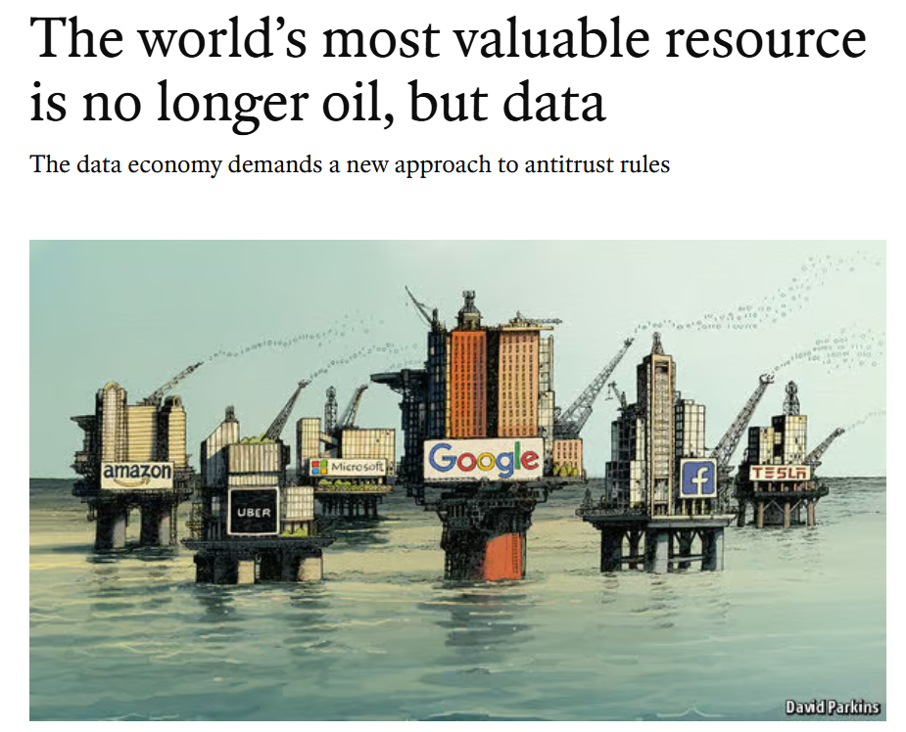
The Data oil field needs strategic refinery
Tech evolution
The cost of storing 1 gigabyte
Impact
1960s
$2 million
1980s $200,000
Early 2000s $7.70
2017
2 cents
2020s Unchecked cloud costs
Data was stored for special usages, i.e. R&D
Limited, central storage
Growth of personal computers
Business data, personal data, grew.
Golden Age of AI
Cloud computing
„Big data“ emerged as more data could be created, processed, stored and analyzed.
Multi-cloud, environments, massive data.
Multi-cloud environments poor governance, costs often out of control.
Copyright © 2025 D3M Labs, Elizabeth Press
AI is already linked to layoffs in the industry that created it | CNN Business, USC Marshall School of Business, https://www.economist.com/leaders/2017/05/06/the-worlds-most-valuable-resource-is-no-longer-oil-but-data,

Slide 9
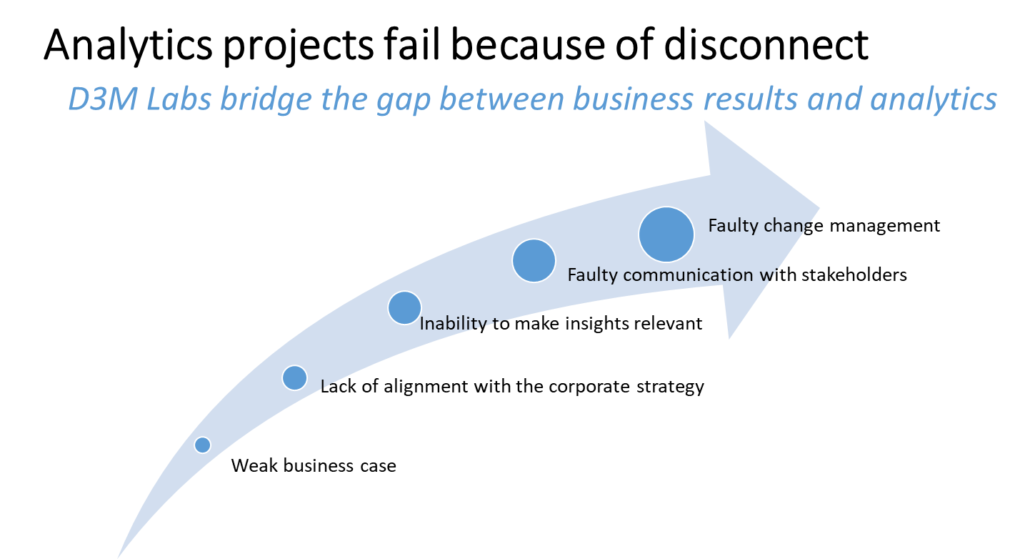
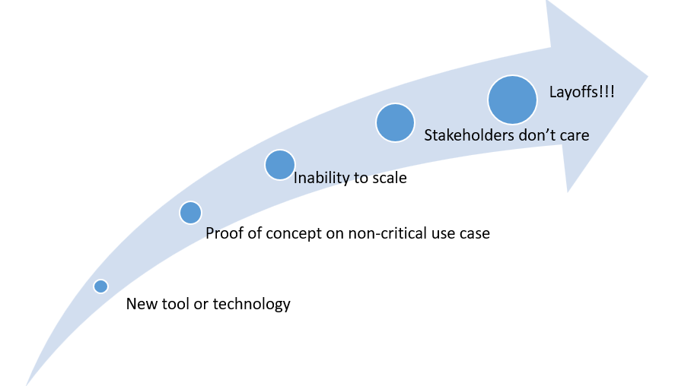
Analytics fail because of disconnect
2015
2024
Copyright © 2025 D3M Labs, Elizabeth Press

Slide 10
Data strategy should align to firm stategy
Business Goals & Strategy
Technology and Architecture
Team Structure & Organiza-tion
Operations, Governance & Quality
Value Manage-ment, ROI, Impact
Security, Compliance, Risk Manage-ment
Data strategy should be an iterative process:
Long-term goals
Mid-term milestones
Regular reviews and iterations
Data strategy is a process, not a document
These are steps I use in iteration:
Understand: Long-term plan
Define: Brainstorm potential solutions
Decide: Solution
Transition plan
Validate

Slide 11
data strategy must Enable Business Strategy
Type of Strategy | Cost Leadership | Differentiation | Focus
Priority | Cost optimization & efficiency | Customer insight & personalization | Customer segmentation & targeting
KPIs for the strategy | Net profit margin, inventory turnover | Brand index, NPS, average usage | Market share in segment, referral rate, cost of acquisition.
Key analytics discipline | Operational performance analytics | Product analytics | Marketing analytics, Customer Insight
Data needed | Operations and financial | Product usage, customer feedback, market data. | Demographic, phsychographic, behavioral data, marketing / campaign data.
How data strategies can fit the generic Porter strategies
Copyright © 2025 D3M Labs, Elizabeth Press

Slide 12
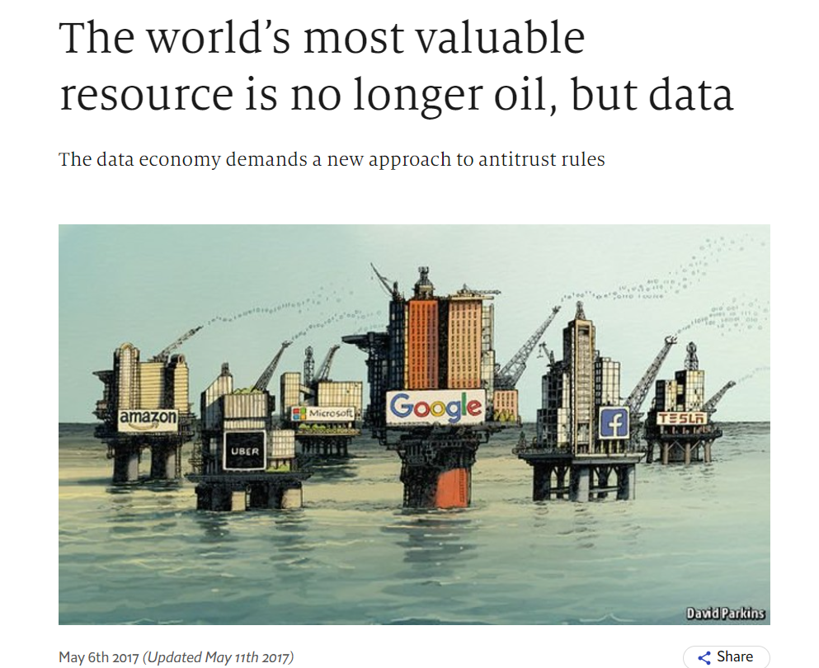
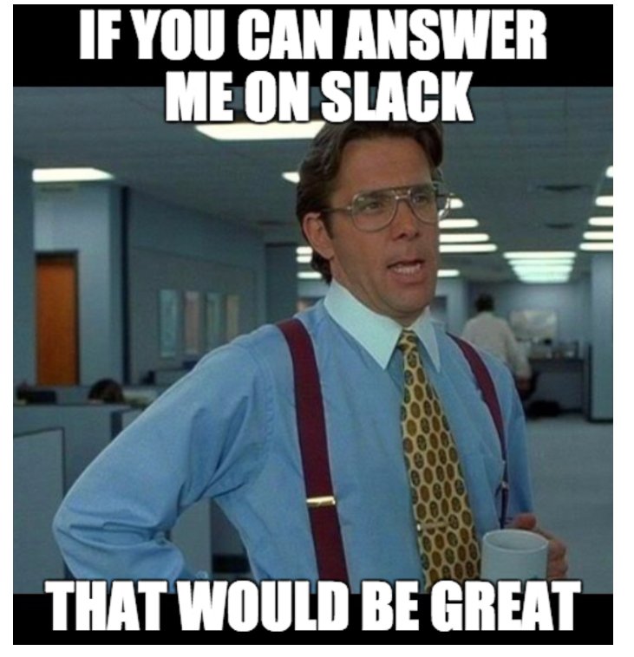
Be honest: Is data strategic or hygenic?
Data is strategic
Data is a hygiene factor:
Data is an enabler of innovation.
Analytics & AI get high investment and are integrated with business strategy.
High culture of data literacy and data maturity.
Standardized data deliverables, focus of data strategy is on simplicity and efficiency.
Data is looking at operational insights & monitoring.
Data has a focus on compliance and risk management
What companies say
Reality
Copyright © 2025 D3M Labs, Elizabeth Press

Slide 13
What is your Level of AI Engagement?
Disruptive innovators: Develop new AI Tech.
End users: Use tools already on the market. MOST PEOPLE ARE HERE.
Fast followers: Scan the market and adopt newest tech innovations, business models and processes.
Shallow innovators: Business model or process innovation, i.e. well implemented recommendation engine.
AI innovation engagement
Copyright © 2025 D3M Labs, Elizabeth Press

Slide 14
Data Strategy has to Fit the situation
Cost optimization & efficiency
Potential data-driven strategy pivot
Identifying redundant systems
Ensuring data governance and compliance, risk management.
Identifying new growth opportunities.
Acquisition and integration of new data sources.
Scalability of data infrastructure.
Ensuring data governance and compliance, risk management.
Restructuring
Growth
Copyright © 2025 D3M Labs, Elizabeth Press

Slide 15
How do you get Ready for AI?
Need & ROI
  Is there an actual need for AI?
  Does your organization have the resources?
  Is the external environment supportive?
Do you need AI? If the answer is not a concrete yes, then ther rest of this chart could be a waste of money.
Data Quality & Availability
  Do you have enough data to make AI worth-while?
  Is your data of sufficient quality & availability?
  Do you have sufficient continued data governance?
Infrastructure ready?
  Is your infrastructure scalable (Compute, Data Management, Model Development & Deployment, Model monitoring & Maintenance, Automation)?
  Are you compliant and secure?
Tools
  Do you have the right analytical tools for your use case?
  Are the right tools compatible with your existing stack?
  Does your organization have the knoweldge to use them?
Can you deliver?
  Can you deliver your AI product?
  Can you measure impact on the business?
  Is there impact on the business?
Copyright © 2025 D3M Labs, Elizabeth Press

Slide 16
Scalable AI is a complex System
Iteratively questioning the components:
What is AS-IS?
What is blocking scalability?
What should be?
Data management
Model development and deployment
Model monitoring and maintenance
Automation and Orchestration
Copyright © 2025 D3M Labs, Elizabeth Press

Slide 17
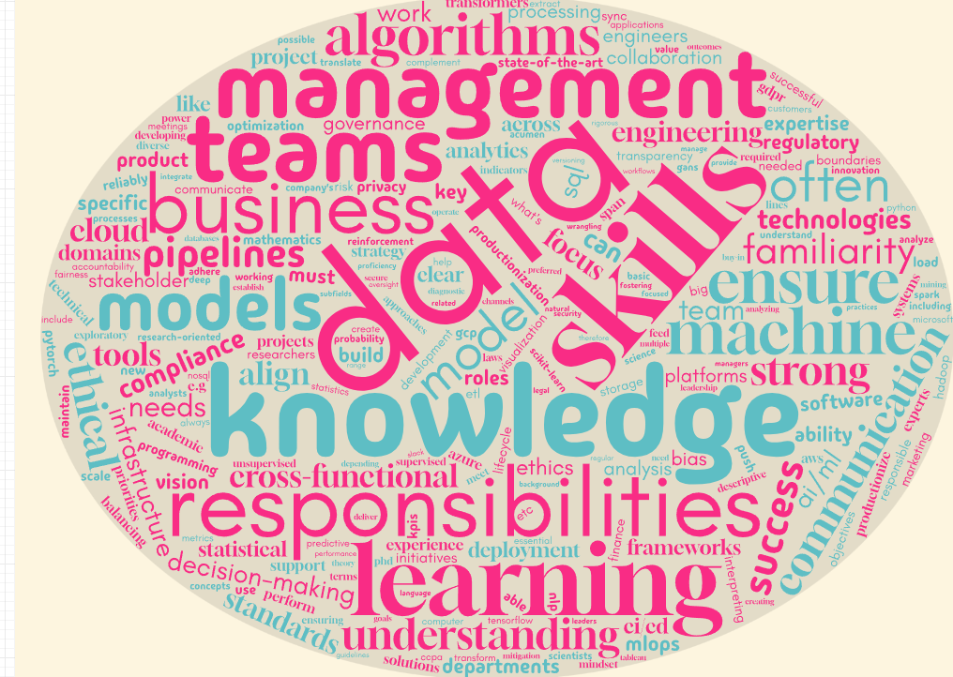
AI Thrives on Interdisciplinary teamwork
Machine learning
Data science, statistics, analytics
Business acumen
Software engineering
Agile & MLOps
AI ethics and compliance
Project management
Product management
Data engineering
Governance & version control
Design and usability
Copyright © 2025 D3M Labs, Elizabeth Press

Slide 18
Measuring Impact, Data Strategy KPIs
Common KPIs from a financial perspective:
Net Profit Margin: Measures the profitability of a company after all expenses have been deducted from revenue.
Formula: Net Income / Revenue.
Return on Investment (ROI): Measures the profitability of an investment relative to its cost.
Formula: (Net Profit / Cost of Investment) x 100.
Operating Cash Flow (OCF): Represents the cash generated from regular business operations, excluding capital investments and financing activities. OCF shows the company’s ability to sustain itself.
Financial KPI from a customer perspective:
Customer Lifetime Value / Cost Acquisition: Important ration showing profitability of a specific customer cohort segment or cohort.
Best Practices:
KPIs should be made in tree-form to correspond to different organizational levels.
There should be KPIs recognizing the ultimate value driver, as well as counterbalances and countermeasures.
Strategic KPIs should be stable over time, with planned reviews and iterations.
Understandability and transparency are key!
Copyright © 2025 D3M Labs, Elizabeth Press

Slide 19
Data Strategy in Public, Corporate & scaleup
Commonalities:
Fluency in money is important – especially for a data & cybersecurity strategy
Professionalism in data and tech are important i.e. (P&L view, structured communication, focus on incrementality instead of „creative chaos.“)
Cross-cultural communication & ethical treatment of employees.
Output-driven view of efficiency & effectiveness over technical purity.
Where leadership and strategy differ
Budgeting and purchasing.
Required documentation and certifications.
Different communities and cultures.
With public, the community and municipality are our stakeholders as well.
Copyright © 2025 D3M Labs, Elizabeth Press

Slide 20
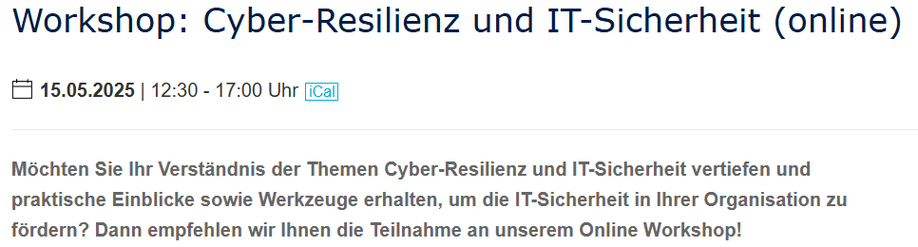


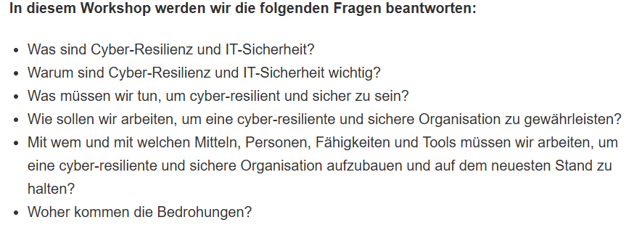
Signup for my upcoming Workshop (In German)
Workshop: Cyber-Resilienz und IT-Sicherheit (online) - chesco - BTU Cottbus-Senftenberg

Slide 21
Let‘s Connect
Personally and D3M Labs:
Elizabeth.Press@d3mlabs.de
My LinkedIn Profile:
Chesco & BTU Research:
Elizabeth.Press@b-tu.de
My Cyber-Resilience workshop:
German language, online workshop May 15th.

